Slide 1

HUD Eastern Woodlands Office of Native American Programs Great Lakes Inter-tribal Housing Association Quarterly Meeting Neil Whitegull, Administrator

Slide 2
FY 2024 HUD ONAP BUDGET
Title I of NAHASDA $1.34 billion
Tribal HUD-VASH $7.5 million
Indian Housing Block Grants (IHBGs) $1.11 billion
IHBD Competitive Grants $150 million
Title VI Loans $1 million
ICDBG $75 million
Imminent threats to health and safety (within ICBGs) $5 million
Training and Technical Assistance $7 million
National Org. Funding (per Sec.703 of NAHASDA) $2 million
Loans Under Section 184 $1.5 million

Slide 3
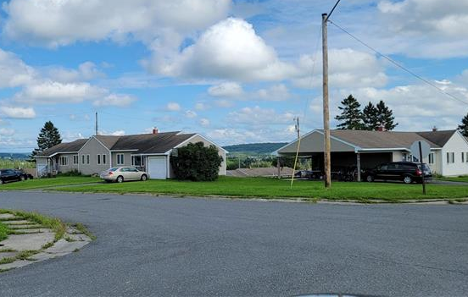
FY 2024 IHBG Competitive Grant NOFO
The IHBG Competitive NOFO has been published. The award ceiling is $7.5 million and the closing date is March 19, 2024. Friday April 19, 2024
https://www.grants.gov/search-results-detail/351845?utm_medium=email&utm_source=govdelivery
Some technical corrections to the NOFO, mainly to address the undisbursed 2016 or prior year funds. This is problematic for applicants because they could lose 3 points on their application for having those old funds

Slide 4
FY 2024 IHBG Competitive Grant NOFO
NOFO FAQS on Codetalk.
https://www.hud.gov/sites/dfiles/PIH/documents/IHBG_Comp_FAQs_FY23.pdf

Slide 5
EWONAP Staff Changes
EWONAP is excited to share that we have a new Grants Management Director, Cheryl Teague, come to us from HUD-Headquarters- MFA.

Slide 6
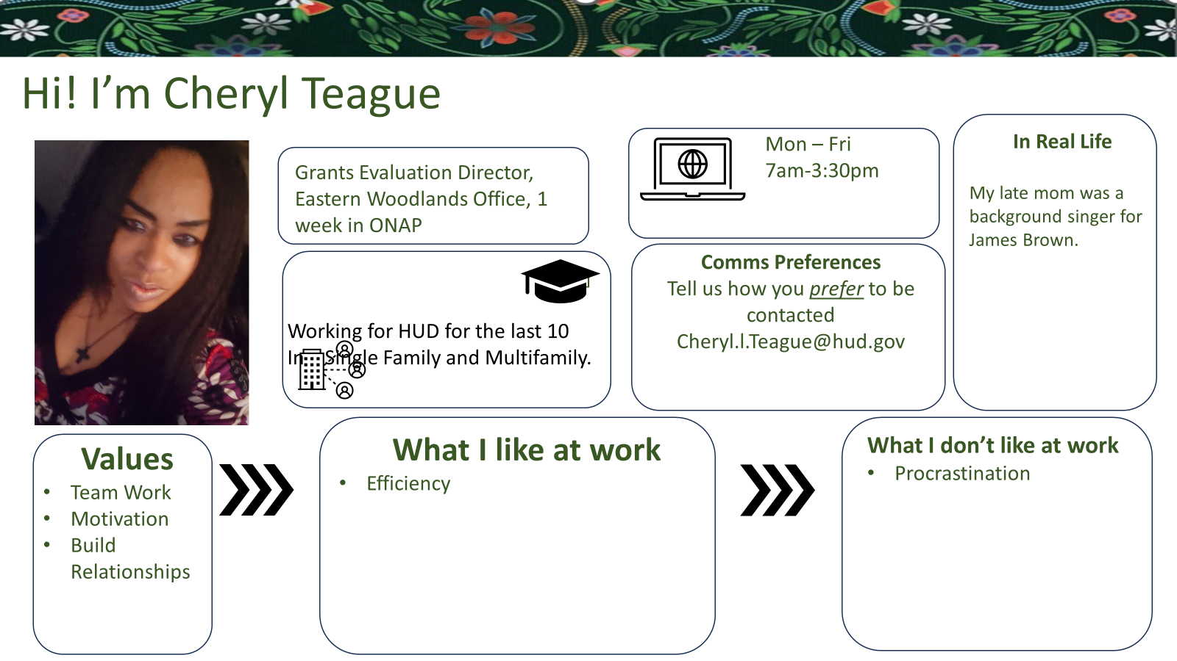

Slide 7
Preservation and Reinvestment Initiative for Community Enhancement Notice of Funding Opportunity
HUD has issued a Notice of Funding Opportunity (NOFO) which appropriates $225 million in grant funding for the PRESERVATION AND REINVESTMENT INITIATIVE FOR COMMUNITY ENHANCEMENT (PRICE) program. PRICE supports communities in their efforts to maintain, protect, and stabilize manufactured housing and manufactured housing communities (MHCs). Tribes and Tribally Designated Housing Entities (TDHEs) are eligible to apply, and at least $10 million of the available funding is intended for Tribal communities. All applications must be submitted to Grants.gov to be eligible for review. HUD will hold several webinars on the NOFO, and the schedule for these can be found here. The application deadline is June 5, 2024.

Slide 8
Preservation and Reinvestment Initiative for Community Enhancement Notice of Funding Opportunity
Preservation and Reinvestment Initiative for Community Enhancement (PRICE) | HUD.gov / U.S. Department of Housing and Urban Development (HUD)
grants.gov/search-results-detail/352690 PRICE NOFO

Slide 9
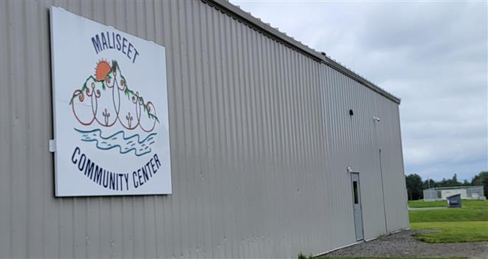
Indian Community Development Block Grant FY 2023
Mattaponi Indian Tribe
Keweenaw Bay Indian Community
Seneca Nation (partial award)
Due to the increased maximum awards, EWO was only able to award projects to three grantees.

Slide 10
ICDBG Tribal Consultation
Upcoming Sessions
Nevada California Indian Housing Association, Hard Rock Hotel, 3317 Forty Mile Road, Wheatland, CA, March 20, 2024
United Native American Housing Association, Annual Meeting, 7390 West Hampden Avenue Lakewood, CO, March 25, 2024
United South & Eastern Tribes, Annual Impact Meeting, Crystal Gateway Marriot, Arlington, VA, March 28, 2024
Southern Plains Indian Housing Association, Quarterly Meeting, 777 W Cherokee St, Catoosa, OK, April 17, 2024
PNRC NAHRO 2024 Conference, 939 W. 5TH Ave., Anchorage, AK, April 24th, 2024
Note: Conference registration not needed to participate in the Tribal consultation

Slide 11
Coronavirus Aid, Relief, and Economic Security Act (CARES) American Rescue Plan (ARP)
We need Tribes and TDHE’s to spend these funds.
Reminder- APR’s have to be submitted for IHP CARES and ARP and ACERS for ICDBG-IT CARES and ARP.
If you have not spent down 50% or more of Covid funds, reminder letters went out earlier this fall, and letters will be going out again in February.
Modification of ICDBG-IT implementation plans or IHP amendments for changes in projects.
Eastern / Woodlands can coordinate Training and Technical Assistance if tribes need to build capacity to spend funds.

Slide 12
Why it’s Important to Submit Timely Audits
Audits are reviewed for compliance with the Single Audit Act and Part 200, including timely submittal of audits.
Untimely submission includes:
Delinquent Reports = Potential Loss of Funds
Enforcement Action = Potential Loss of Funds
Reduced Points in Competitive Scoring = Potential Loss of Funds
Notes:
ONAP Recipients Audit Responsibilities
ONAP recipients are responsible for submitting IPA audits conducted in compliance with the Single Audit Act (SAA) and 2
CFR Part 200. A non-Federal entity that expends $750,000 or more in Federal funds in a fiscal year must submit an annual audit that complies with 2 CFR Part 200. ONAP programs covered under audit requirements: IHBG, ICDBG, CARES, ARP, Section 184, Title VI, T-VASH, RHED and ROSS Programs.
EWONAP Audit Responsibilities
- The IPA audit is the primary source of data on a recipient's financial position and internal controls.
- Review IPA audits to ensure that the reports are in compliance with the requirements at 2 CFR Part 200.
- Ensure that audits are completed and reports are received in a timely manner and in accordance with the requirements of 2 CFR Part 200.
- Follow up regarding any open HUD findings to ensure that the recipient initiates corrective actions and resolves the findings.

Slide 13

Grants Evaluation and Management System (GEMS)
Dear Tribal Leader Letter 08-18-2023 announced that GEMS will be rolled out nationwide on September 25, 2023. The Dear Tribal Leader Letter is available on CodeTalk: https://www.hud.gov/sites/dfiles/PIH/documents/DTL_GEMS_Rollout.pdf

Slide 14

Grants Evaluation and Management System (GEMS)
You will need to register for a GEMS account through the registration portal: https://hud.my.site.com/GEMS/s/login/SelfRegister?locale=us
Tara Chapman and Tonya Walters can provide assistance

Slide 15
Training and Technical Assistance T/TA
• Indian Housing Plan (IHP) | • Procurement | • Capacity
• Environment Reviews | • Construction | • Crime Prevention
• Board of Commissioners | • Tax Credit & Title VI | • Program Income
• Financial and Fiscal Management | • NAHASDA Essentials | • Home Buyer Education
• Renewable Energy
Notes:
ONAP Recipients Audit Responsibilities
ONAP recipients are responsible for submitting IPA audits conducted in compliance with the Single Audit Act (SAA) and 2
CFR Part 200. A non-Federal entity that expends $750,000 or more in Federal funds in a fiscal year must submit an annual audit that complies with 2 CFR Part 200. ONAP programs covered under audit requirements: IHBG, ICDBG, CARES, ARP, Section 184, Title VI, T-VASH, RHED and ROSS Programs.
EWONAP Audit Responsibilities
- The IPA audit is the primary source of data on a recipient's financial position and internal controls.
- Review IPA audits to ensure that the reports are in compliance with the requirements at 2 CFR Part 200.
- Ensure that audits are completed and reports are received in a timely manner and in accordance with the requirements of 2 CFR Part 200.
- Follow up regarding any open HUD findings to ensure that the recipient initiates corrective actions and resolves the findings.

Slide 16
General Contact
Via TEAMS (email your Specialist to request a TEAMS meeting)
EWONAP Specific Website: https://www.hud.gov/program_offices/public_indian_housing/ih/codetalk/onap/ewonap

Slide 17
EWONAP Contacts U.S. Department of Housing and Urban Development 77 West Jackson Boulevard, Room 2404/Chicago, Illinois 60604-3507 Telephone: (800) 735-3239, Fax: (312) 353-8936

