Slide 1
Meeting Housing Needs in Michigan
Karen Gagnon
Office of Housing Strategies Manager/Tribal Liaison

Slide 2
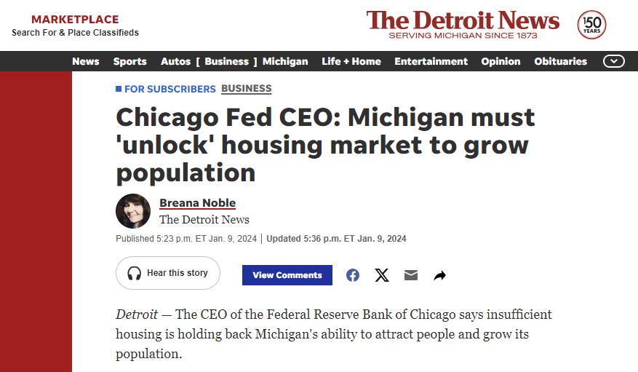
Notes:
Earlier this year the head of the Chicago Fed visited Michigan and had some candid comments about one big thing holding back our state’s economic growth right now. We hear the same thing from site selectors: increasingly the first thing they ask when visiting or inquiring about a new market is housing starts. Place-Talent-Business connections: Business needs talent, talent wants place, place needs business.

Slide 3
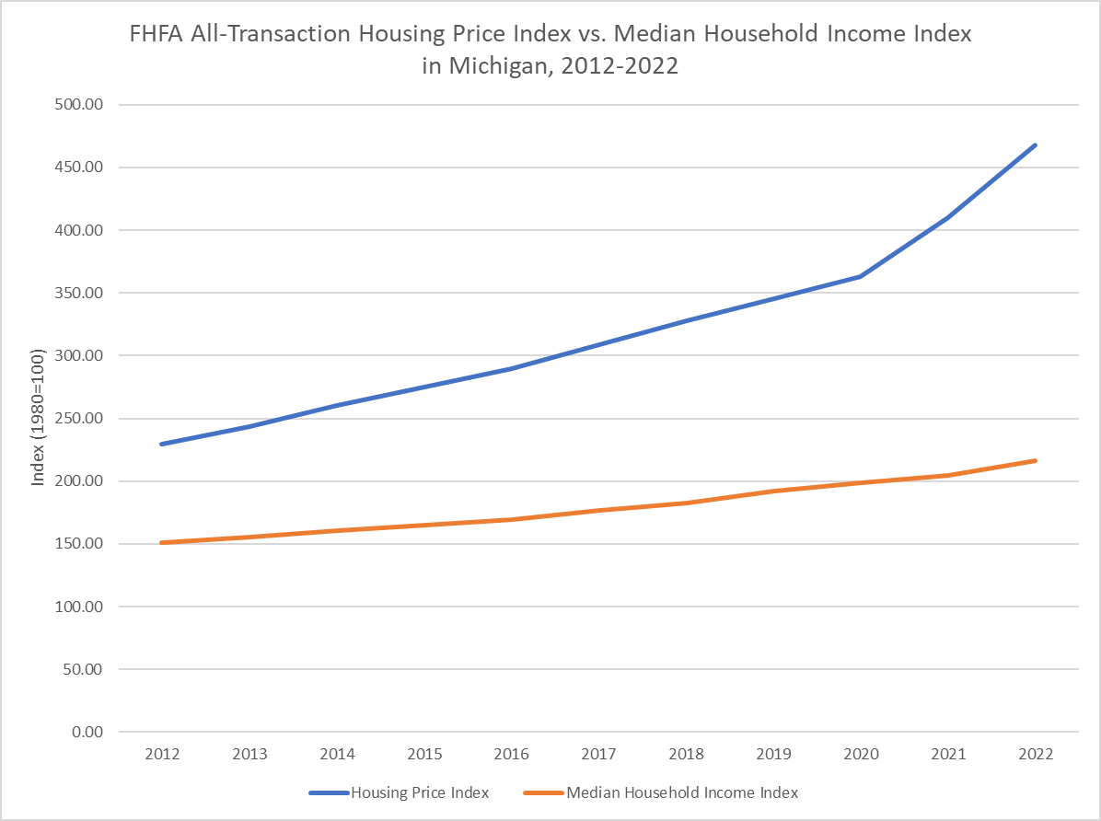
Michigan’s Housing Crisis
Notes:
We know that Michigan has a housing crisis. How do we know this? The price of housing in Michigan is rising more quickly than our incomes are keeping up, and this has accelerated since the pandemic. This data set is tracked by the Federal Housing Finance Agency, and both numbers use a base of 100 set to 1980. So as you can see over the last decade, housing prices have about doubled in Michigan. Over the same time period, our incomes have increased by just about 40 percent.

Slide 4
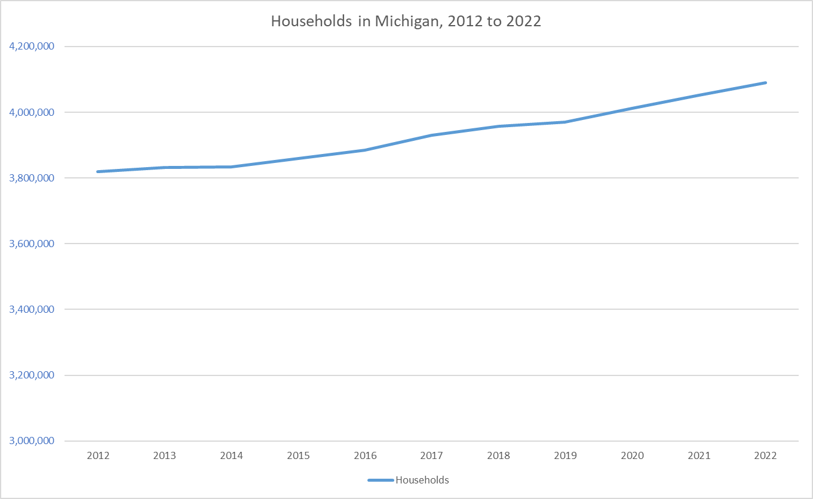
Notes:
At the same time, our population is increasing, just not at the same rate as other states. So as you can see over the last decade we added 270,726 additional households to our existing population living here in Michigan.

Slide 5
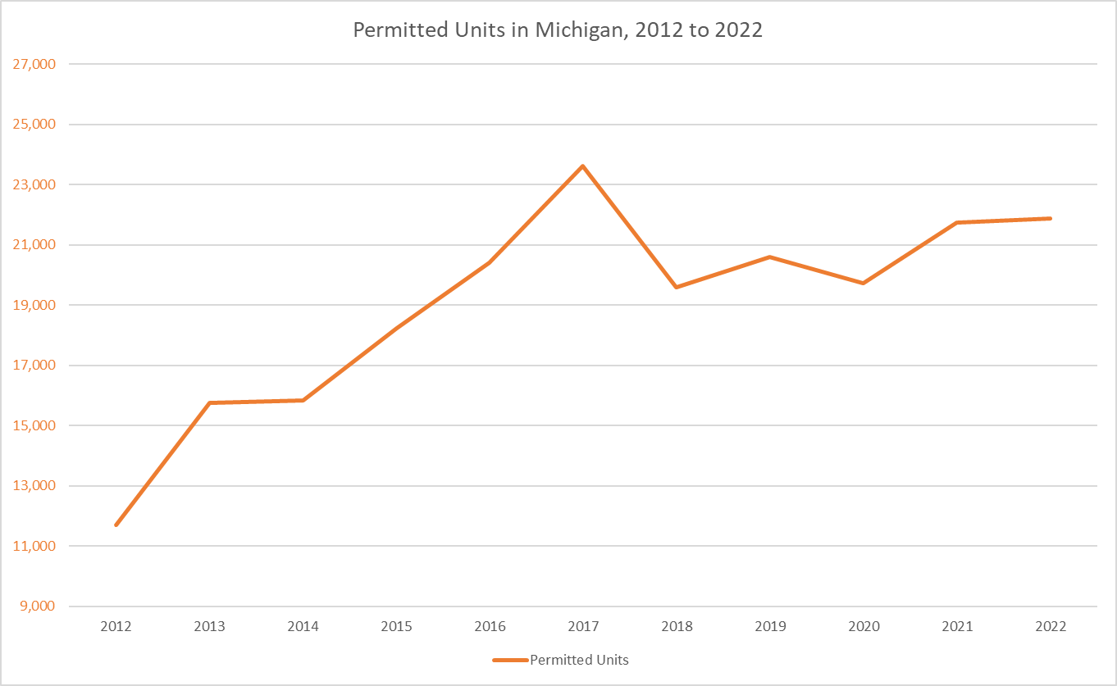
Notes:
But for all those new households, we just added a total of 209,073 additional homes since 2012 in Michigan. Keep in mind, this does not indicate strictly what people think about when they think of a new home, or an upscale detached single family home with a yard. This is all permits, so it includes apartments, townhomes, and renovated buildings that needed some work to be livable again. We need all of the above solutions to this national crisis, but for the last ten years, we haven’t been building and renovating enough homes to keep up with the demand of people who want to live here today, let alone incentivize additional growth or address the growing supply shortage.

Slide 6
Our approach at MSHDA:
Moving quickly to solve problems
Last year, the Legislature established Housing TIF.
Missing Middle program supported by $100M in one-time federal American Rescue Plan Act (ARPA) funds.
CDBG funds moved into MSHDA.
MI Neighborhood – launches 4/2
Notes:
Housing TIF: The Brownfield Act permits the use of tax increment financing (“TIF”) as a funding tool to help cover the additional costs associated with redeveloping a brownfield property – In July 2023 the Brownfield Act was amended to include certain housing development activities as eligible activities

Slide 7

Notes:
Michigan’s housing market faces numerous longstanding inequities that make it difficult for all residents to obtain safe, healthy, affordable, and attainable housing. To address these complex, intersecting challenges in a coordinated manner that engages all stakeholders in the housing sector, our state needed a plan.
Planning began in August of 2020. After extensive research and engagement – including more than 7,000 individuals – Michigan’s first Statewide Housing Plan was published in June 2022.
The Plan seeks to accomplish a few things. First, we want to cultivate and sustain a connected and collaborative housing ecosystem. Second, we want to produce and/or preserve at least 75,000 housing units over the next five years. Beyond that, the Plan has 8 priorities, 37 goals, and 134 strategies – so it’s very comprehensive.
We’ve designated 15 regions across the state, each with its own unique demographic, economic, and housing characteristics. Every region has at least one lead agency – chosen by stakeholders in the region – to grow their regional housing ecosystem. The lead agencies have also been responsible for the development of a regional action plan that’s in support of the Statewide Housing Plan. We’re now moving into the implementation phase of those plans.

Slide 8
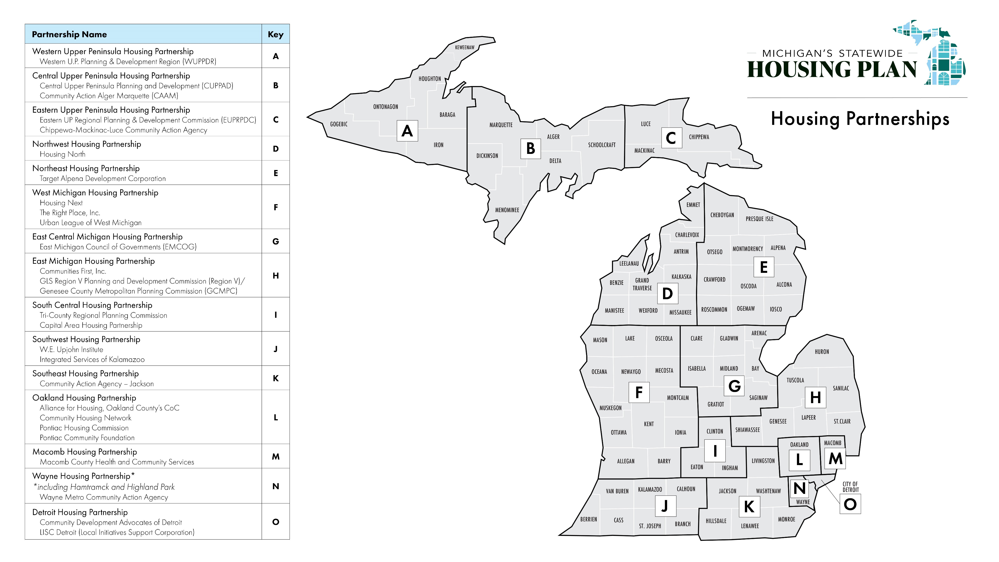

Slide 9

Michigan.gov/HousingPlan
Statewide Housing Plan Regional Housing Partnerships Lead agencies and contact information Regional Action Plans Quarterly Progress Reports
Notes:
Regional Action Plan themes:
Housing Stock: Housing production and preservation
Preventing & Ending Homelessness
Housing Ecosystem
Communications & Education
QPRs:
Progress on plan implementation
Production data
MSHDA investment data

Slide 10
2024 Regional Investment Strategy
Per Capita
  Households (2022)
Economic
  Employment (2022)
  Employment Growth (2019-2022)
  MEDC Job Projections (2023-2024)
Racial Equity
  Decrease in Black Homeownership Rate (2012-2016 & 2017-2021)
  Percent of Minority Population
Housing Need
  Household Growth (2019-2022)
  Rate of Housing Instability (2022)
  Share of 190k Housing Unit Need
  Share of For-Sale Homes Affordable to 100% AMI
  Change in Share of For-Sale Homes Affordable to 100% AMI (2019-2022)
  Share of Housing Stock Built Prior to 1970
  Point-in-Time Homeless Count (2022)
  Housing + Transportation (2019)
Notes:
$60MM
Transparent, equitable, and data driven

Slide 11
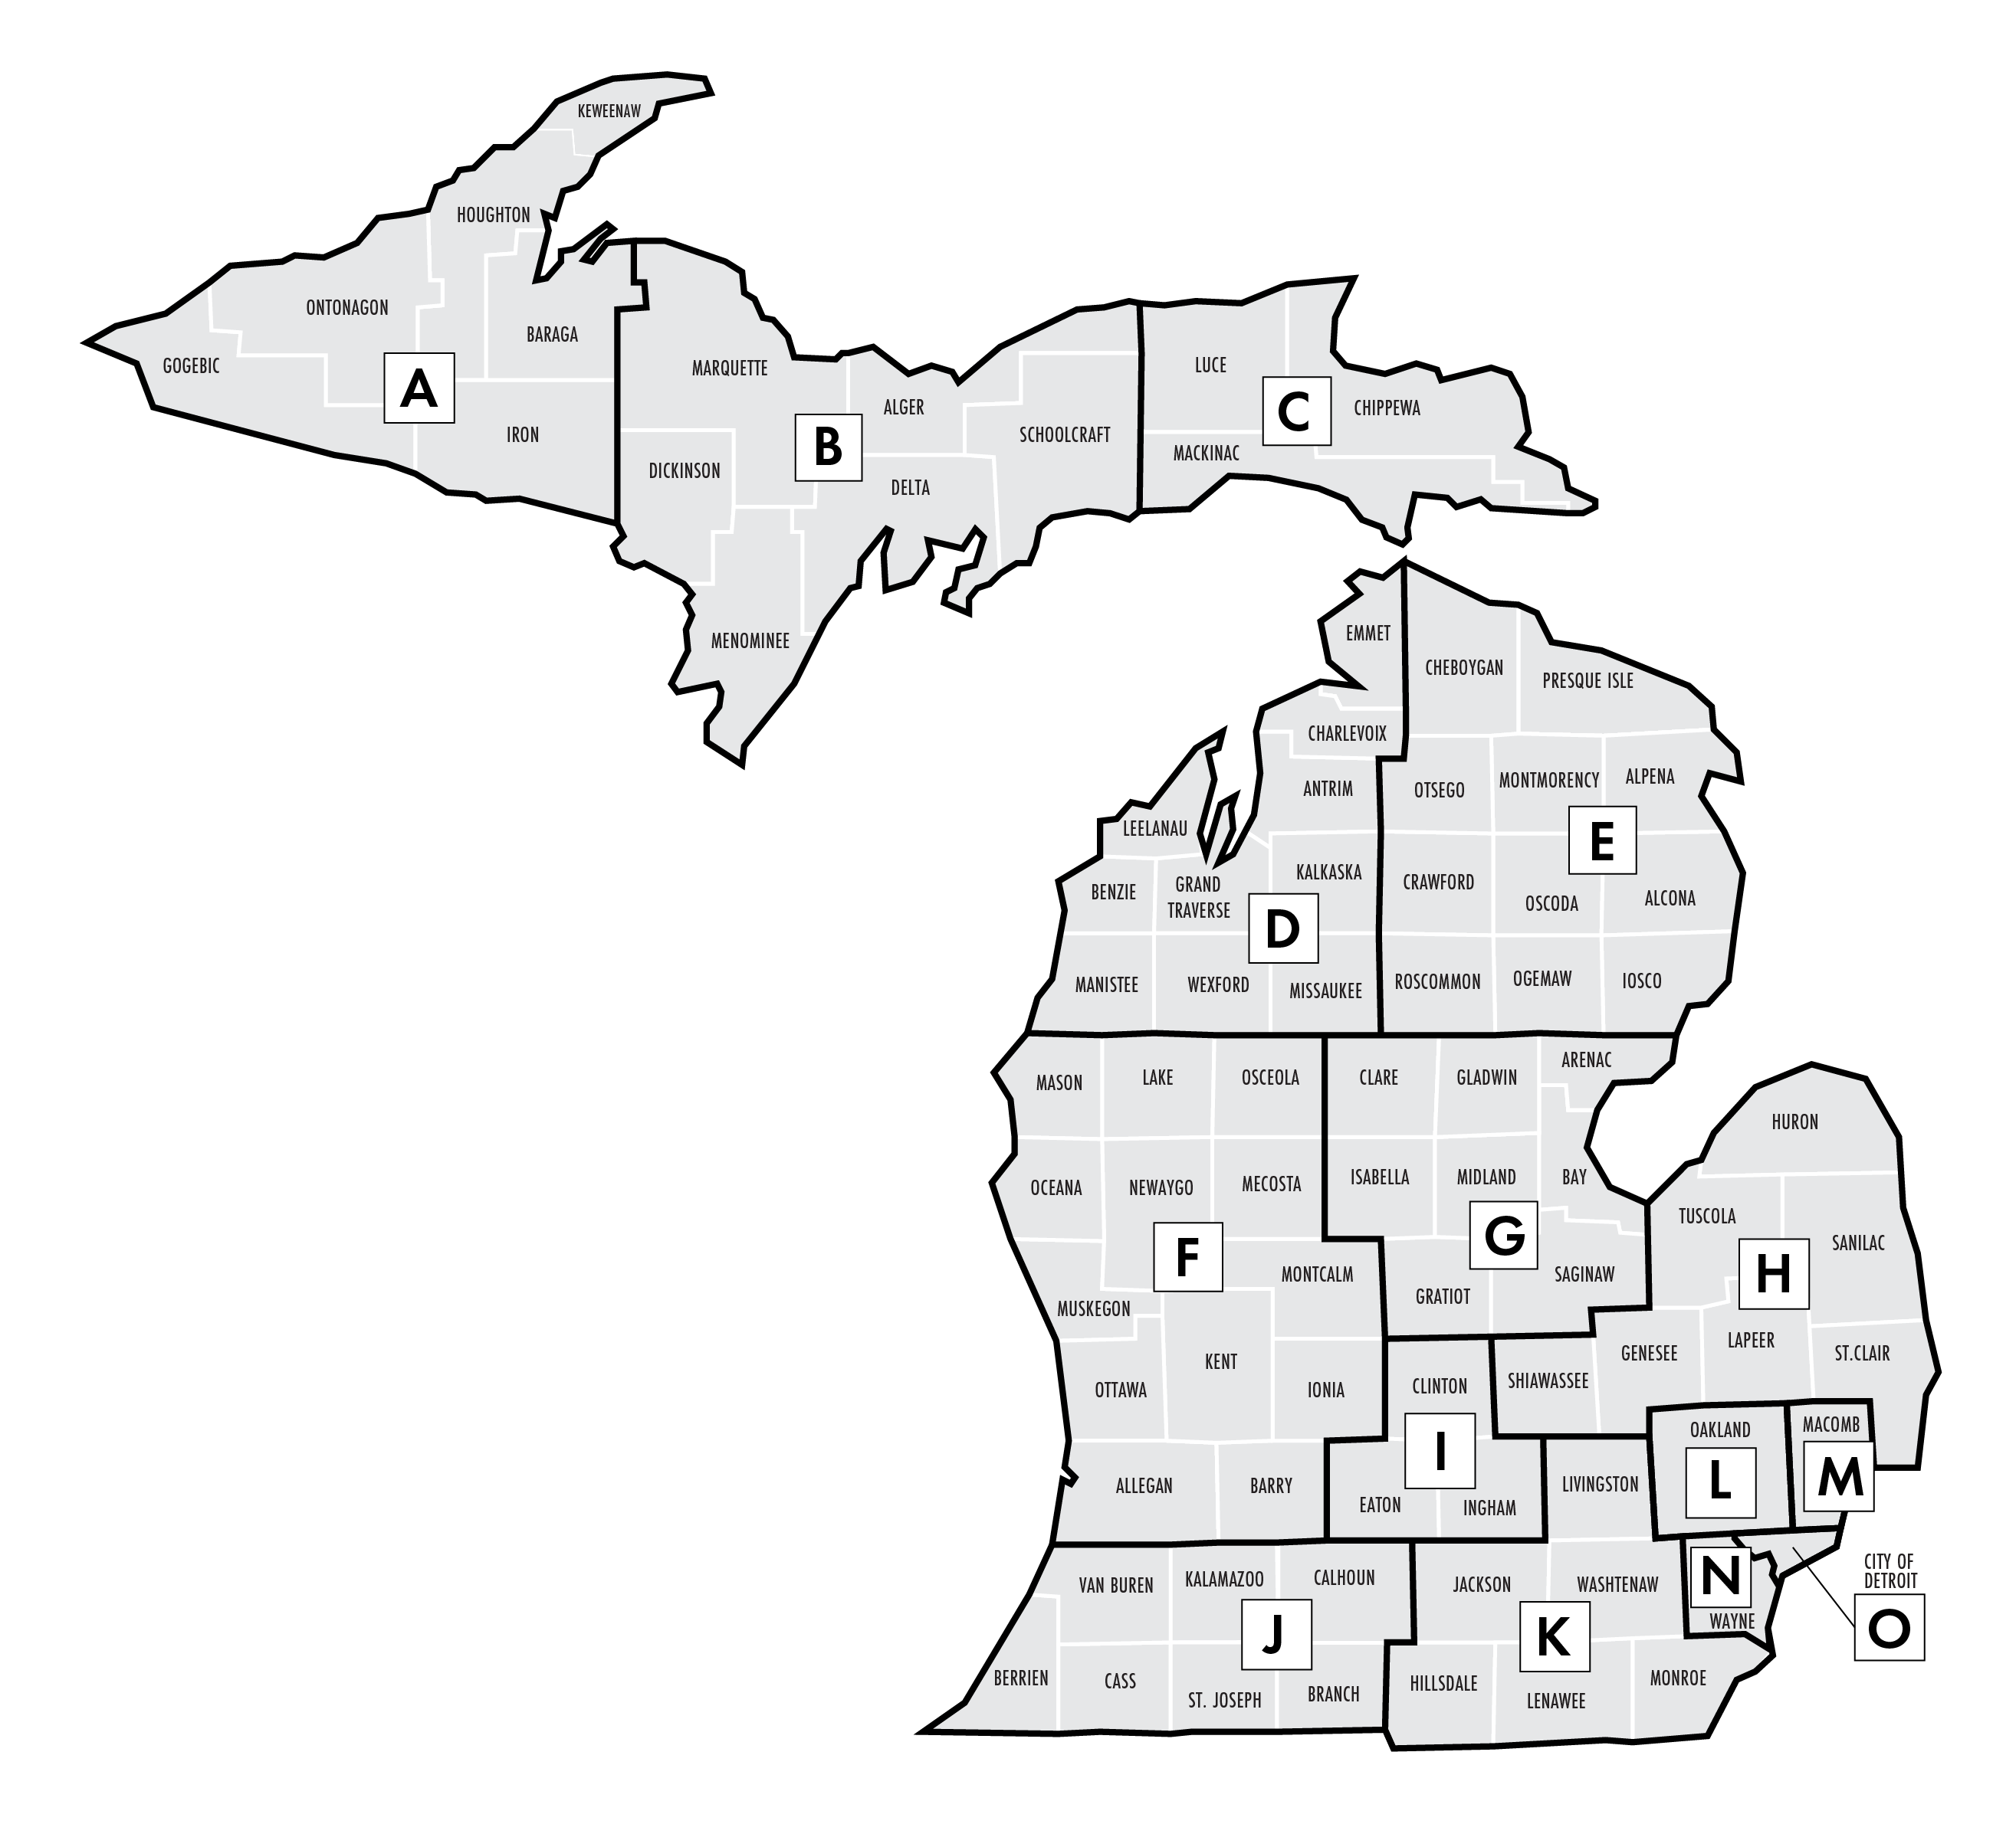
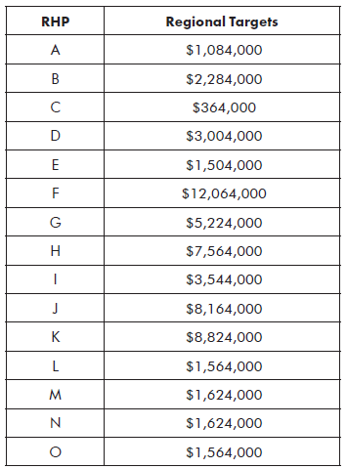
2024 Regional Investment Strategy
Notes:
Next on MSHDA’s agenda:
Senate Bill 293 is sitting on the House floor awaiting a vote.
House Bill 5032 is awaiting action in the House Small Business & Housing Committee, chaired by Rep. Jason Hoskins.
MHRA has not been introduced but should be up in the Senate very soon.

Slide 12

Tribal Nations Housing Development Assistance Program
Notes:
Senate Bill 293 is sitting on the House floor awaiting a vote.
House Bill 5032 is awaiting action in the House Small Business & Housing Committee, chaired by Rep. Jason Hoskins.
MHRA has not been introduced but should be up in the Senate very soon.

Slide 13
TNHDAP
Background
National American Indian Housing Council / BeauxSimone Consulting
Objective: housing production
1:1 meetings
Tribal housing resource toolkit
Training
Development project plans
Federal Home Loan Bank of Indianapolis
Notes:
builds on tribal nations’ existing capacity by providing the financial, knowledge, and technical resources each needs to develop affordable housing programs and projects that respond to their unique communities.
National American Indian Housing Council to offer a series of tailored trainings as well as one-on-one project and organizational technical assistance.
Begin with individual outreach to the 12 federally recognized tribal nations that share geography in Michigan, followed by an assessment of the need in each participating nation.
Need will be determined by reviewing existing data that a participating nation has and/or has access to.
The outreach and identification of need(s) will inform the creation of a housing finance and development toolkit, tailored to the unique opportunities and challenges in tribal nations.
Second phase of the effort involves three two-day, in-person sessions in which the content of the toolkit is delivered to project teams from each participating nation.
The sessions are a combination of direct training, peer-to-peer learning, and case studies. Anticipated topics include: affordable housing models, determining the need, the development process, assembling the development team, affordable housing financing programs and structures, operations budgeting, property management, culturally relevant design, construction management, and leasing a property.
Additionally, individualized technical assistance plans will be crafted for each participating team.
Intensive one-on-one technical assistance will be offered to each participating nation, both between the sessions and after completion of the training series. The assistance will cover project finance (e.g., identification of sources, supporting applications) and development (e.g., advancing project plans, predevelopment activities).
The Federal Home Loan Bank of Indianapolis is supporting this new program with a grant of up to $3 million, which marks the Bank’s largest grant to a single organization. The grant will provide flexible funding to help remove barriers to program participation and will cover critical predevelopment expenses, respond to additional capacity building needs and opportunities, and help bridge project financing gaps.

Slide 14
TNHDAP – Travel Stipend
Based on trainings held in Grand Traverse, Lansing, Kalamazoo
Approximate distance from tribal central government locations
How many tribal communities involved
Per person, per trip
Mileage, hotel, meals
State of MI travel rates OR US Government Services Administration Rates
Notes:
This schedule is based on tribes' nearby communities and their proximity to the proposed training workshop locations. This is a per person per trip amount that includes funding for mileage at the State rate ($0.44/mile), hotels, and food (about $75/day/person). There are assumptions made to determine this rate per tribe in that teams will bring approximately three people in individual cars and stay on average three nights at a hotel for each workshop. However, with this flat rate there is some flexibility in how those funds are dispersed across a team for each workshop.
I want to confirm the flexibility referred to in the highlighted statement below means that we may be able to provide a travel stipend (not reimbursement) to a fourth team member from the same tribal nation if another team brings fewer than three – and/or doesn’t participate at all. I’m assuming the numbers below contemplate up to 36 participants (12 tribal nations X 3 participants per)? Fewer than 36 participants would not mean we increase the amount of the travel stipend, correct? If/when we have a balance in a budget activity, we can move it to another.
Tribes usually refer to GSA mileage, lodging, and MIE rates for travel; I have attached the GSA rates for Michigan. NAIHC has a travel scholarship application form and travel expense reimbursement form (all receipts and mileage maps must accompany the form) that we can share.

Slide 15
MSHDA Contact
Karen Gagnon
GagnonK@michigan.gov
Office of Housing Strategies Manager
Tribal Liaison

