Slide 1
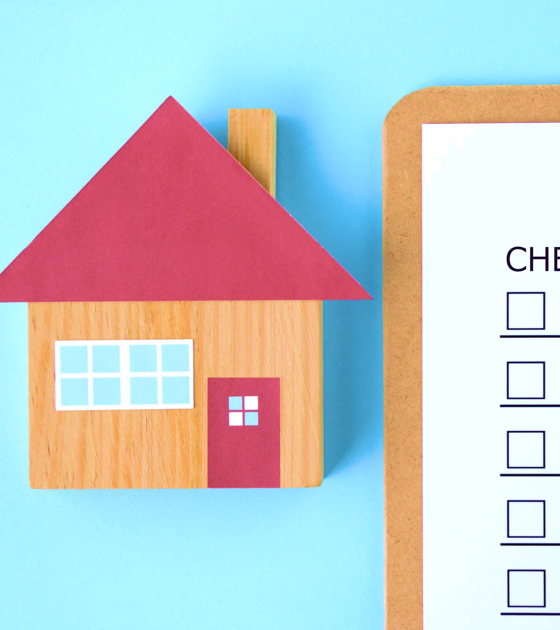

H-Life: Healthy-living Inspections for Everyone
Introducing a new model for housing inspection and maintenance policy to drive better housing and health outcomes

Slide 2





Roadmap of presentation
Overview of model conception
Model vision, goal, and components
Preview of H-LIFE Model Standards and Components
Path Forward
Q&A and Connect

Slide 3

Core values:
Health of Mother
Earth
Then,
Health of the Home
Then,
Health of the
Individual

Slide 4
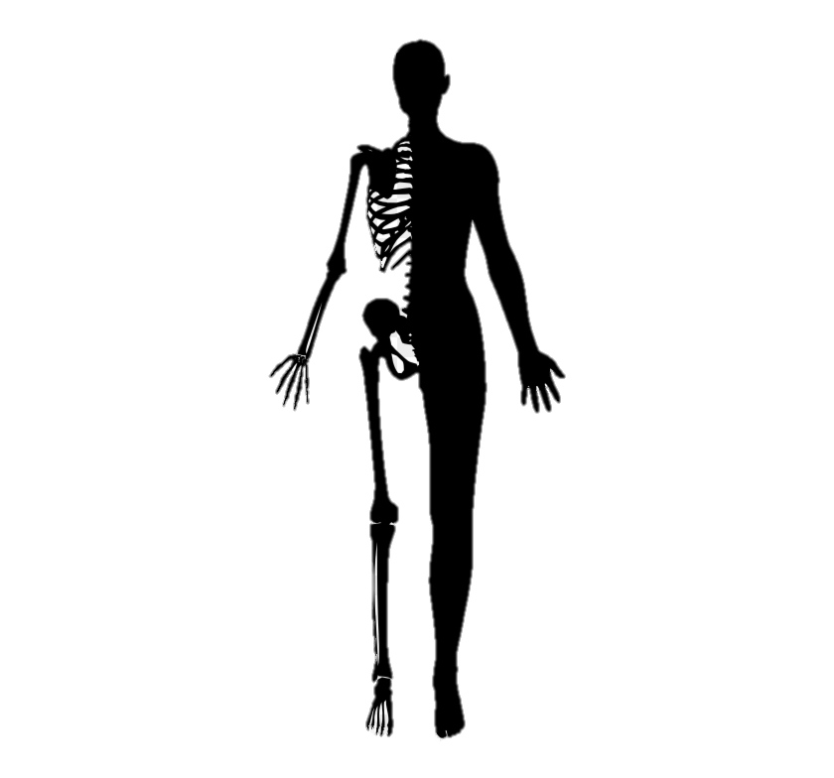
Anatomy as a metaphor for the importance of inspections and maintenance
Structural inspections are
designed to maintain the bones
Building envelope
Integrity of the foundation
Load bearing walls
Type and quality of materials
Housekeeping inspections are designed to ensure things function
Excess and uncovered garbage
Presence of mold, pests, and infestations
CO2 and smoke detectors are working properly
HVAC system is clean and operable
Notes:
When we zoom in even further we can see that caring about housing is much more than just caring about a physical space; it’s about caring about the person.
So one way to view the necessity of housing inspections is to look at it from the lens of the human body.
There are two types of housing inspections: structural and housekeeping.
Structural focuses on the exterior of the house, the bones of the body. When the bones of the body are broken, the body has a harder time staying upright and being able to maintain itself. The same for the house. So structural inspections are designed to repair the extremities to prevent this from happening.
Housekeeping inspections are everything else - these inspections are the blood, the organs, of the human body. Just as we need our organs to be working to keep our lungs breathing and hearts beating, we need housekeeping inspections to keep the home a healthy place to live.
Shared blame. Highlighting the responsibility of the housing staff AND the residents. Housing staff moreso on structural; residents housekeeping

Slide 5
Current design may limit community capacity to address underlying challenges
Silos
  Minimal or no exchange of information
No accountability
  Tribes bear the full cost of repairs and maintenance
Burden
  High financial and health costs
Notes:
recurring mold/mildew in places that are not expected

Slide 6
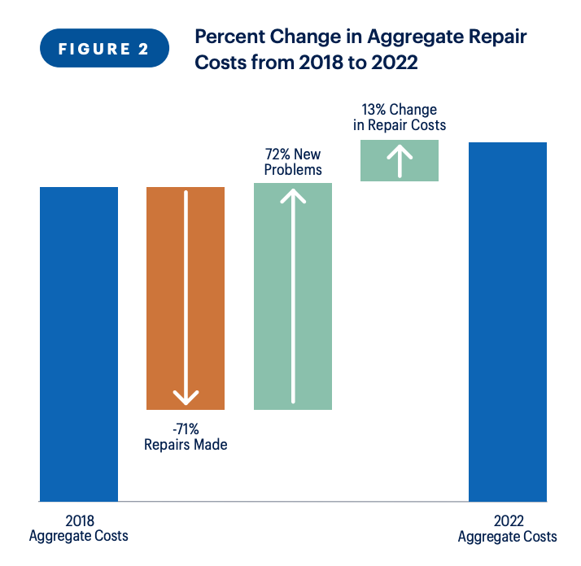
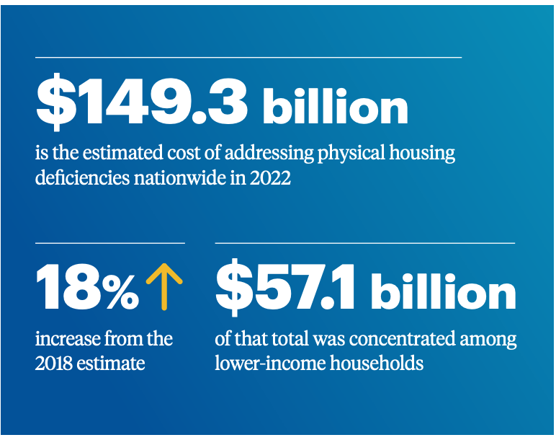
Sacrificing repairs and maintenance leads to above average economic costs
Source: Federal Reserve Bank of Philadelphia. Research Brief: Updated Estimates of Home Repair Needs and Costs. 2023.

Slide 7
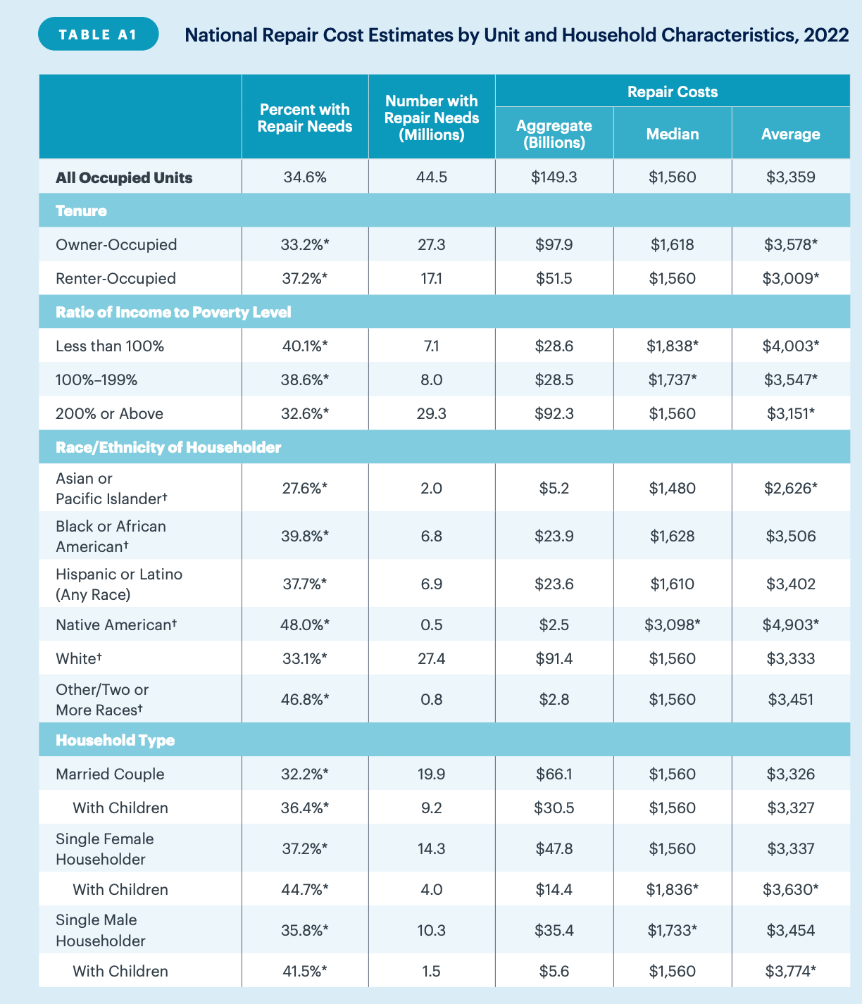
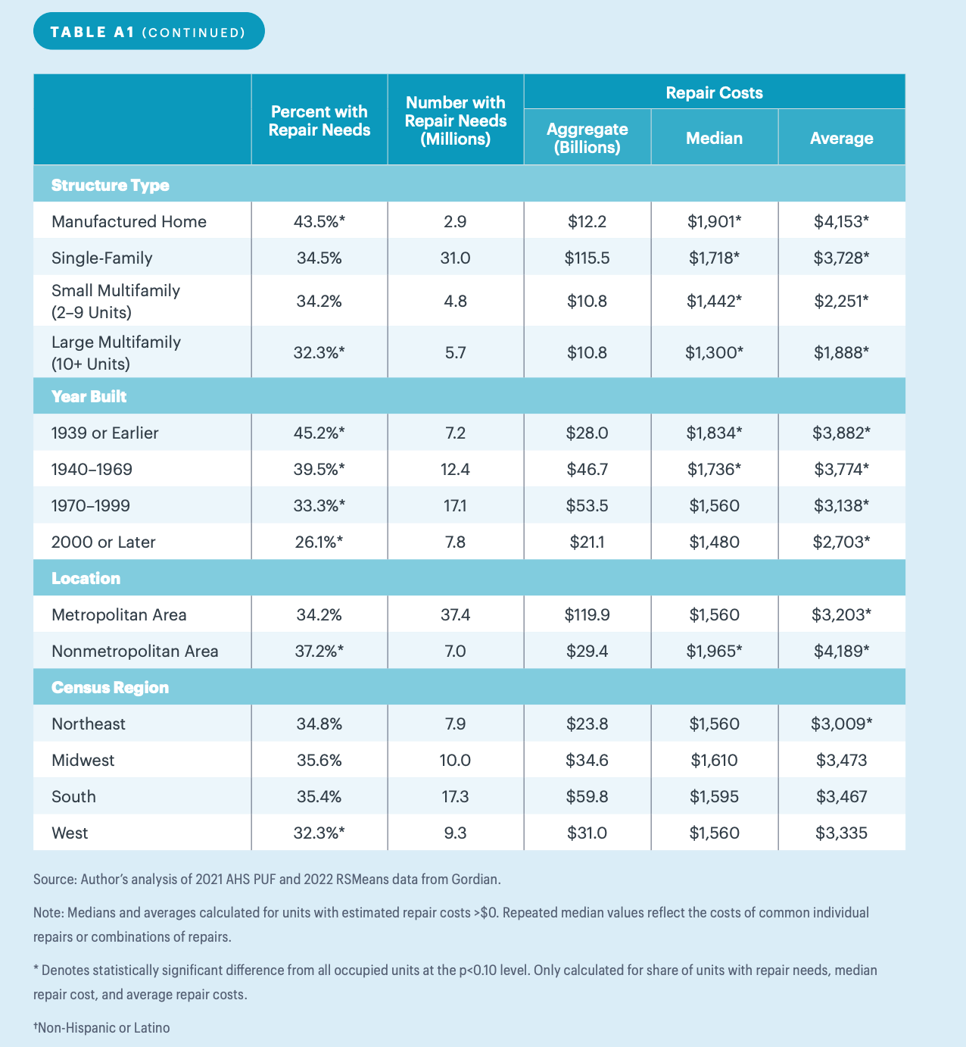

Slide 8


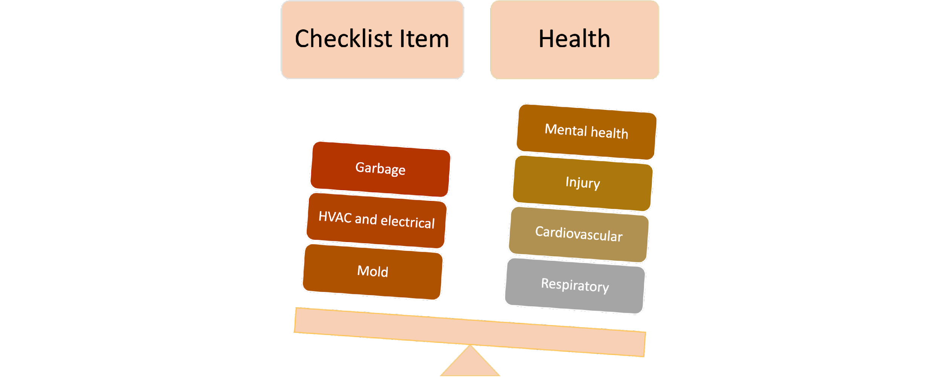
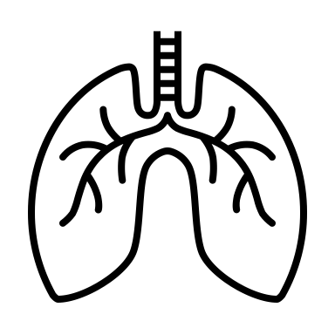

Sacrificing repairs and maintenance leads to above average
morbidity and mortality
In 2020, AI/AN accounted for 88% and AAPI 54%
of overall US heart disease deaths
AI/AN report 2.5x more psychological distress than the general population
In 2018, AI/AN population was 20% more likely to have asthma than non-Hispanic whites
AI/AN experience injury mortality rates 2.4x greater than the general population
Source: https://www.ihs.gov/newsroom/factsheets/injuries/
Source: https://www.kff.org/other/state-indicator/number-of-heart-disease-deaths-per-100000-population-by-raceethnicity-2/?currentTimeframe=0&sortModel=%7B%22colId%22:%22Location%22,%22sort%22:%22asc%22%7D
Source: https://minorityhealth.hhs.gov/omh/browse.aspx?lvl=4&lvlid=30
Notes:
Foregoing or delaying housing inspections has similarly disruptive health concerns for American Indians and Alaska Natives.
Disparities in housing seen among the American Indian/ Alaska Native population can be mirrored in disparities in health diagnoses for Native American households.
These health conditions are preventable.
It is important to recognize that prevention directly impacts health and well-being. Therefore, it requires a public health investment in housing inspections. Without an investment in the sustainability and maintenance of homes, Native households and low-income renters will continue to be disproportionately impacted by preventable, chronic health conditions, due to issues that should and could have been addressed quickly and easily.

Slide 9
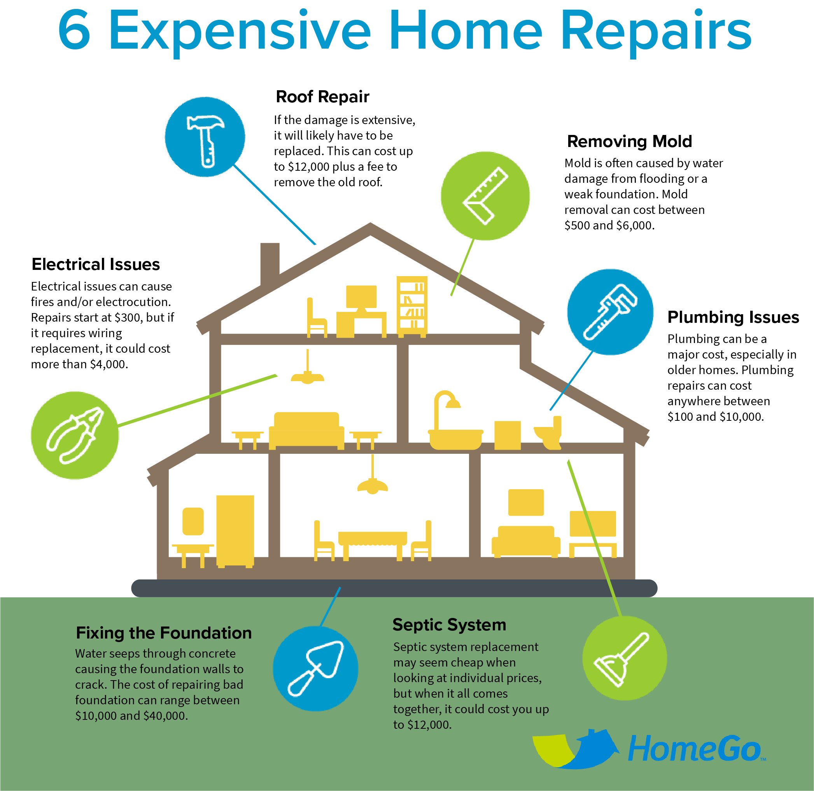
High financial cost of housing and health silos.
Asthma as a case example:
Uncontrolled, or poorly controlled asthma

Slide 10
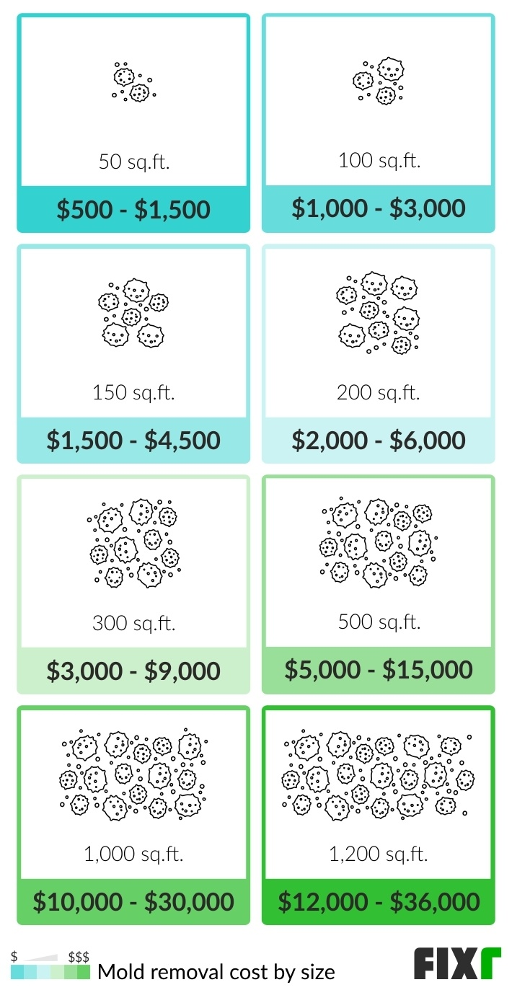




Shared responsibility between the resident and housing authority
Behaviors encouraging mold growth:
Garbage
High moisture levels
Not cleaning or drying wet surfaces immediately
Expired food

Slide 11
If the root of the problem does not get fixed, we risk recurring challenges.
Uncontrolled, or poorly controlled asthma relates to an increase in:
Emergency department visits
Hospitalizations
Work and school absenteeism

Slide 12
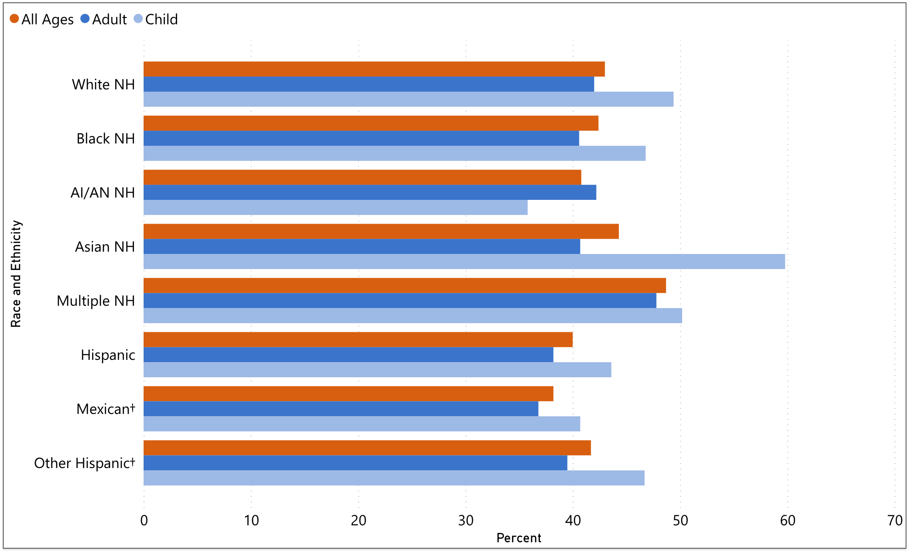
National data (2023) for asthma attacks by race and ethnicity.
Source: National Center for Environmental Health https://www.cdc.gov/asthma/data-visualizations/default.htm

Slide 13
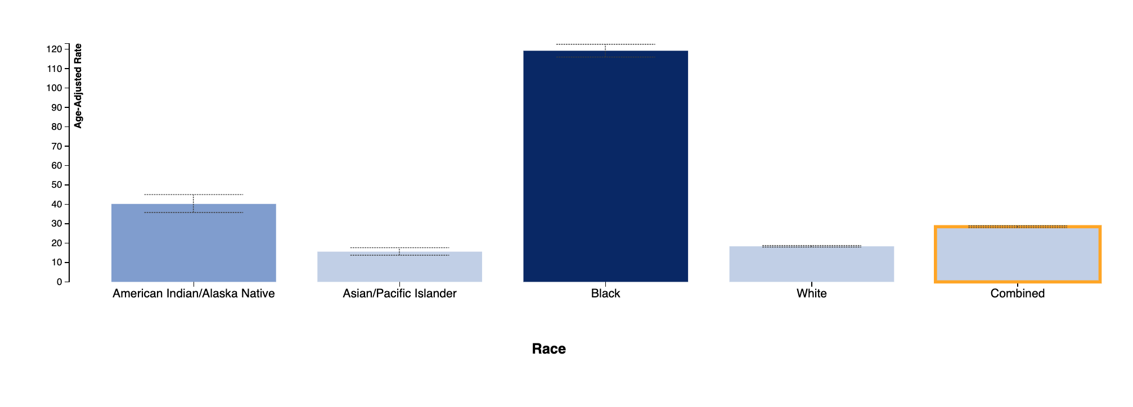
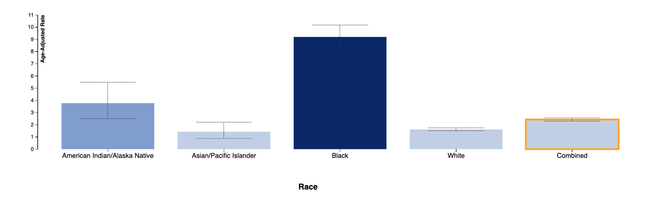
Wisconsin data (2022) for asthma ED visits by race and ethnicity.
Source: Wisconsin Department of Health and Human Services Environmental Public Health Tracking Program
Wisconsin data (2022) for asthma hospitalizations by race and ethnicity.
Source: Wisconsin Department of Health and Human Services Environmental Public Health Tracking Program

Slide 14
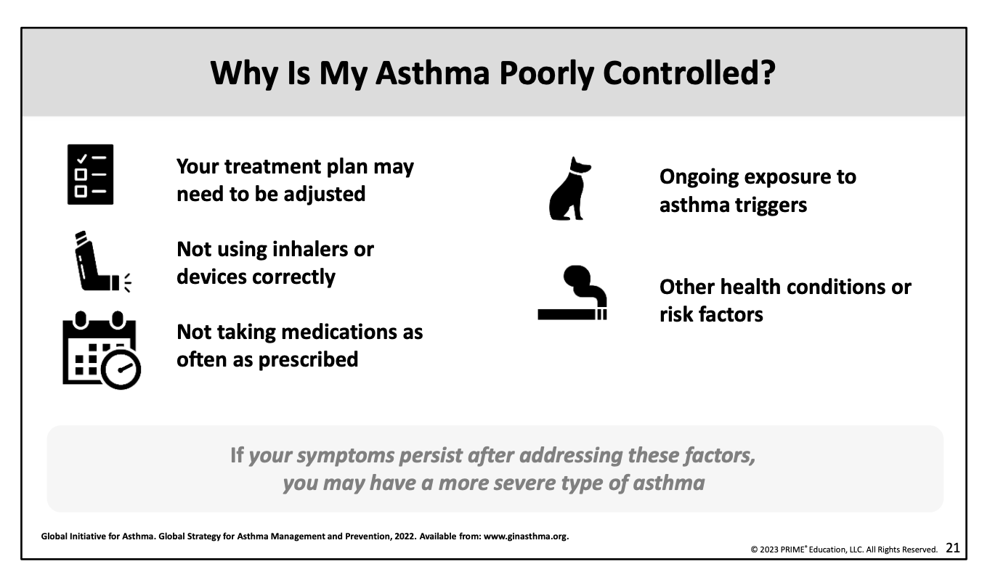
You cannot manage asthma (or other health conditions) if the triggers are still present
Notes:
HH. Issue that we’re highlighting is that you might always see uncontrolled or poorly controlled athma if you can’t address underlying triggers such as mold exposure, pests from excess garbage, and all other housekeeping related behaviors we talked about earlier. Becomes a recipe for disaster. If you have persistent triggers, you will have persistent asthma, and if you don’t change things in your home then the cycle will persist. When this cycle persists, we have an even bigger financial problem https://media.primeinc.org/upload/programs/22PT231/Empowering%20Native%20American%20Communities%20in%20Asthma%20Care%20A%20Patient%20Education%20Toolkit%20for%20Providers.pdf
What stories? Referral or recurring challenges?

Slide 15
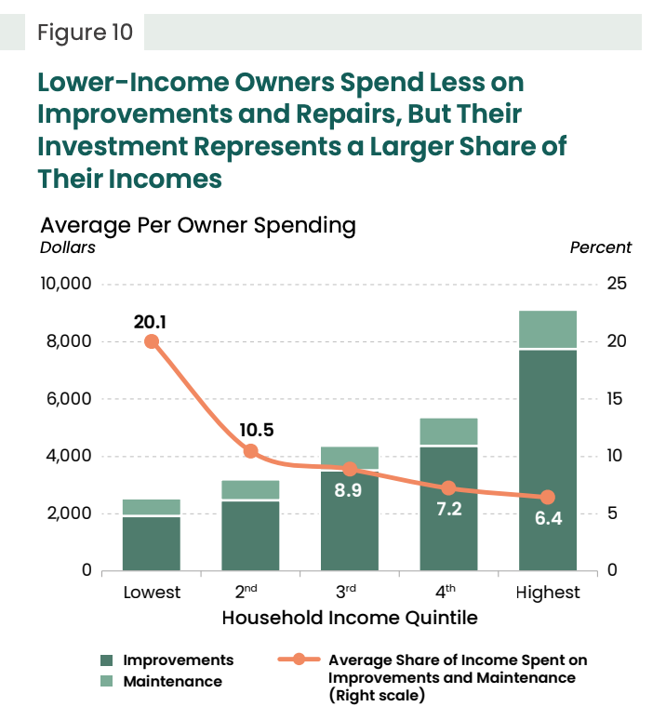
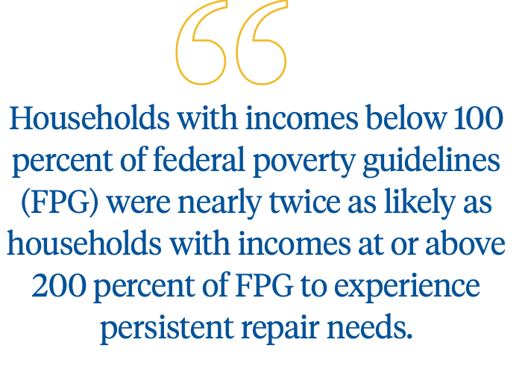
Source: Federal Reserve Bank of Philadelphia. Research Brief: Updated Estimates of Home Repair Needs and Costs. 2023.
Source: Joint Center for Housing Studies at Harvard University. Improving America’s Housing. 2023.

Slide 16
Problem
Gaps
Solution
Reactive vs proactive problem solving contributes to high economic and health burden among Tribal communities
Housing and health professionals are bound to addressing problems within their sectors and cannot force changed behavior
H-Life

Slide 17



Value: Evidence-informed model that focuses on housing inspection and maintenance policy to bridge health and housing knowledge and wholistically inform monitoring and maintenance
Goal: Improve housing inspection and maintenance policies to break silos between the health and housing sectors to prevent housing-related negative health outcomes
Vision: Afford everyone the human right to health and sustainable safe, sanitary, comfortable, and nourishing homes for generations

Slide 18

Healthy homes reduce unnecessary economic costs and health burden
Elements within home will either stabilize or destabilize your health
Health is driven by the quality of your home environment
Inspections and maintenance must be frequent, thorough, and collaborative to maintain the health of the home and resident(s)

Slide 19
H-Life Definition
Healthy-living inspections for everyone, or H-life, is a model informed by the U.S. Department of Housing and Urban Development’s Healthy Homes and the National Center for Healthy Housing (NCHH) principles to advance equity by improving housing and preventing morbidity and mortality among minority communities. H-Life serves as a framework to build health-centric inspection and maintenance policies, so that housing authorities can better disrupt the negative cycle of housing conditions and poor health outcomes.

Slide 20
Four core elements
The document defines the intent of H-life and promotes a unified understanding of the core elements and expectations of the adaptation of the following model standards:
Expansion of inspection and maintenance checklists
Health and Housing Communications
Financing
Case management

Slide 21
  Standard list of specs
  Distinct timelines
  Interactive checklists
  Trilateral
  Housing, Health, and Residents
1.Checklists
2.Communication
3.Financing
4.Cases
  Cost savings from increased preventive measures
  Healthy Home workforce
  Limit cases that need to be managed

Slide 22
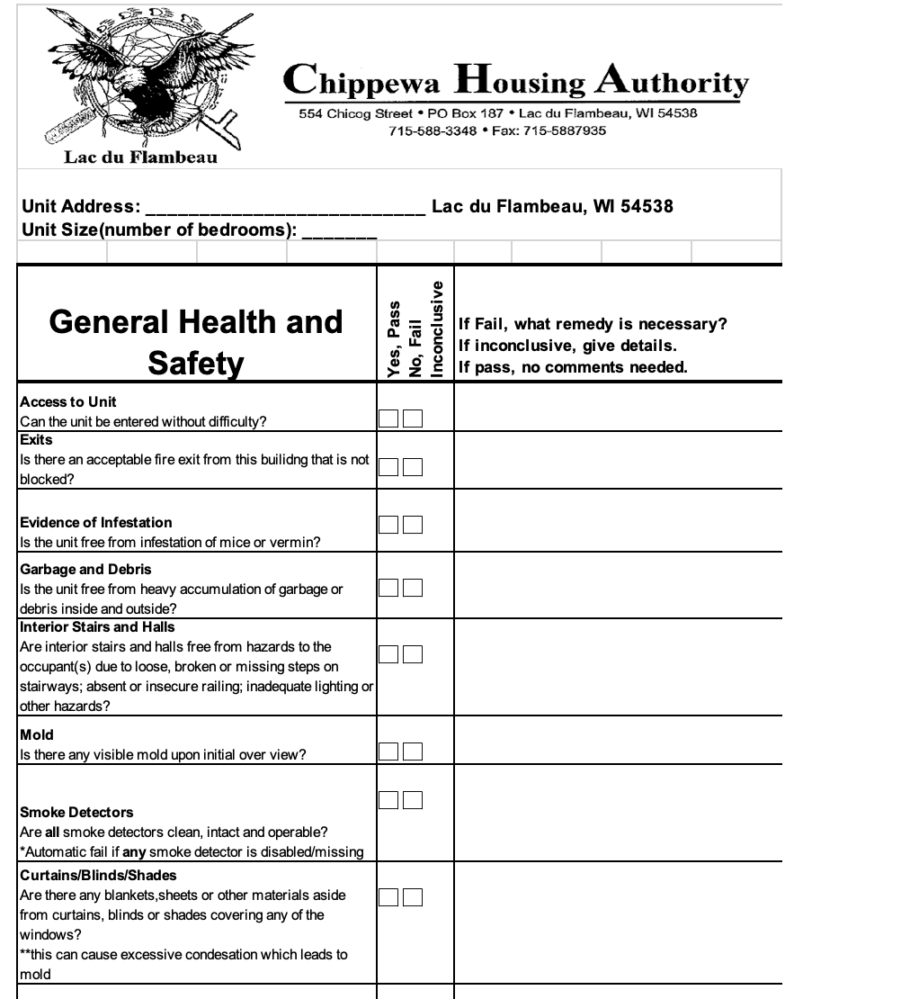
1. Modify checklists to include the health and housing impact of an item on the same document
Healthy Home Inspection Checklist
Health impact
Urgency
Resource
Notes:
Will be turned into a template and call it the “healthy home inspection checklist” or have a health impact statement on each checklist

Slide 23

2. Improve communication by using a tri-lateral approach to break silos
Pathway 3. Facilitate direct information exchange on acute and chronic housing and health conditions
Pathway 1. Change learned behavior via educational materials
Housing Authorities
IHS
Residents
Health Clinics
Pathway 2. Tailor treatment plans
Notes:
Educational materials we are considering are things like:
Stories that demonstrate the consequences of positive and negative behaviors
Diagrams that demonstrate the course of certain actions on the interior and exterior of the home
Step-by-step videos for preventing and addressing a potential hazard

Slide 24
3. Additional cost savings from increased prevention efforts can finance new roles
Housing Authority
Inspectors
Healthy Home Navigators
Residents
Notes:
What might this workforce look like?

Slide 25
Housing Authority
Target: IHS, EPA, DHS, etc.
Sample description: Lead adaptations to maintenance and inspection plans and procedures
Target: Residents
Sample description: Responsible for completing checklists with residents
Healthy Home Managers
Healthy Home Coordinators
Healthy Home Navigators
Target: Health clinics
Sample description: Lead information exchange with health clinics

Slide 26
Take home: Use H-Life to inform the design of policies and operations
Introduce
Discover
Encourage
Systematic shift in the way housing authorities can prevent expensive home repairs and remediation
New mechanisms for sustaining and advancing housing stock
Cross-sector partnerships

Slide 27

Where we are today
Implement
Awareness
Education
Create a central bank of knowledge for the relationship between housing quality and health, so housing professionals, health practitioners, and community members alike can take actionable steps towards improving housing situations
Design model standards to ensure the information gathered in Phase I is used to inform decisions around housing inspection, housekeeping, and maintenance policies
Expand on the housing and health workforce to introduce a sustainable solution for Tribes seeking to improve the housing and health of their community

Slide 28

Where we are headed
Review
Review H-LIFE model standards for accuracy, relevance, and usability
Begin
Begin finalizing model standards in May 2024

Slide 29
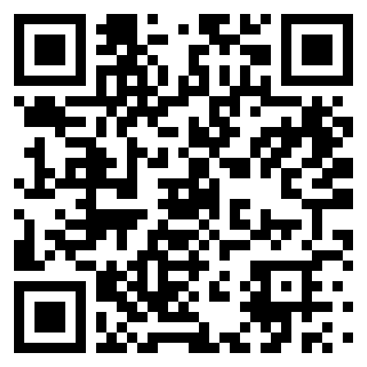
Get involved!

Slide 30
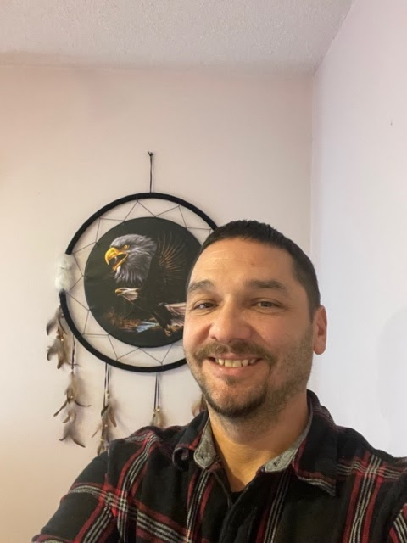

Connect with Us!
Hailey Hernandez, MPH
Email: hhern.consulting@gmail.com
Ph: (224) 336-8065
Connect on Linkedin
Jeff Ackley Jr., Native Land Construction and Consulting
Email: jeffackleyjr@gmail.com
Ph: (715) 622-0540
Connect on Linkedin

