Slide 1

Training and Technical Assistance Department

Slide 2
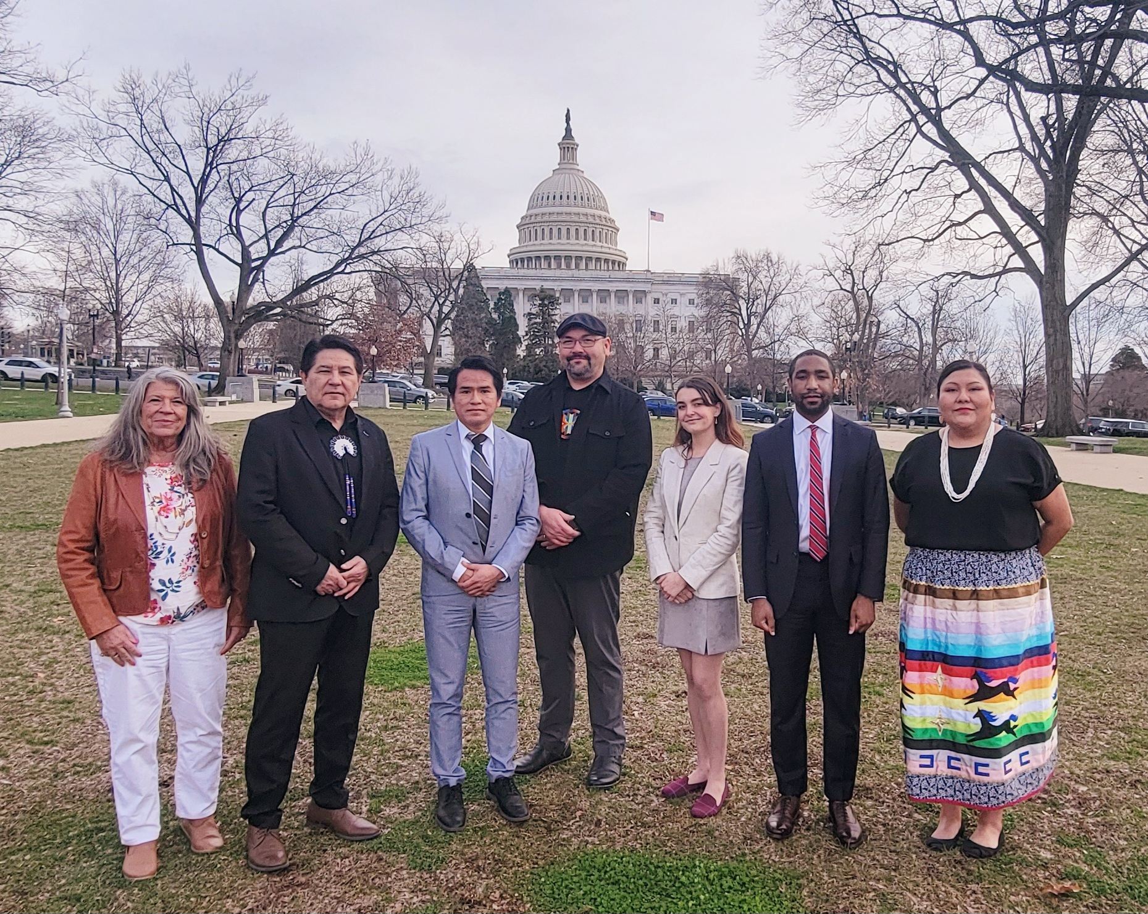
Naihc staff

Slide 3
FOR THE PEOPLE – FOR FIFTY YEARS!
Mission Statement
“To effectively and efficiently promote and support American Indians, Alaska Natives and native Hawaiians in their self- determined goal to provide culturally relevant and quality affordable housing for native people.”

Slide 4
History of NAIHC
Founded in 1974 at a 501(C)(3) Corporation
275 Voting Members representing 474 Tribes
13 Associate Members
Headquarters in Washington, DC

Slide 5
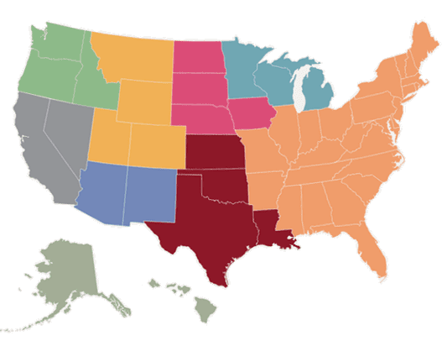
Board Members
Board Members Represent Regions 1 - 9

Slide 6
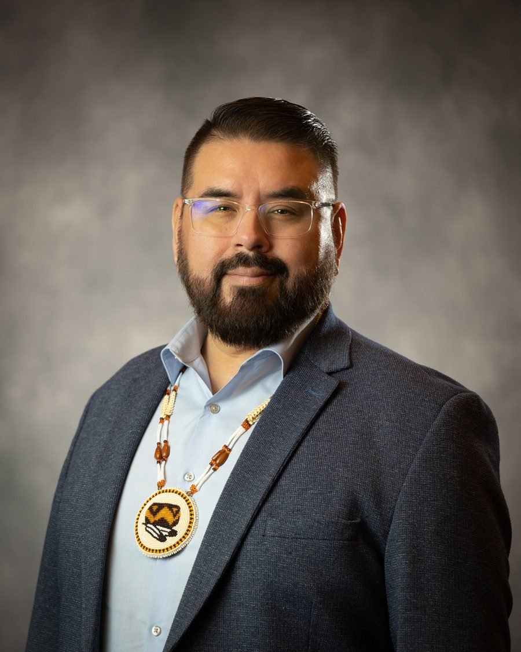
Board Chairman Thomas Lozano

Slide 7
3 Components of NAIHC
Advocacy
Membership
Training & On-site Technical Assistance

Slide 8

HUD ONAP Regional Trainings and Technical Assistance

Slide 9
Native American Housing Assistance and Self-Determination Act of 1996
SEC. 703. TRAINING AND TECHNICAL ASSISTANCE.
There are authorized to be appropriated for assistance for a national organization representing Native American housing interests for providing training and technical assistance to Indian housing authorities and tribally designated housing entities such sums as may be necessary.
Community Compass Eligible Activities
Needs Assessments
Direct TA & Capacity Building Engagements
Self Directed and Group Learning
Data analysis, reporting, and performance measurement

Slide 10
Regional HUD ONAP Trainings
“Resiliency” Best Practice Toolkit
IHP/APR
Construction – Force Account
Effective Housing Decision Making
2 CFR Part 200
Board of Commissioners
Tribal Council Roles & Responsibilities
Housing Policy
Non-Discriminatory Laws in Housing
Methamphetamine/Remediation of Units
Self-Monitoring
Tribal HUD VASH
Financial Management
Grants Evaluation
Procurement and Contract Administration
Conveyance Process
Indian Housing Law
Uniform Physical Conditions Standards
ICDBG
Executive Director

Slide 11
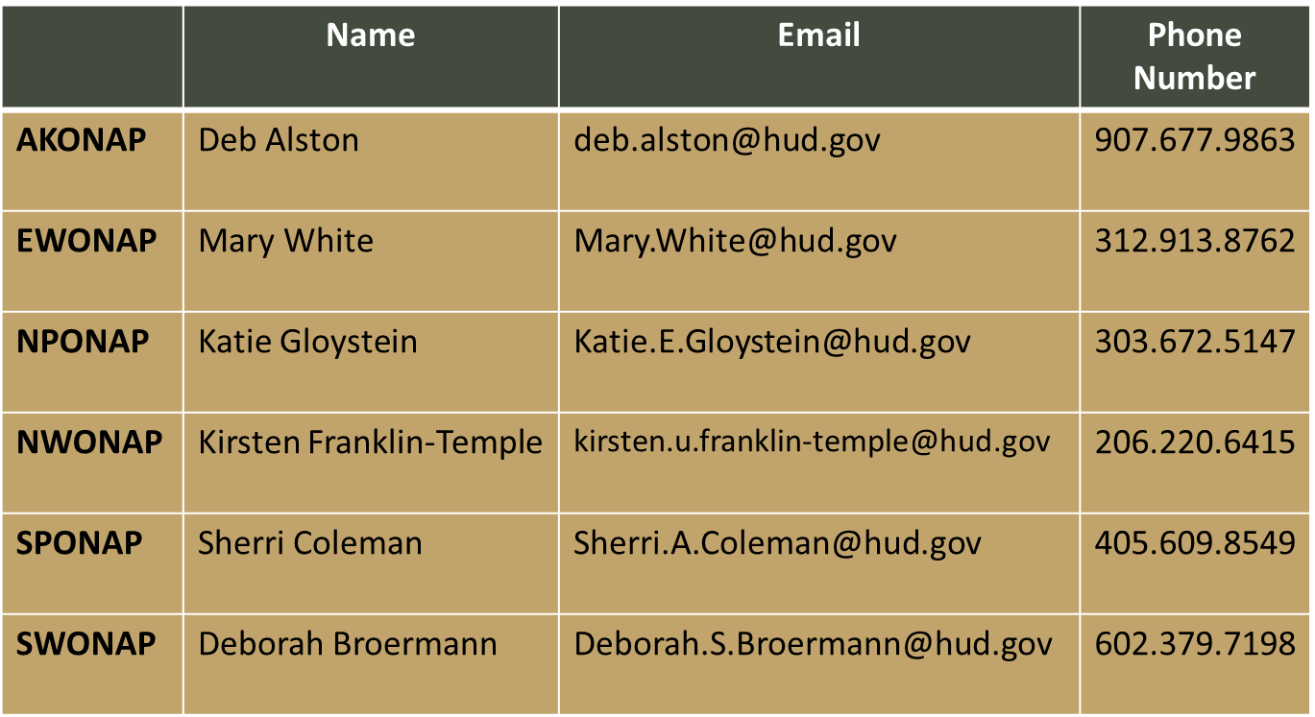
TA Contacts by ONAP Area Office

Slide 12
TA Projects
A Glimpse into some of naihc’s successful technical assistance assignments

Slide 13
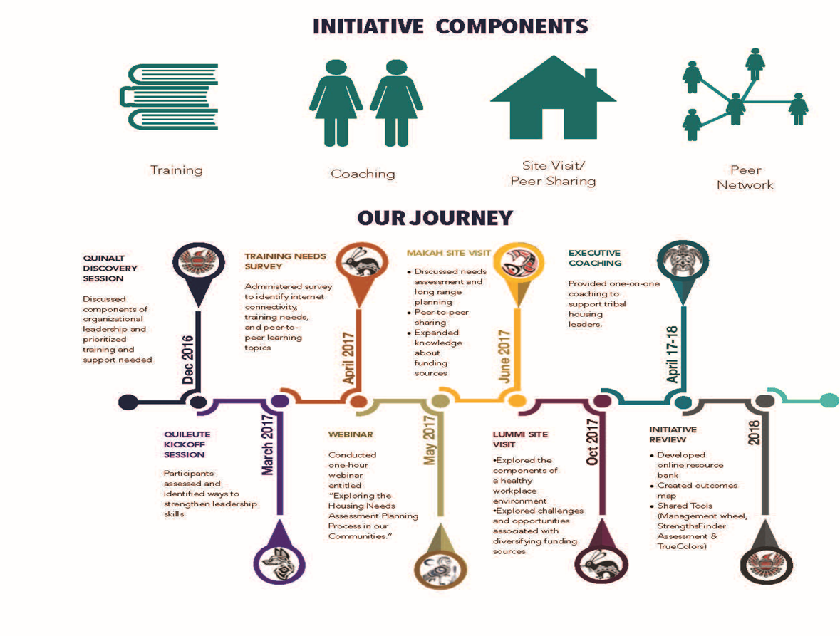
Washington coastal leadership cohort

Slide 14
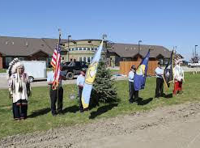
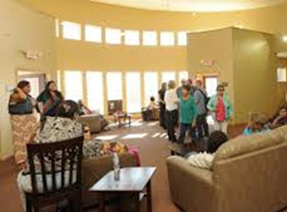
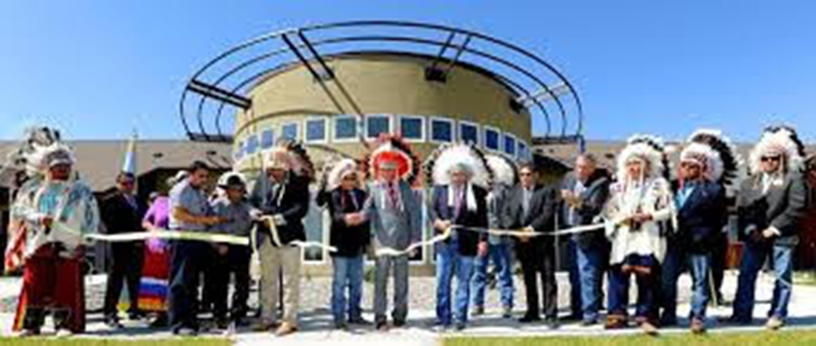
Crow Tribe Apsaalooke Warriors Complex

Slide 15
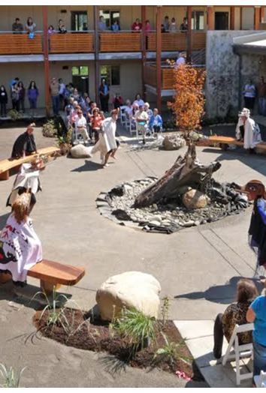
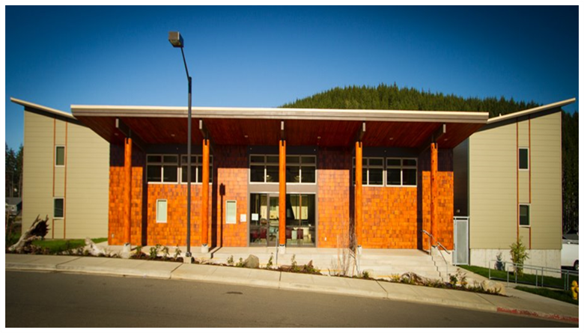
SAIL RIVER HEIGHTS “MAKAH SELF-DETERMINATION AT WORK”
21 UNITS OF PERMANENT SUPPORTIVE HOUSING

Slide 16
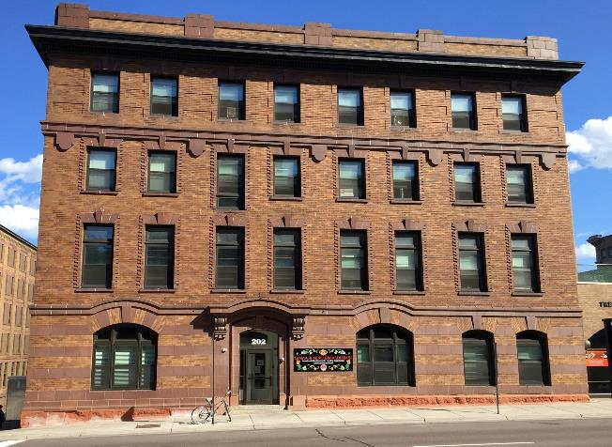
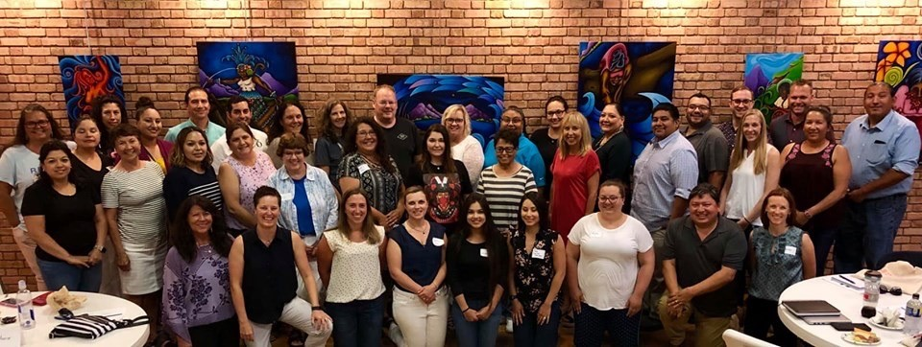
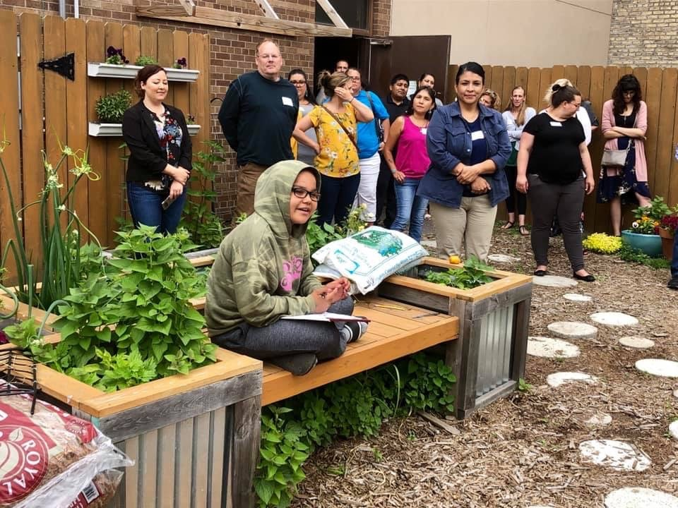
Tribal TA Cohort: Addressing Homelessness in Tribal Areas 2019 -2022
American Indian Community Housing Organization
Gimaajii-Mino-Bimaadizimin
Duluth, MN
Notes:
TA – remote, in person, and PSH site visits in Duluth, Denver & Neah Bay, Makah,
• Gila River
• Sault Ste. Marie
• Cook Inlet
• Nez Perce
• NARA/NAYA
• NADC
• Sisseton Wahpeton
• Red Lake Shelter
• Ho-Chunk
• Oneida Nation

Slide 17
Community Needs Assessments – Strategic Planning
Shoshone-Bannock Tribes Planning Program: Tribal Housing Opportunities; Program Technical Assistance 2015 – 2017
“At the conclusion of the data collection process we, as a collaborative team, were able to regroup and strategically plan the next steps for the next three years in order to bring some of the identified needs from the assessment to fruition. A three year strategic plan was put into place thus allowing for a clear, concise, and a direction with vision to take place. Working with neutral facilitators allowed the Shoshone-Bannock Tribes to see the vison of strategically planning development with a purpose and a goal. The Shoshone-Bannock Tribal Housing Opportunities Program is progressively moving forward with many facets of the strategic plan put into motion as a result from the Needs Assessment venture and technical assistance provided to us by NAIHC technical assistance team.”
Shalynn A. Perisol, MPA Shoshone-Bannock Tribes Planning Program

Slide 18
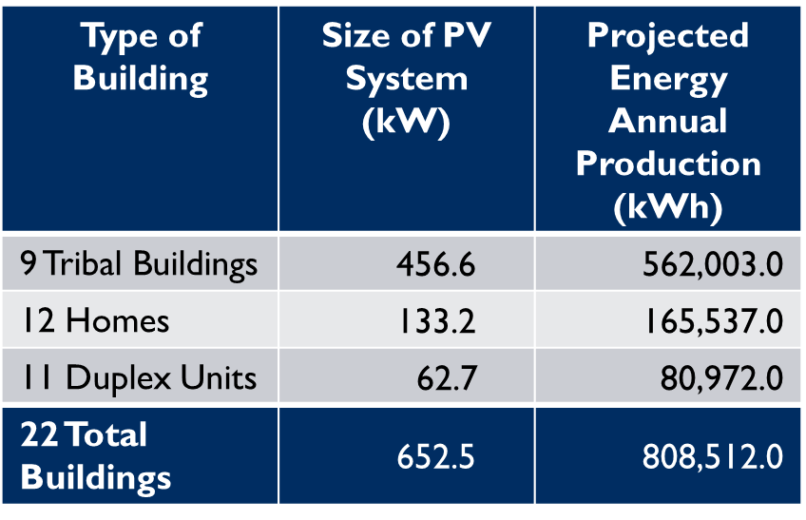
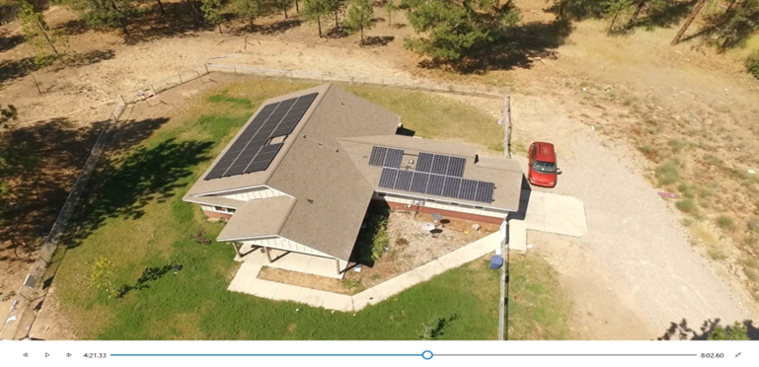
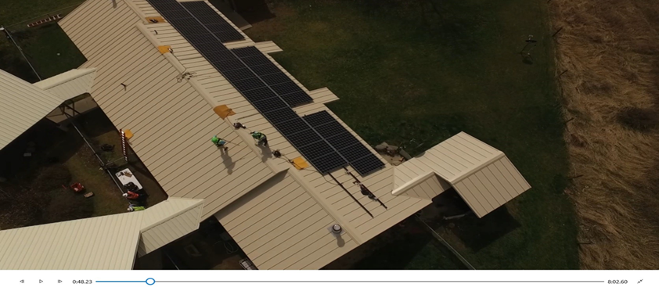
Funding Energy Efficiency/Renewable Energy
Spokane Sockeye Housing
Photo courtesy Spokane Indian Housing Authority
Spokane Tribe Children of the Sun Solar Initiative
Spokane Tribe Senior Housing
Photo courtesy Spokane Indian Housing Authority

Slide 19
Responsible Renters Program
Instructor & Participant workbook & training materials
Credit counseling
Budgeting
Components of lease agreement
Positive communication skills
Cleanliness & safety
Good neighbor
Proper procedures to end tenancy
Avoiding eviction
Notes:
Rentwise

Slide 20
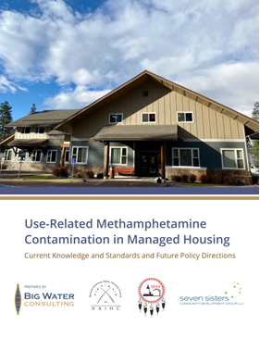
Salish & Kootenai Methamphetamine Remediation Data Analysis
Contamination from methamphetamine use in managed housing continues to be an acute issue across Indian Country, but there has been little scientific research done to understand and evaluate the health risks associated with exposure to such contamination. The Salish and Kootenai Housing Authority (SKHA) requested Training & Technical Assistance (T&TA) from HUD Office of Native American Programs (ONAP) to conduct research to evaluate the scientific basis for the spectrum of current standards for safe or acceptable levels of use-related methamphetamine contamination in managed housing in part to facilitate their own development and adoption of new meth standards and practices, but also to create a technical resource to assist other Tribally Designated Housing Entities across Indian Country.
The Use-Related Methamphetamine Contamination in Managed Housing: Current Knowledge and Standards and Future Policy Directions report is a product of the T&TA request to HUD ONAP that was requested by the SKHA, coordinated by National American Indian Housing Council (NAIHC) and conducted by Big Water Consulting and Seven Sisters Community Development Group.
Full SKHA Statement Here
View full report here

Slide 21


Leadership Institute

Slide 22

Leadership Institute.
Founded in 1999, the NAIHC Leadership Institute presents interactive, live training courses each year in exciting cities across the country. In addition to our eLearning products, NAIHC will continue offering live trainings as an avenue for housing professionals to peer network and receive individualized assistance from our extensive network of consultants and subject matter experts.
Participants have the opportunity to earn a track certification in General Housing Management, Financial Management, Occupancy Management or Development Management. All course credit is applied towards NAIHC’s premier certification, the Professional Indian Housing Manager.
Notes:
The National American Indian Housing Council is pleased to launch – A new way to train. The Leadership Institute Program. eLearning.

Slide 23

Certification.
General Housing Management Specialist
Indian Housing Management
Supervisory Management
Financial Management Specialist
Financial Management
Basic Accounting
Occupancy Management Specialist
Admissions & Occupancy
Resident Services
Property Maintenance Management
Acquisition Basics
NTCCP: NAHASDA & LIHTC Certification or Pathways Home
Development Management Specialist
Project Management
Environmental Compliance
Acquisition Basics
65
Total PIHM Certifications issued since 1999
38
Total Track Certifications issued
between 2018-2023
2000+
Total of LI Participants since 1999

Slide 24
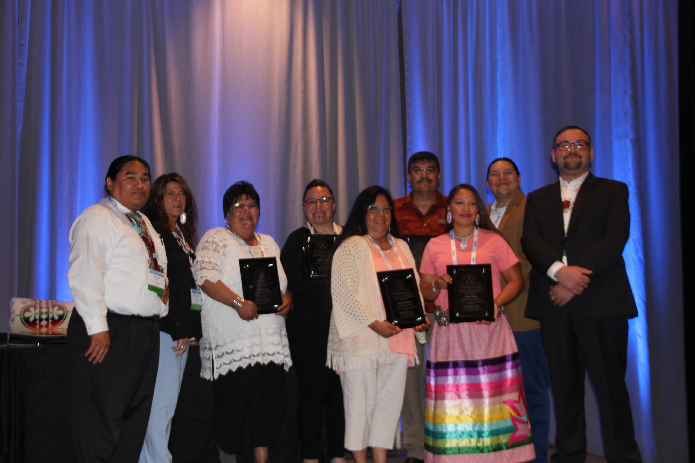
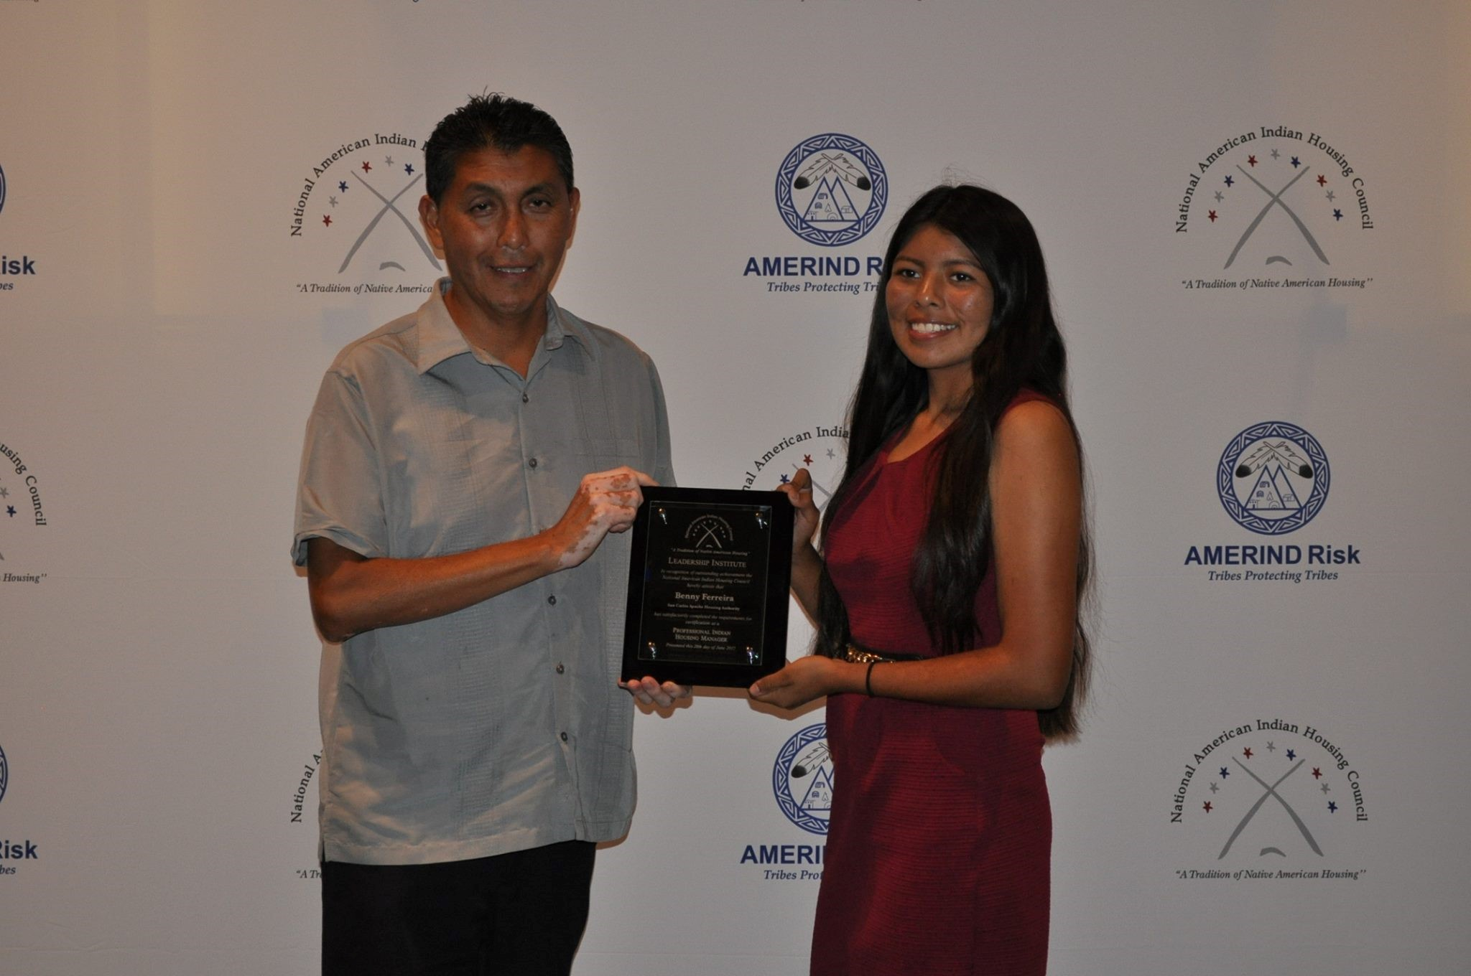
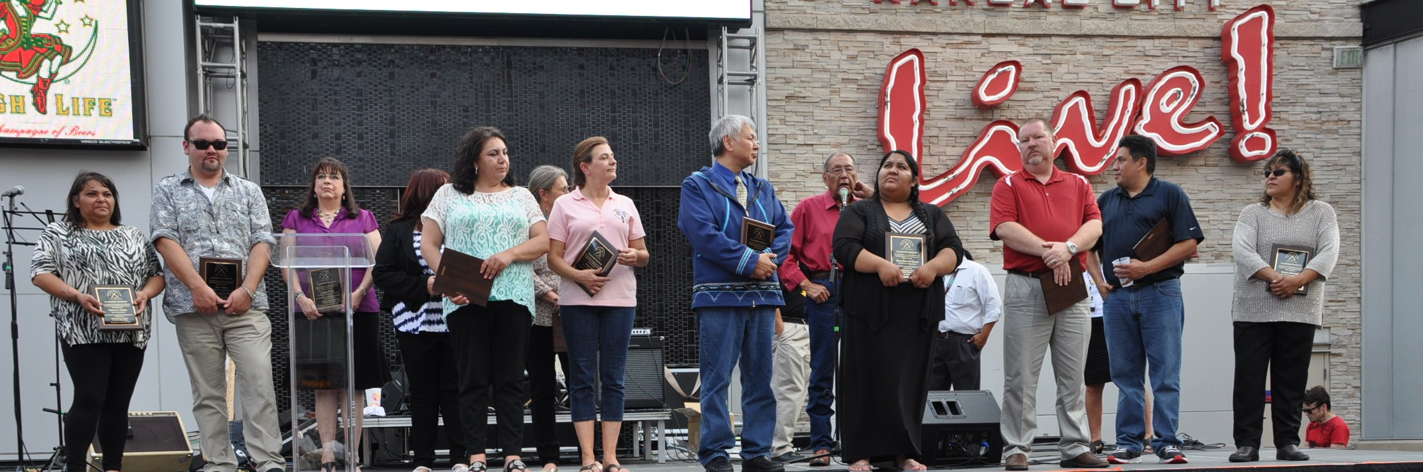
Professional Indian Housing Manager
Indian Housing Management
Supervisory Management
Property Maintenance Management
Project Management
Financial Management
Acquisition Basics
Admissions & Occupancy
Resident Services

Slide 25
Resume Your Path To Certification in 2024
Indian Housing Management – June 24-26, 2024, in conjunction with NAIHC Annual Convention
Hollywood, FL
Property Maintenance Management – October 2024
Sioux Falls, SD
Admissions & Occupancy – July 2024
San Diego, CA
Financial Management – September 2024
Austin, TX
NTCCP: NAHASDA & Low Income Housing Tax Credits Certification – August 2024
Phoenix, AZ
Supervisory Management – December 2024, in conjunction with NAIHC Legal Symposium
Las Vegas, NV
Notes:
The National American Indian Housing Council is pleased to launch – A new way to train. The Leadership Institute Program. eLearning.

Slide 26

Leadership Institute |eLearning.
Indian Housing Management
Available Now
Pathways Home for the Homebuyer
Available Now
Admissions & Occupancy
Coming Soon!
Acquisition Basics
In Development
NTCCP: NAHASDA & LIHTC
In Development
Setup an online profile today @
learn.naihc.net

Slide 27
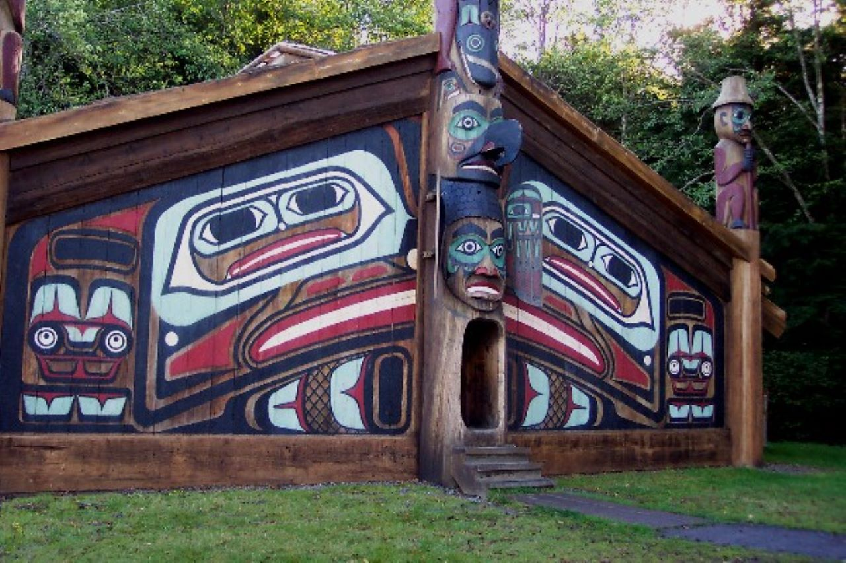


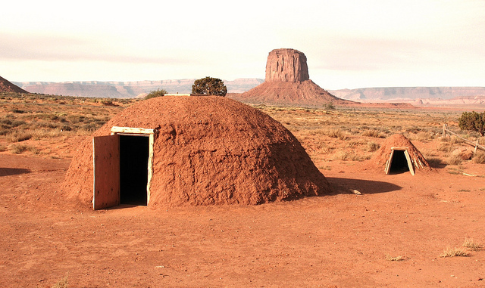


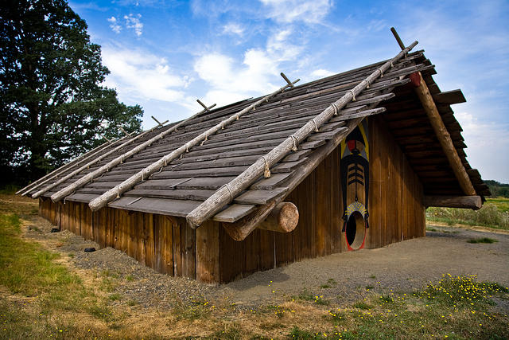
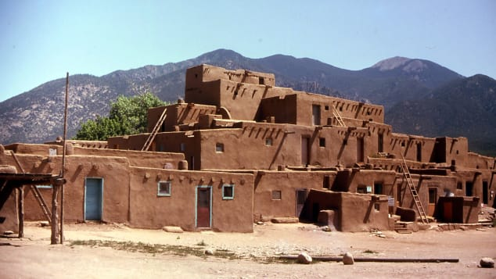
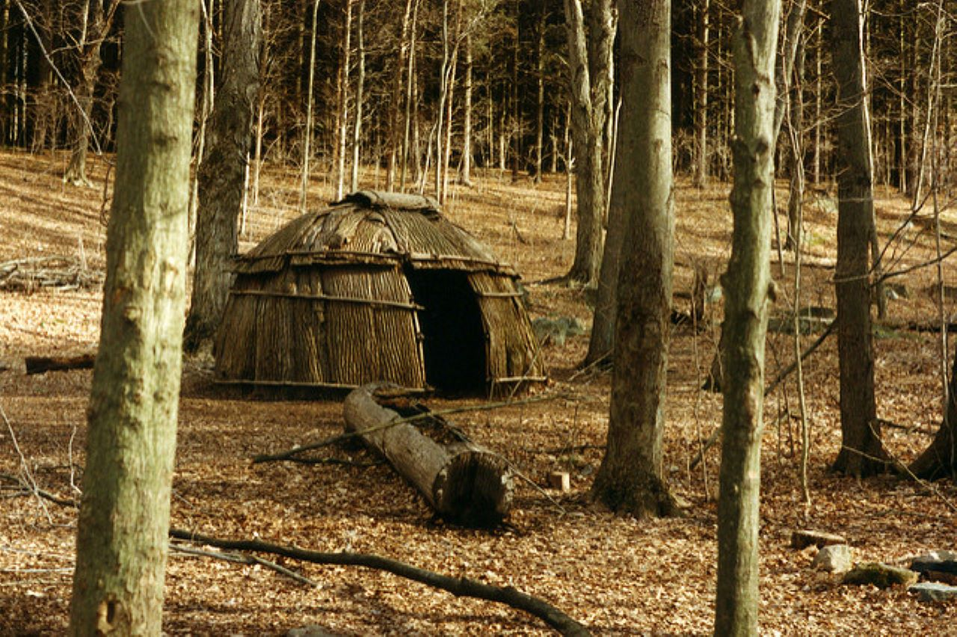
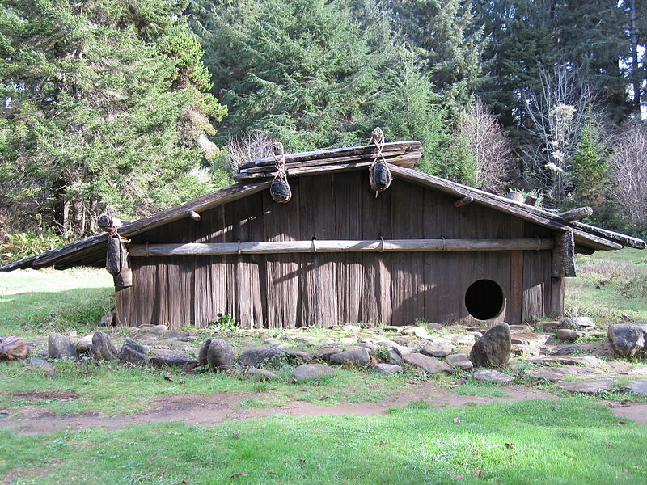

A Native Homeownership Guide

Slide 28

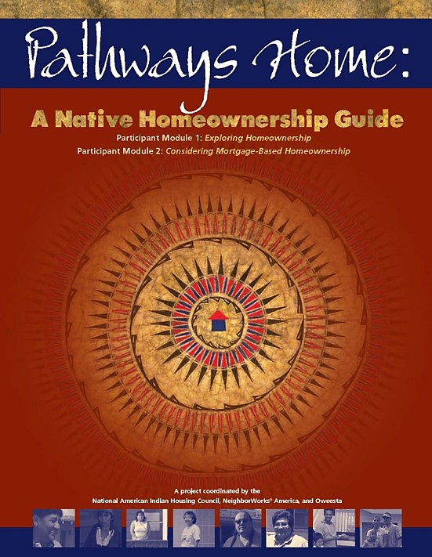
Pathways Home helps Native people and their families develop the skills required to purchase a home and is the premier homebuyer education course for Native homebuyers.

Slide 29
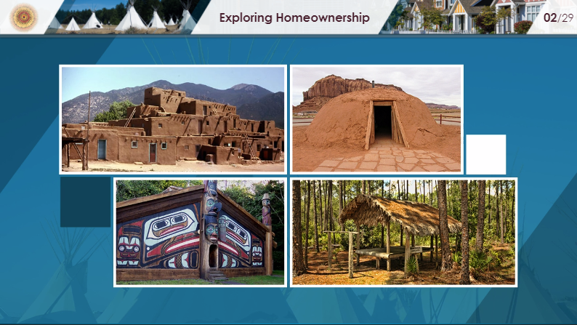

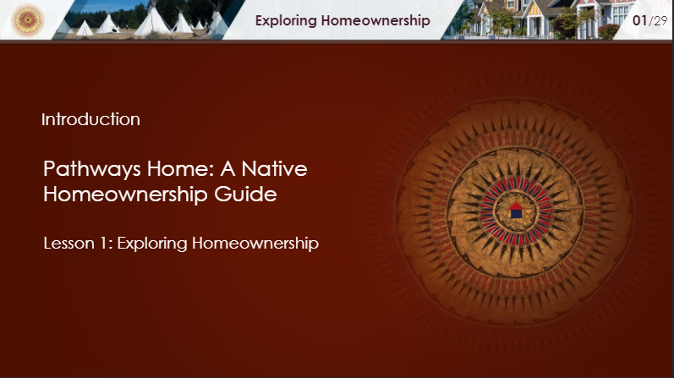
Our popular course will now be available directly to potential homebuyers completely online!
eLearning.

Slide 30

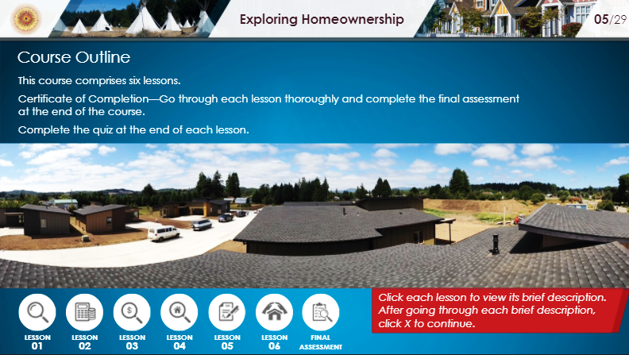
Exploring Homeownership
Budgeting for Homeownership and Calculating Affordability
Evaluating Credit for Homeownership
Finding a Home
Applying for a Home Loan
Protecting Your Assets

Slide 31

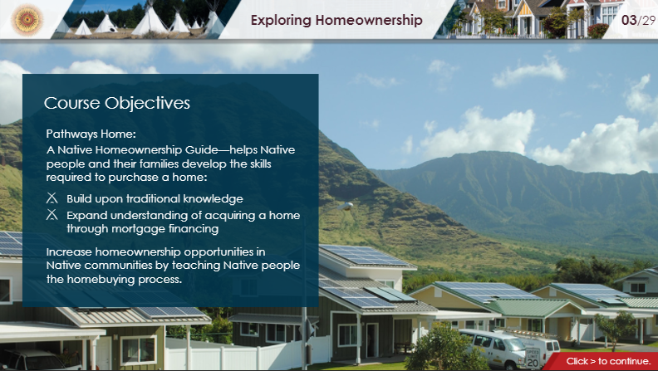
Upon successful completion of the self-paced course, participants will receive a Certificate of Completion to be used for access to various mortgage products and down payment assistance programs made available to Native people.

Slide 32


Slide 33




Slide 34

Join us in Seminole, Florida for our annual Convention & Tradeshow

Slide 35
More Information
Contact Erla Sagg at esagg@naihc.net for Sponsorship Opportunities, Exhibitor booth spaces, and other information
Hotel Room Block Deadline: May 1, 2024
Early Bird Registration ends:
More Information: https://naihc.net/annual-convention/

Slide 36
Ahéhee’
Erla R. Sagg
NAIHC Training & Technical Assistance Program Director
esagg@naihc.net
www.naihc.net
(202) 454-0913
202-789-1754

