Slide 1
Indian Health Service
GLIHA Meeting
Scott Snell
DSFC Overview
August 6, 2024

Slide 2
Overview
Indian Health SErvice
2

Slide 3
Indian Health Service
One of the Agencies of the
Public Health Service
Department of Health and Human Services
  Agency for Healthcare Research and Quality (AHRQ)
  Agency for Toxic Substances and Disease Registry (ATSDR)
  Centers for Disease Control and Prevention (CDC)
  Food and Drug Administration (FDA)
  Health Resources and Services Administration (HRSA)
  Indian Health Service (IHS)
  National Institutes of Health (NIH)
  Substance Abuse and Mental Health Services Administration (SAMHSA)

Slide 4
Mission
Provide a comprehensive health services delivery system
  for American Indians and Alaska Natives
  with maximum Tribal involvement
  Develop, manage, coordinate programs to meet tribal health needs.

Slide 5
Mission
. . . To raise the health status of American Indian and Alaska Native people to the highest possible level.

Slide 6
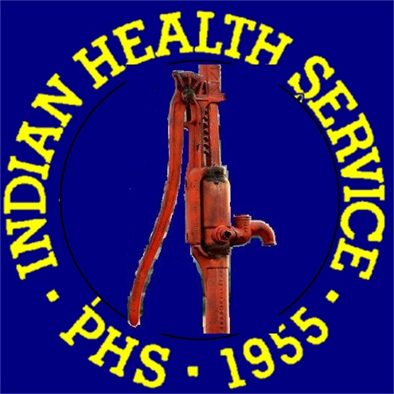
Division of Sanitation Facilities Construction (DSFC)

Slide 7
Division of Sanitation Facilities Construction (DSFC)
Public Law 86-121 created the SFC Program
to provide by contract or otherwise,
  essential sanitation facilities,
  necessary appurtenances and fixtures,
for Indian homes

Slide 8
Division of Sanitation Facilities Construction (DSFC)
The IHS Division of Sanitation Facilities Construction (DSFC) is the environmental engineering component of the IHS health delivery system.
The DSFC program enters into technical and financial agreements with Indian tribes and Alaska Native communities for the cooperative development and continuing operation of safe water, wastewater, and solid waste systems, and related support facilities.

Slide 9
Division of Sanitation Facilities Construction (DSFC)
In partnership with the tribes, the SFC Program provides the following services:
  Develop and maintain an inventory of sanitation deficiencies in Indian and Alaska Native communities for use by IHS and the Congress.
  Provide environmental engineering assistance with utility master planning and sanitary surveys.
  Develop multi-agency funded sanitation projects; accomplishes interagency coordination, assistance with grant applications, and leveraging of IHS funds.
  Provide funding for water supply and waste disposal facilities.
  Provides professional engineering design and/or construction services for water supply and waste disposal facilities.
  Provides technical consultation and training to improve the operation and maintenance of tribally owned water supply and waste disposal systems.
  Advocates for tribes during the development of policies, regulations, and programs.
  Assists tribes with sanitation facility emergencies.

Slide 10
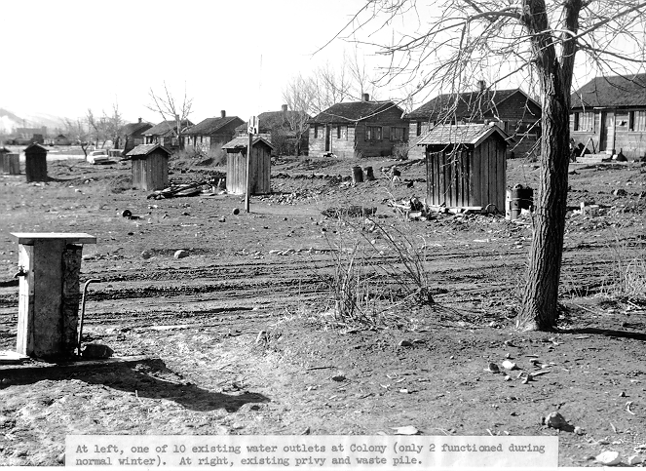
First IHS SFC Project – 1958 Elko, Nevada

Slide 11
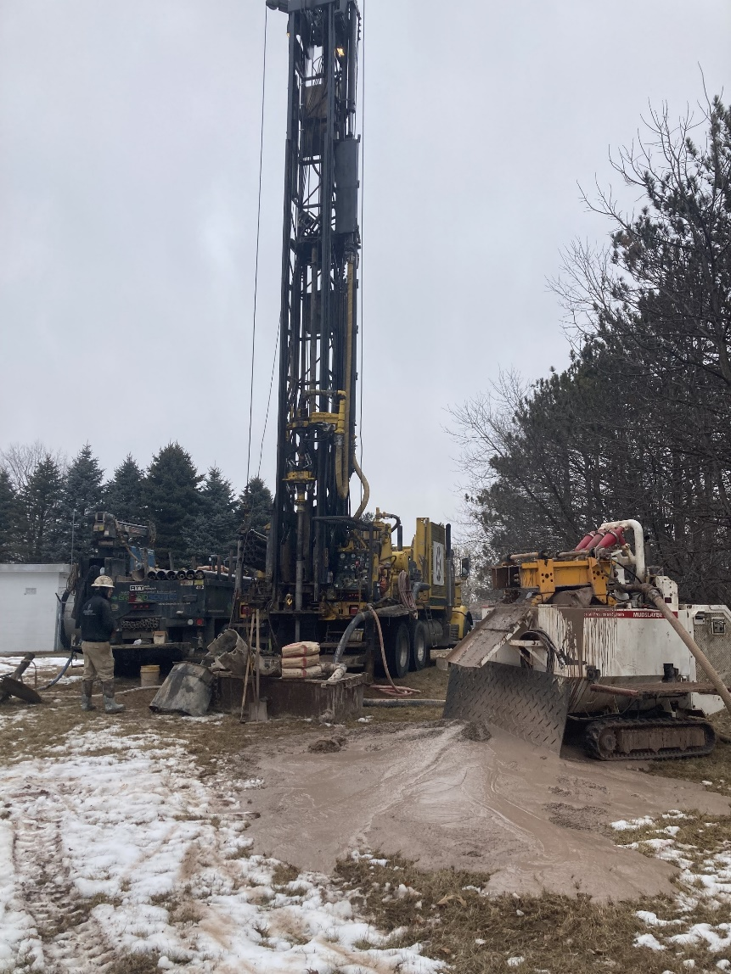
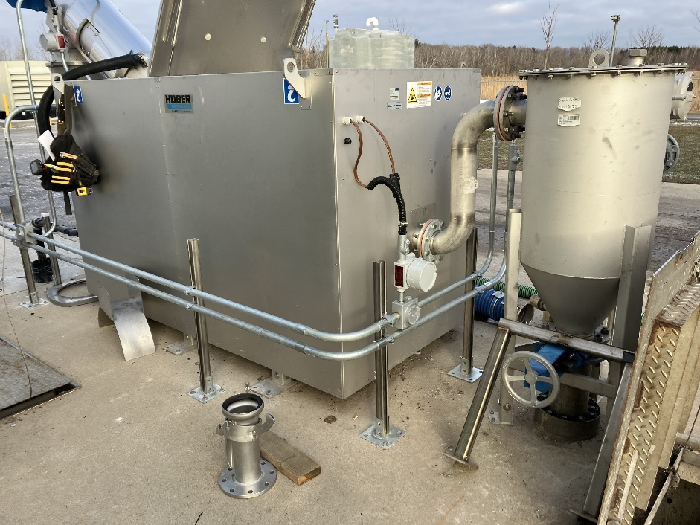
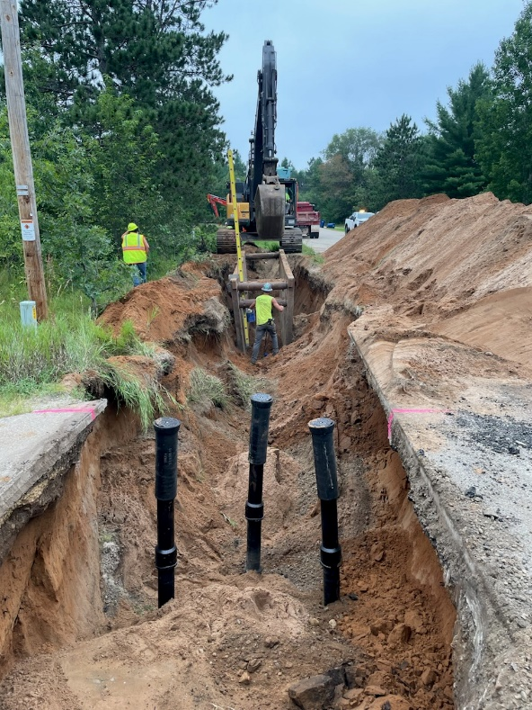
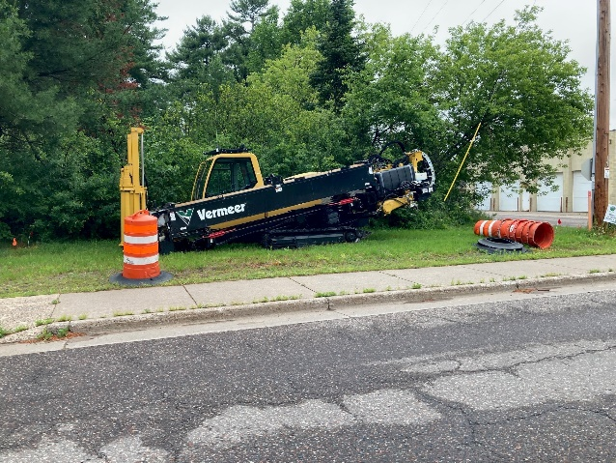
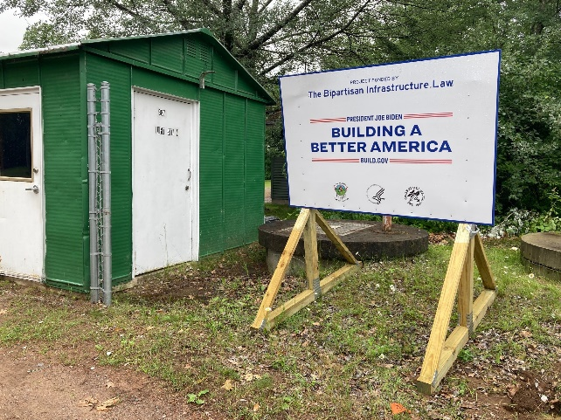
The SFC Program Today

Slide 12
Eligibility
Who can IHS can serve?
  IHS can only serve homes for members of Federally recognized AI/AN tribes (year round permanent residence)
What type of services can be provided?
  IHS provides water, sewer, solid waste (community infrastructure or individual onsite) facilities
What type of home cannot be served?
  IHS cannot serve HUD funded homes, or
  Commercial, institutional, recreational, seasonal, or non-tribally owned

Slide 13
Eligibility
Why can’t IHS funds be used to serve HUD homes?
  Prohibition appearing annually in the appropriations act for IHS:
  “none of the funds appropriated to the IHS may be used for sanitation facilities for new homes funded with grants by the housing programs of the U.S. Dept. of Housing and Urban Development.”

Slide 14
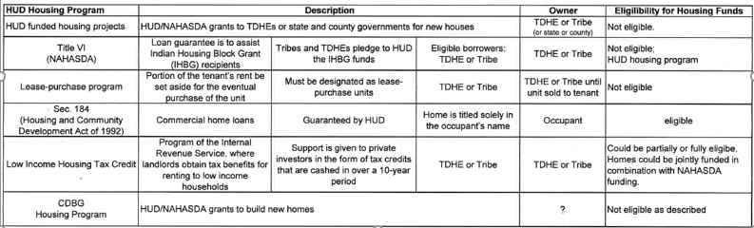
Eligibility

Slide 15
Funding
Four types of sanitation facilities projects:
  Housing: Projects to serve new or like-new housing, such as Indian homes being constructed or rehabilitated by the BIA-Home Improvement Program (HIP), tribes, individual homeowners, or other nonprofit organizations
  Regular: Projects to serve existing homes
  Special projects (studies, training, or other needs related to sanitation facilities construction), and
  Emergency projects. (Small scale emergencies such as failed well pump, failed control panel, etc…)

Slide 16
Funding
Infrastructure Investment and Jobs Act (IIJA). or Bipartisan Infrastructure Law (BIL)
  Appropriates $700 million in each year from fiscal year (FY) 2022 through FY 2026, for a total of $3.5 billion for the IHS Sanitation Facilities Construction (SFC) program. These resources are available until expended.
  3% per year ($21M) for salaries, expenses, and administration.
  0.5% ($3.5M) to the Office of Inspector General for oversight activities
  Up to $2.2B can be used for projects considered economically infeasibile due to high unit costs.
  Intended to address backlog of projects for existing homes (Regular)

Slide 17
Funding
Infrastructure Investment and Jobs Act (IIJA). or Bipartisan Infrastructure Law (BIL)
  $3.5B was sufficient to address the estimate of all projects in the Sanitation Deficiency System (SDS) at the time the legislation was passed
  However, new projects continue to be identified and added to SDS
  Cost estimates change due to ongoing planning activities and changing economic conditions
  SDS is unlikely to go away

Slide 18
Funding
Infrastructure Investment and Jobs Act (IIJA),
or Bipartisan Infrastructure Law (BIL)
Bemidji Area (MN, WI, and MI)
 | # of Proj | IIJA $ | Homes Served
Year 1 (22) | 28 | $11.3M | 4,533
Year 2 (23) | 8 | $10.1M | 2,345
Year 3 (24) | 12 | $8.9M | 1,215

Slide 19
Funding

Slide 20
Funding

Slide 21
Funding

Slide 22
Progress Metrics
 | 2015 Submittal | 2024 Submittal
Total Projects | 206 | 72
Feasible Projects | 168 | 40
Total Cost | $139M | $94M
Feasible Cost | 102M | $47M
Homes w/o water | 386 | 0
Homes @ DL4-5 | 672 | 1
Homes @DL 2-5 | 11,778 | 5,445
$ not indexed to the CPI

Slide 23
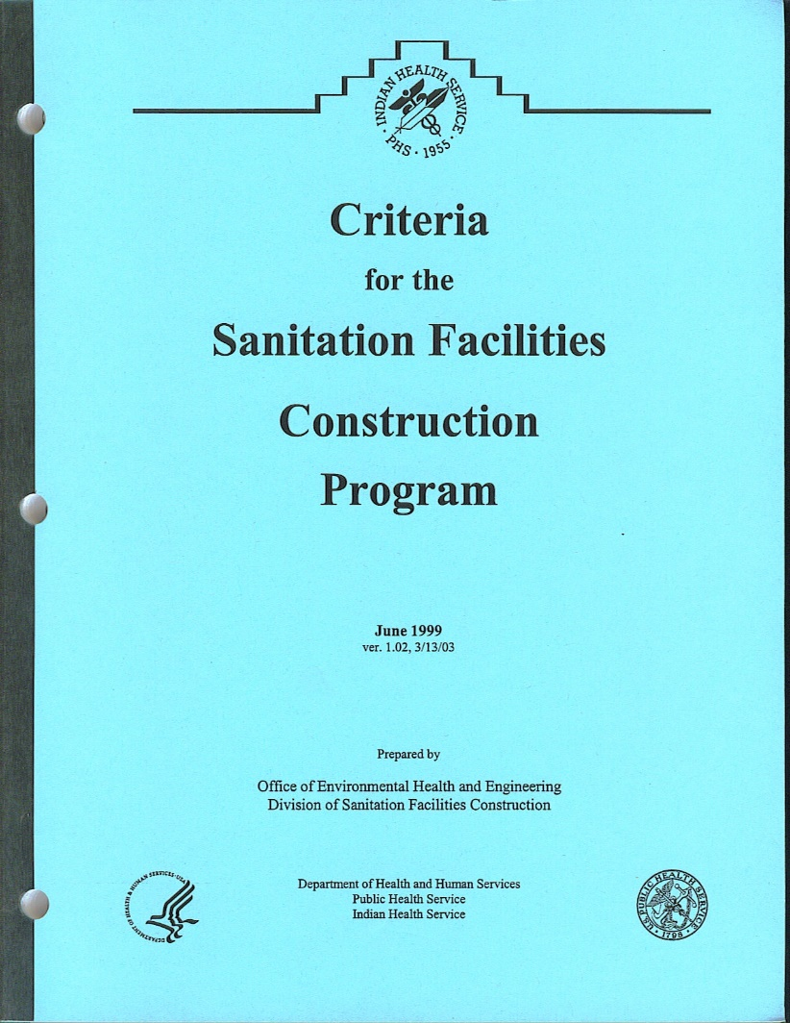
References
Everything (almost) you ever wanted to know about
the SFC Program . . .

Slide 24
References
Scott Snell
Director, Bemidji Area DSFC
2225 Cooperative Court
Bemidji, MN 56601
Scott.snell@ihs.gov
218-444-0502
www.ihs.gov
https://www.ihs.gov/dsfc/

Slide 25

Closeout
25

