Slide 1

HUD Office of Native American Programs
EASTERN/WOODLANDS
Neil Whitegull,
Administrator

Slide 2

BIG NEWS
FY 2023 IHBG Comp Awards , Eastern / Woodlands Region 12 awards, $48,588,892. 154 new units.
Aroostook Band of Micmaqs 3,000,000
Pleasant Point Passamaquoddy Reservation 2,990,596
Bay Mills Indian Community 2,999,700
Keweenaw Bay Indian Community 3,000,000
Sault Tribe Housing Authority 6,000,000
Lumbee Land Development 4,663,585

Slide 3
BIG NEWS
FY 2023 IHBG Comp Awards , Eastern / Woodlands Region 12 awards, $48,588,892. 154 new units.
Akwesasne Housing Authority 3,032,604
Chickahominy Indian Tribe-Eastern Division 2,798,068
Ho-Chunk Nation of Wisconsin 5,202,739
Lac Courte Oreilles Housing Authority 3,000,000
Oneida Nation 6,000,000
Red Cliff Band of Lake Superior Chippewa Indians 5,800,000

Slide 4
FY 24 IHBG Competitive NOFO
The FY 2024 Indian Housing Block Grant (IHBG) Competitive Notice of Funding Opportunity (NOFO) has been published. Tribes and Tribally Designated Housing Entities (TDHEs) are encouraged to apply for part of the $150 million available in grants to carry out affordable housing activities for the benefit of low-income American Indian and Alaska Native families. The NOFO can be found here. Applications are due by August 29, 2024, and are to be submitted though ww.grants.gov.
A Dear Tribal Leader letter regarding the NOFO can be found here . DTL_FY24_NOFO_Announcement_IHBG_Comp.pdf (hud.gov)

Slide 5
Coronavirus Aid, Relief, and Economic Security Act (CARES) American Rescue Plan (ARP)
We need Tribes and TDHE’s to spend these funds.
Reminder- APR’s have to be submitted for IHP CARES and ARP and ACERS for ICDBG-IT CARES and ARP.
If you have not spent down 50% or more of Covid funds, reminder letters went out earlier this fall, and letters will be going out again in February.
Modification of ICDBG-IT implementation plans or IHP amendments for changes in projects.
Eastern / Woodlands can coordinate Training and Technical Assistance if tribes need to build capacity to spend funds.

Slide 6
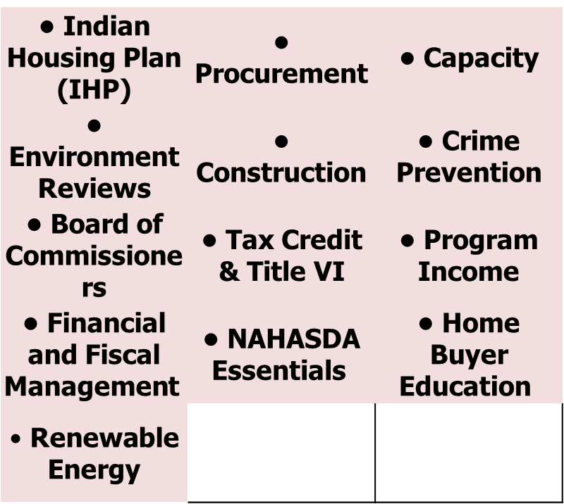
Training and Technical Assistance T/TA
s.

Slide 7
Supportive Housing will be rewarding
Housing will be provided to your targeted tribal members with support services available to them.
Becomes easier for the deployment of support services.
Provides housing with dignity.
Reduction in resources of your local service providers.
Many residence will gather the resources to grow into other housing opportunities.

Slide 8
Build America, Buy America
Waiver extended to October 1st. Developing implementation, training plans and addressing comments received.
Senators Murkowski and Sullivan sent letter to OMB June 3, asking for extension or waiver.

Slide 9
Dear Tribal Leader Letter
Simplified Environmental Reviews
HUD’s Office of Native American Programs (ONAP) will provide training on Simplified Environmental Reviews: Use of the Programmatic and Limited Scope Review. The training webinar will be held on August 29, 2024, from 2:00 p.m. – 3:30 p.m. Eastern Daylight Time. You may join the webinar 10 minutes prior – view in your time zone.
To join the webinar, click on the link below:
https://intellor.webex.com/intellor/j.php?MTID=mda7b954cc7790beb91381ec46e3b7fcd
Follow the prompt to connect to the event by computer or telephone.
If you cannot join by computer, you may dial in by phone only at 1-202-735-3323 with access code 8389437#.

Slide 10
General Contact
Via TEAMS (email your Specialist to request a TEAMS meeting)
EWONAP Specific Website: https://www.hud.gov/program_offices/public_indian_housing/ih/codetalk/onap/ewonap
Neil Whitegull, Neil.a.Whitegull@hud.gov
715-299-6026. 312-913-8494. 312-670-1945 wk cell

Slide 11

Q&A
Notes:
Guiding Questions:
What’s Working?
What can be improved?
What recommendations do you have for us that would support you and your team?

