Slide 1
Rural Development Program Overview Great Lakes Indian Housing Association
Presented by: Brian Leyh, Rural Business Specialist

Slide 2
USDA Rural Development’s Mission
Notes:
RD’s mission is to assist rural communities in creating prosperity so they are self-sustaining and economically thriving through investments that create ladders of opportunity, build regional resilience and support the growth of emerging markets.
We have more than 40 loan, grant, and technical assistance programs to support economic development in rural communities.

Slide 3
Rural Development
Rural Business-Cooperative Service
Rural Housing Service
Rural Utilities Service
Notes:
At the national level, programs and services are delivered through three agencies.
RBS is about job/business retention and job/business creation programs. It is also home to the REAP program which involves renewable and energy efficiency programs.
RUS – focuses on community water and sewer. Electric and broadband.
Community Facility Programs. CF includes Loan and grant programs for such things as Police and Fire Protection, day-care, Health care, Libraries, and so forth.
RHS – we will discuss next.
At the state level, Minnesota has 11 offices, including the State Office in St. Paul. We have approximately 55 employees that administer our programs statewide and are overseen by an appointed State Director, Colleen Landkamer.

Slide 4
USDA Rural Development Single Family Housing Direct Programs
502 Direct Loans

Slide 5
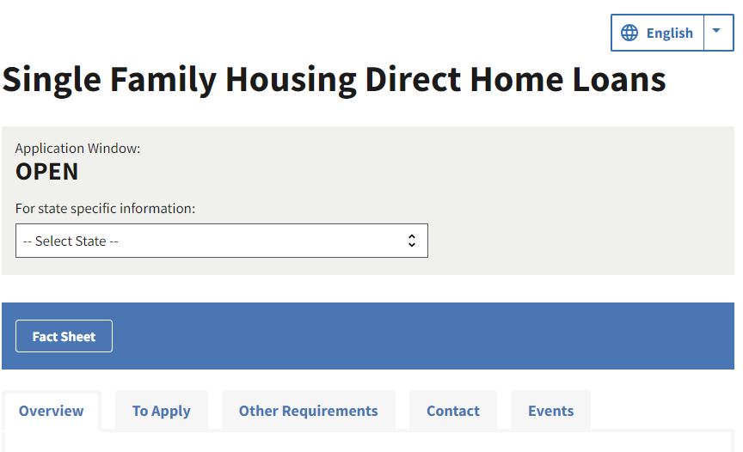
Direct Home Loans
https://www.rd.usda.gov/programs-services/single-family-housing-programs/single-family-housing-direct-home-loans
RD makes direct loan to homebuyers.
Benefits of program:
Fixed low interest rate with subsidy as low as 1%,
Extended payback term (33-38 yrs.),
No down payment required, and
Loans up to 100% of value of home.
Applicants adjusted household income must meet low or very low-income eligibility.
Home must meet property requirements; and
Home must be in eligible rural area.
Notes:
Purpose: The D-SFH program assists low- and very-low-income applicants obtain decent, safe and sanitary housing in eligible rural areas by providing and affordable loan product with payment assistance to increase an applicant’s repayment ability. Payment assistance is a type of subsidy that reduces the mortgage payment for a short time. The amount of assistance is determined by the adjusted family income.
Population limit: Generally 20,000 and some communities were grandfathered into the program and can have a population of up to 35,000.
Loan Term: Most loans are for a 33 year term and the interest rate as of July 2024 is 4.875%.
Payment Assistance: This is a subsidy that is reviewed on a regular basis and can subsize the interest rate down to 1% (Payment assistance recapture possible if home is sole or refinanced)
Low Income: 80% of the County Area Median Income.

Slide 6
USDA Rural Development Single Family Housing Direct Programs
504 Home Repair Loans and Grants

Slide 7
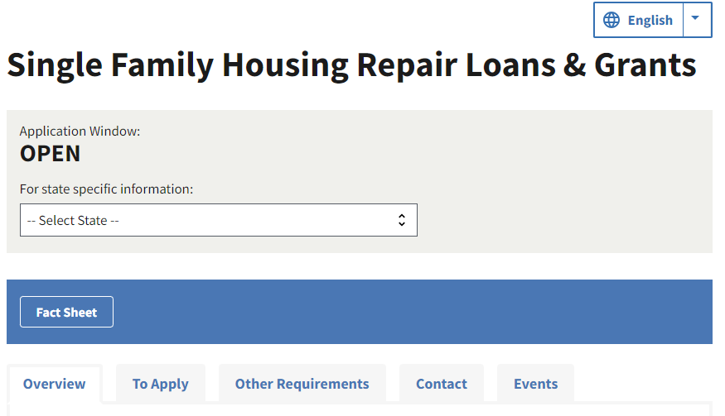
Home Repair Loans & Grants
Loan Program: This program assists very low-income homeowners with a loan to repair, improve or modernize their home.
Loans less than $7,500 secured by note only
1% Fixed, 20 years repayment
Max. Loan $40,000
Grant Program: Grants to individuals (62+) very low-income homeowners to remove health and safety hazards in their home.
Max. Grant: $10,000
https://www.rd.usda.gov/programs-services/single-family-housing-programs/single-family-housing-repair-loans-grants
Notes:
Purpose: The SFH program assists very-low-income applicants obtain funding to repair improve or modernize their homes
Population limit: Must be in an eligible rural area. Generally 20,000 and some communities were grandfather into the program and can have a population of up to 35,000.
Loan Term: 20 year term and the interest rate has always been 1.0%.
Very Low Income: 50% of the County Median Household Income.
Max Loan Amount: $40,000 and maximum grant amount is $10,000 (for grant assistance must be over 62 and improvement need to be for health/safety or accessibility purposes)
Grant Agreement: Grantees need to sign a grant agreement and if the property is sold or transferred in 3 years the grant need to be repaid.
Partnering and fund leveraging – RD works with partners to leverage dollars on a project.

Slide 8
USDA Rural Development Single Family Housing Direct Programs
Housing Preservation Grants

Slide 9
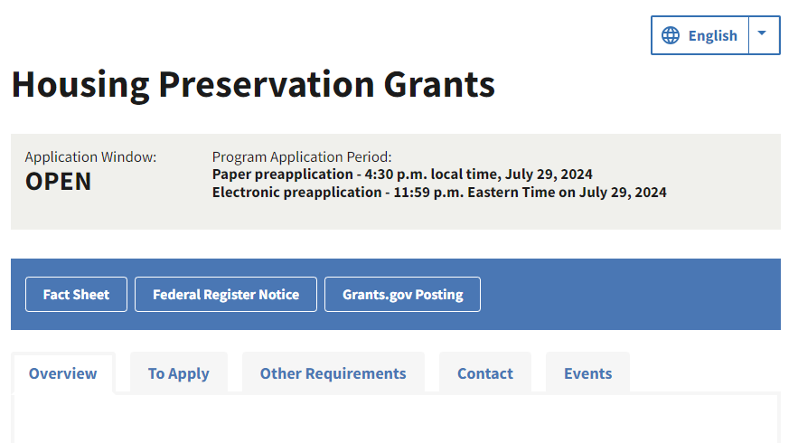
Housing Preservation Grant Program
Grants to eligible organization for the repair or rehabilitation of housing occupied by low and very low-income people.
Up to 20% for authorized administrative costs.
Project must be in eligible rural area.
Applications are accepted on annual basis through a Notice of Funding Availability published in the Federal Register.
Application due by July 29, 2024.
https://www.rd.usda.gov/programs-services/single-family-housing-programs/housing-preservation-grants
Notes:
Provides grants to sponsoring organizations for the repair or rehab of housing owned and occupied by low- and very-low-income rural citizens.
MN typically receives around $200,000 annually.
Federally recognized tribes, nonprofits, and state and local governmental entities are eligible to apply.
Funds may be used to repair owner occupied housing or rental property owners may receive assistance for repairs if units stay available to low- and very-low-income families.

Slide 10
USDA Rural Development Single Family Housing Direct Programs
Site Loans

Slide 11
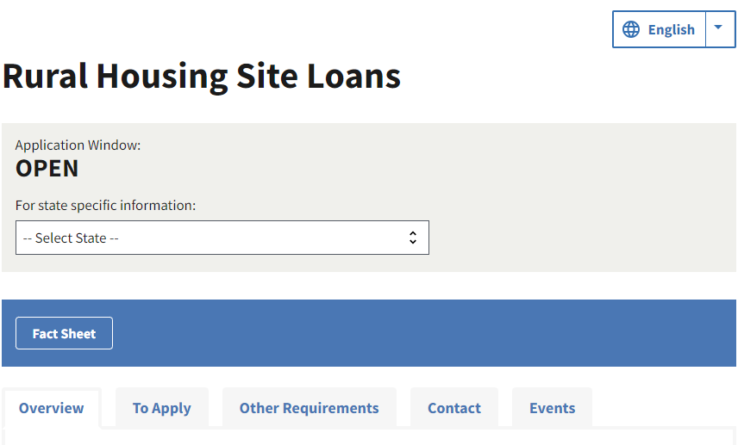
Site Loans
https://www.rd.usda.gov/programs-services/single-family-housing-programs/rural-housing-site-loans
Loans made to acquire and develop sites for low- or moderate-income families.
Loan applicant may be private or public non-profit organization (Including Habitat Affiliates) or a Federally Recognized Indian Tribe.
Benefits: Lower cost of construction and working with one lender that is invested in the success of the project.
Terms:
5-year loans
Section 523 loans: 3% interest rate
Section 524 loans: below-market-rate established and published monthly, fixed at closing
Applications are accepted year-round through state/local offices

Slide 12
USDA Rural Development Single Family Housing Direct Programs
Native CDFI Relending Demonstration Program

Slide 13
Native CDFI Relending Demonstration Program
Purpose
To increase homeownership opportunities for Native American Tribes, Alaska Native Communities, and Native Hawaiian communities in rural areas
Provide capital to NCDFIs- loans made to NCDFIs will be relent to the ultimate recipients (low- and very low-income tribal members, who will live in Indian Country in need of affordable, modest single-family homes)
Terms
33-year loan -initial principal and interest payment deferred for 3 years
1 percent interest rate
Annual payments

Slide 14
Native CDFI Relending Demonstration Program(Cont’d)
Who is eligible to apply?:
Eligible entities for these competitively awarded loans include Certified Native Community Development Financial Institutions (NCDFIs).
How do we define a NCDFI?
Native Community Development Financial Institution. An entity that has been certified as a community development financial institution by the Secretary of the Treasury; that is not less than 50 percent owned or controlled by members of Indian Tribes, Alaska Native communities, or Native Hawaiian communities; and for which not less than 50 percent of the activities of the entity serve Indian Tribes, Alaska Native communities, or Native Hawaiian communities; the term ‘Native Hawaiian’ has the meaning given the term in section 801 of the Native American Housing Assistance and Self-Determination Act of 1996 (25 U.S.C. 4221);
How do I apply?
A Notice of Funding Availability (NOFA) was published in the Federal Register on July 1,2024 to announce the funding availability and the application requirements. Applications are due August 9, 2024.

Slide 15
USDA Rural Development Single Family Housing Guaranteed Programs
Section 502 Program

Slide 16
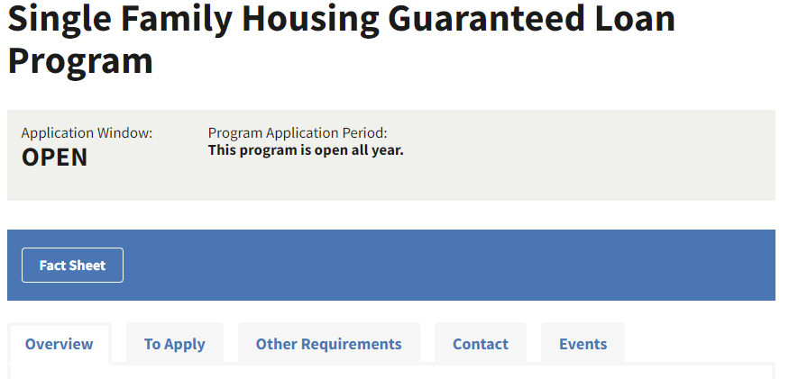
Guaranteed Home Loans
https://www.rd.usda.gov/programs-services/single-family-housing-programs/single-family-housing-guaranteed-loan-program
RD assists approved lenders in providing loans to homebuyers.
Benefits of program:
Backed by RD, the 90% loan note guarantee minimizes lender risk;
Combination Construction-to-Permanent (single close) option is available;
No set maximum purchase price.
Applicants adjusted household income must meet moderate or low- income eligibility.
Home must meet HUD standards; and
Home must be in eligible rural area.
Notes:
The Section 502 Guaranteed Loan Program assists approved lenders in providing low- and moderate-income households the opportunity to own adequate, modest, decent, safe and sanitary dwellings as their primary residence in eligible rural areas. Eligible applicants may purchase, build, rehabilitate, improve or relocate a dwelling in an eligible rural area with 100% financing. The program provides a 90% loan note guarantee to approved lenders in order to reduce the risk of extending 100% loans to eligible rural homebuyers – so no money down for those who qualify!
Eligible buyers can purchase an existing, eligible dwelling, or build new using the USDA Combination Construction-to-Permanent (Single Close) Loan Program.
Applicants agree to occupy the dwelling as their primary residence and properties must be a single family dwelling.
• There is no set maximum purchase price. Loans are based on an applicant’s repayment ability.
There are no set acreage limits, although acreage must be considered common for the area.
• The interest rate is negotiated between the applicant and the lender, and must be a 30-year fixed rate.

Slide 17
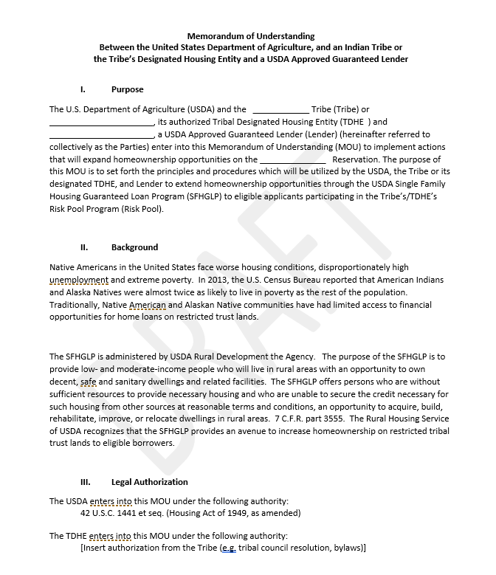

Single Family Housing Guaranteed Loan Program
Memorandum of Understanding (MOU)
First one signed with 1st Tribal Lending. Opens origination and secondary market purchasing through broker relationships.
Offers specified accommodations to the lender regarding default and foreclosure processing.
Not a standardized form – this is open to alterations.
Notes:
Note that our program already allows for lending on Tribal trust land, and therefore we have no need to develop a sperate program. We found a need to make some alterations to the foreclosure process as it has been that concern holding lenders from utilizing our product on reservations.

Slide 18
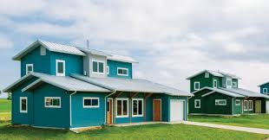
Single Family Housing Guaranteed Loan Program
Pilot Programs for Native Americans
Appraisals – making accommodations for the lack of availability of appraisers with knowledge and experience of trust land property
Repair/Rehab – allows for properties on federally recognized reservations currently owned without liens to utilize the rehabilitation and repair program

Slide 19
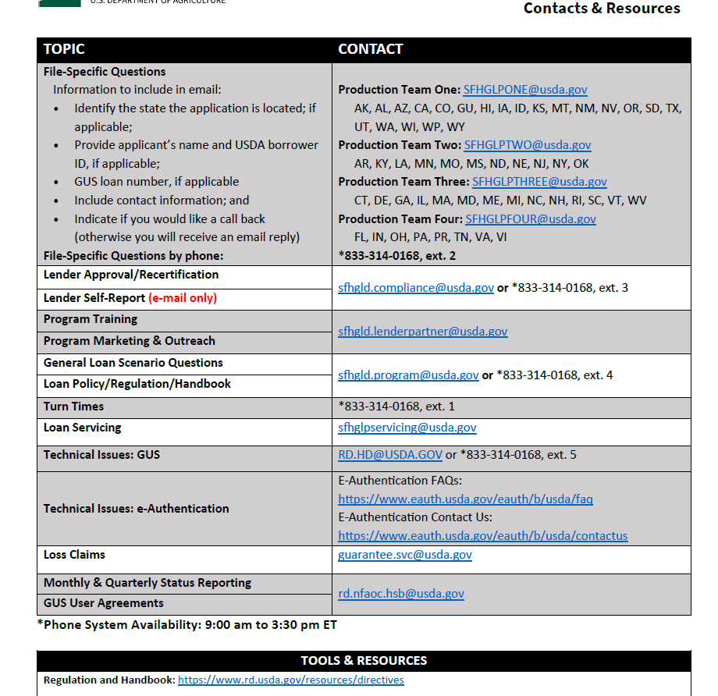
Single Family Housing Guaranteed Loan Program SFH Guaranteed Contacts
For training, marketing, or further information
surrounding our Native American efforts,
please contact the LPA team at:
sfhgld.lenderpartner@usda.gov

Slide 20
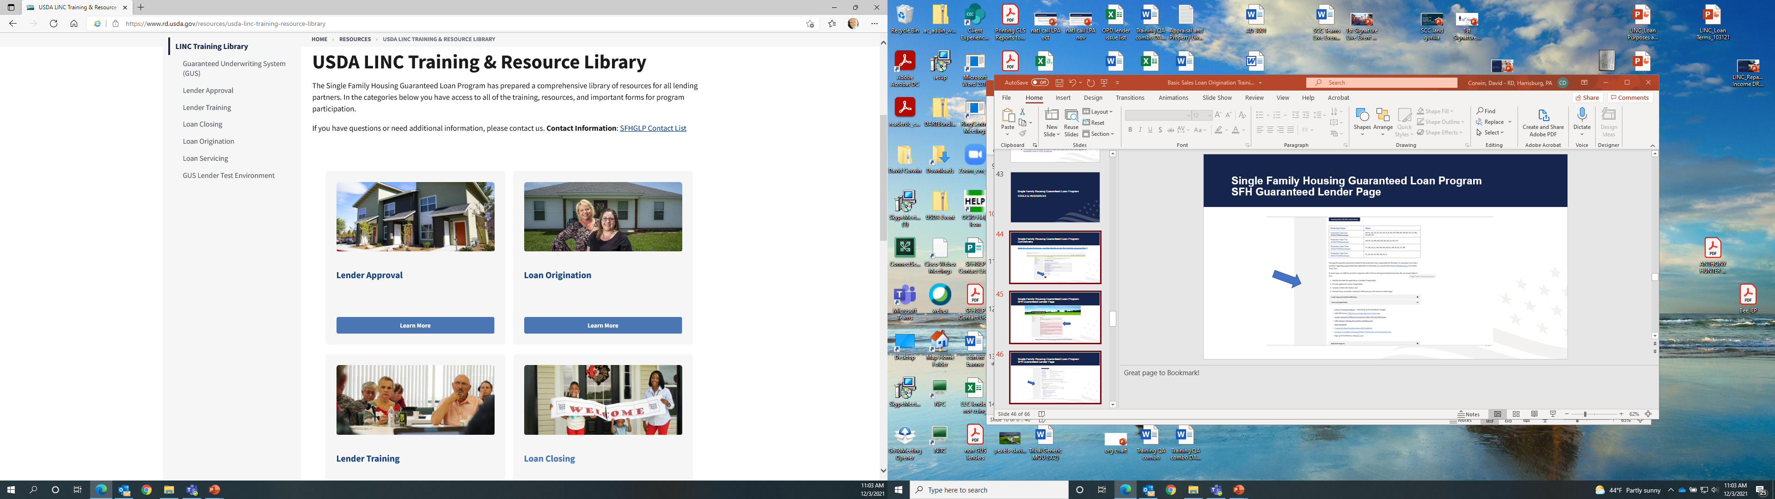
Single Family Housing Guaranteed Loan Program GovDelivery
www.rd.usda.gov/programs-services/lenders/usda-linc-training-resource-library

Slide 21

Single Family Housing Direct Programs Updates
Sign Up for GovDelivery notices to receive email updates on the Single-Family Housing Direct Programs
Using the link below, enter your email and select the “SFH Direct Loan and Grant Programs” (and any other programs of interest) and then click “Submit”
https://public.govdelivery.com/accounts/USDARD/subscriber/new?qsp=USDARD_25
Notes:
Sign up for GovDelivery to receive email updates on the Single Family Housing Direct Programs.
Using the link on this slide, enter your email and select “SFH Direct Loan and Grant Programs” (and any other programs of interest) and then click “Submit”.
This email subscription service is used to provide updates regarding changes to the:
Section 502 program’s interest rate
Handbook-1-3550
Certified packaging process
And much more…

Slide 22
Contact Information
Assistance under USDA Rural Development programs is available to applicants in areas designated as “rural.” Under law, the definition of “rural area” is different for each program.
Contact your local USDA Rural Development office for more information.
Or go to: www.rd.usda.gov/mn
Brian Leyh – Rural Business Specialist
Brian.leyh@usda.gov
763-689-3354, ext. 114
USDA is an equal opportunity provider, employer, and lender.

Slide 23

End
USDA is an equal opportunity provider, employer, and lender.
Notes:
For any questions related to the programs discussed today, please reference the program contacts maps located within your folders.

