Slide 1
Non-Targeted HUD Housing Resources Available to Native Communities

Slide 2
This presentation will cover:
Office of Community Planning and Development Programs
Block Grant Programs
Competitive Grant Program
Rental assistance programs
Mortgage insurance programs
Great Lakes Thriving Communities Technical Assistance Center (Great Lakes TCTAC)
Notes:
I’ll discuss the use of these fund on and off the reservation and how to access them.

Slide 3
Office of Community Planning and Development
Formula Block Grant Programs
Community Development Block Grant Program (CDBG)
Home Investment Partnerships Program (HOME)
Emergency Solutions Grant Program (ESG)
Housing Opportunities for Persons with AIDS (HOPWA)
Competitive Grant Program
Continuum of Care Program (CoC)

Slide 4
Formula Block Grant Funds
These funds are accessed through the cities, states and counties that receive them each year (see handout for Minnesota grantees)
Participants of projects funded through these programs must be low or moderate-income as defined by HUD

Slide 5
CDBG Program
Potential housing-related uses
Homeowner rehabilitation
Downpayment assistance
Housing Counseling
Acquisition of land where housing will be built
Site preparation for new housing construction

Slide 6
Use of CDBG with ICDBG
ICDBG – 1 percent set-aside in the Housing and Community Development Act of 1974, and is distribute through an annual NOFA (versus an annual formula)
May be used jointly on an activity:
The CDBG focus is on benefitting Low- and Moderate-Income persons
Eliminate duplication of benefit – defined scope for each grant
State CDBG must be spent in non-entitlement areas with incidental benefit outside of the area allowed
Tribal Members may benefit if they are considered a resident of the unit of general local government
Prior to using CDBG with ICDBG, it is recommended that you contact your local CPD Office. Here in Minnesota you should contact Marcia Kolb, Minneapolis Field Office Director of Community Planning and Development, at marcia.a.kolb@hud.gov

Slide 7
The HOME Program
HOME funds can be used for
Homeowner rehabilitation
Homebuyer activities: Finance the acquisition, and/or rehabilitation or new construction of homes for homebuyers
Rental Housing: Affordable rental housing may be acquired and/or rehabilitated, or constructed
Tenant-based rental assistance (TBRA): Financial assistance for rent, security deposits and, under certain conditions, utility deposits.

Slide 8
Use of HOME Funds on Reservations
While there is no HOME statutory or regulatory mandate to do so, Participating Jurisdictions (PJs)* may provide HOME program funds to Tribes and tribally designated housing entities.
The PJ would need to impose and enforce a deed restriction on any HOME-assisted property located on tribal lands, as required by statute.
*Participating Jurisdictions are those government entities that receives HOME Program funds

Slide 9
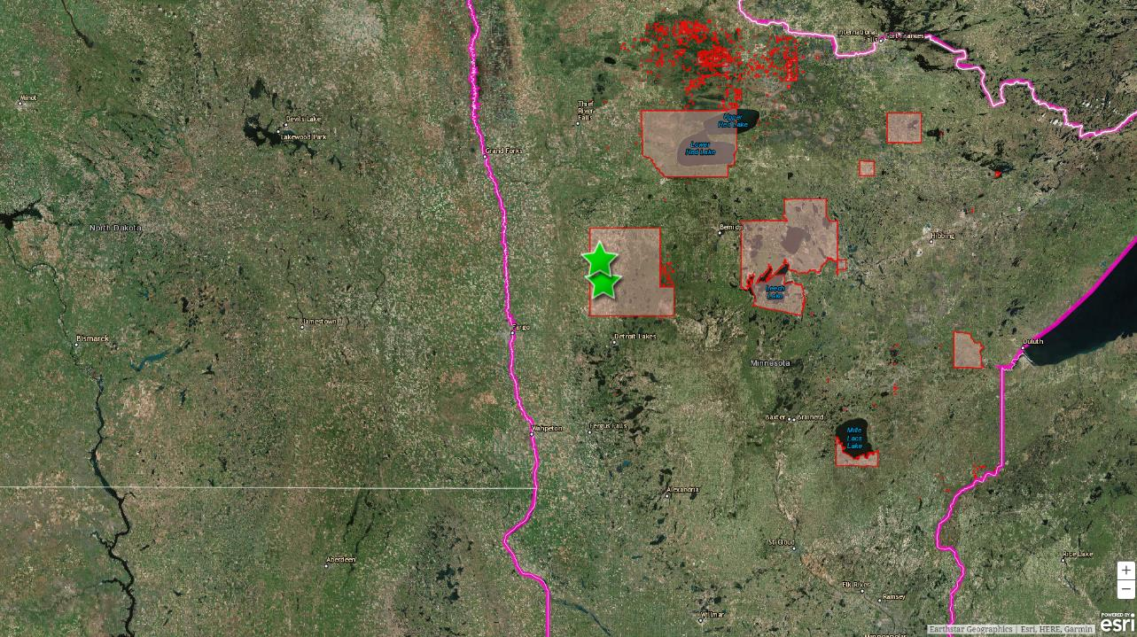

HOME is used on reservations in Minnesota
Two examples can be found on the White Earth reservation in Mahnomen County
Notes:
Ma-nommen

Slide 10
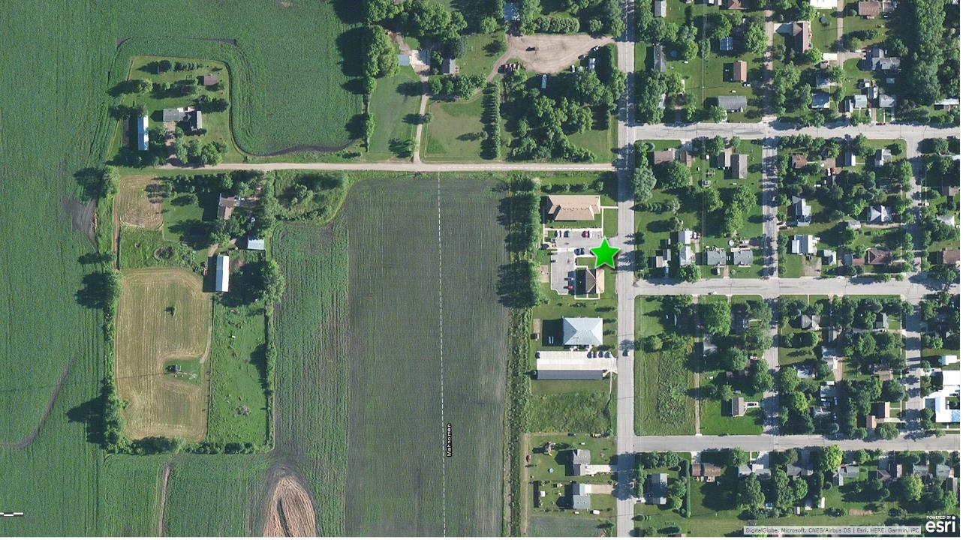
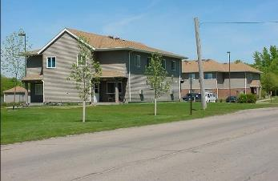
Park Terrace Apartments is located on the White Earth reservation
$164,999 in HOME funding
11 units rehabbed
Completed on October 30, 2007
Park Terrace Apartments in Mahnomen, Minnesota

Slide 11
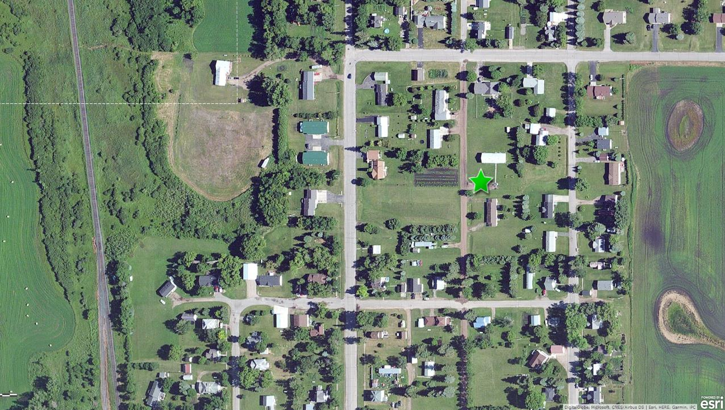
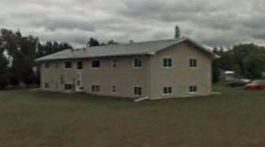
1608 2nd Street in Waubun, Minnesota is on the White Earth reservation
$56,000 in HOME funding
4 units rehabbed
Completed on June 6, 2003
Exterior view of 1608 2nd Street in Waubun, Minnesota
Notes:
Wah-Been

Slide 12
The Emergency Solutions Grant Program (ESG)
ESG funds can be used for:
Outreach to homeless persons on the streets
The renovation or operation of emergency shelters
Homelessness prevention
Rapid rehousing of homeless individuals or families

Slide 13
Use of ESG on Reservations
Funds may be used on reservations
Activity would need to be carried out by a private nonprofit organization
For technical assistance needs, please contact Marlisa Grogan, Special Needs Assistance Specialist, at marlisa.m.grogan@hud.gov
In Minnesota, you should also contact Marcia Kolb, Minneapolis Field Office Director of Community Planning and Development, at marcia.a.kolb@hud.gov

Slide 14
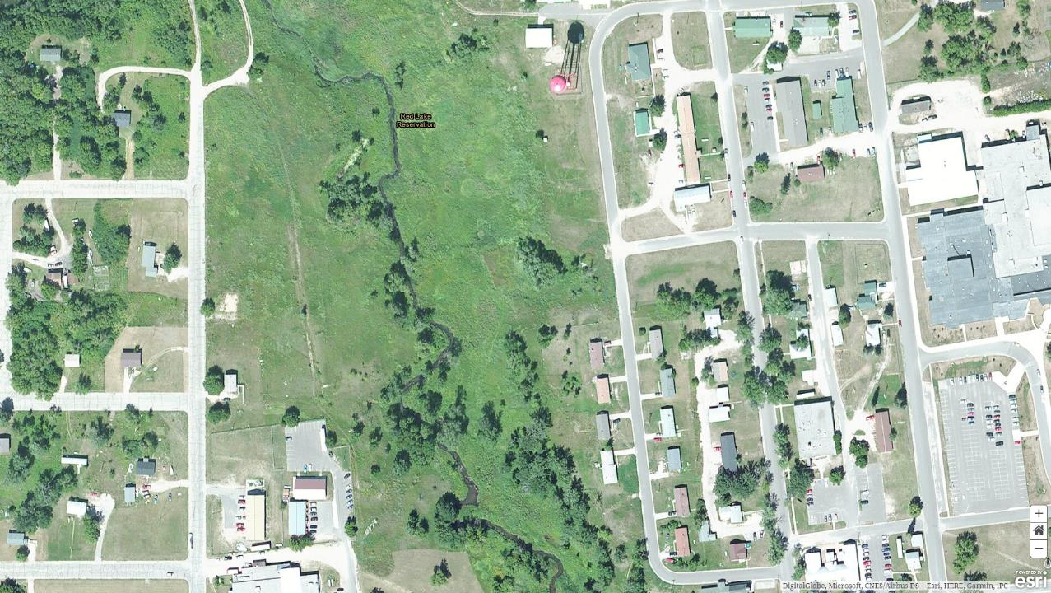

Red Lake Homeless Shelter is on the Red Lake Reservation
The State of Minnesota has provided this shelter ESG funds for many years.

Slide 15
The Housing Opportunities for Persons with AIDS Program (HOPWA)
Funds must be used to assist persons with HIV/AIDS and their families
Eligible uses of funds include:
Acquisition, rehabilitation or new construction of housing units
Housing facility operations
Long-term rental assistance
Short-term rent and utility payments to prevent homelessness
Supportive services such as assessment and case management, substance abuse treatment, mental health treatment, nutritional services, job training and placement assistance, and assistance with daily living

Slide 16
Use of HOPWA on Reservations
Funds may be used on reservations
Activity would need to be carried out by a private nonprofit organization
For technical assistance needs, please contact Rita Flegel, Director of the Office of HIV/AIDS Housing, at rita.h.flegel@hud.gov
In Minnesota, you should also contact Marcia Kolb, Minneapolis Field Office Director of Community Planning and Development, at marcia.a.kolb@hud.gov

Slide 17
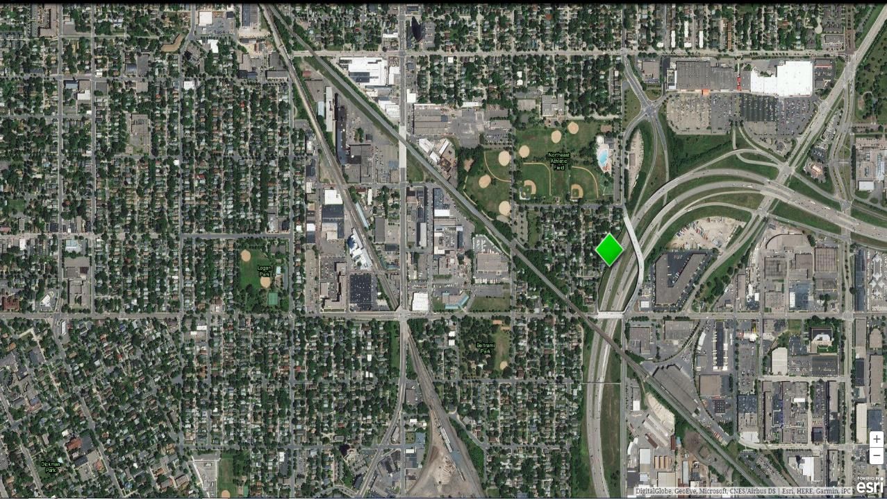
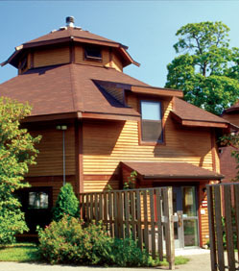
Maynidoowahdak Odena in Minneapolis is managed by Indigenous Peoples Task Force.
The State of MN allocated HOPWA funds to this project that was constructed in 1999.
Maynidoowahdak Odena in Minneapolis
Notes:
MAH nih doo wah dock O-dee-nuh

Slide 18
Continuum of Care Funds
Funds are awarded each year through a competitive process
Eligible applicants are nonprofit organizations and State and local governments
Applicants apply through a “Continuum of Care,” which is a coalition of organizations (nonprofits, government agencies, businesses, etc.) that are working to prevent and eliminate homelessness in a particular geographic area
In Minnesota there are ten Continuum of Care coalitions (see handout for contacts)

Slide 19
Uses of Continuum of Care funds
Funds must be used to serve people who meet HUD’s definition of homeless
Funds can be used for permanent or transitional housing but not for emergency shelter
Eligible uses of funds include acquisition, rehabilitation, new construction, leasing, rental assistance, operation and supportive services.

Slide 20
Use of CoC Funds on Reservations
Funds can be used for projects on reservations
Neither Tribes nor Tribal Housing Authorities are eligible applicants
Private Nonprofit Organizations are eligible to apply, however
Prior to applying for funds an organization should contact Marlisa Grogan, Special Needs Assistance Specialist, at marlisa.m.grogan@hud.gov
In Minnesota, you should also contact Marcia Kolb, Minneapolis Field Office Director of Community Planning and Development, at marcia.a.kolb@hud.gov
Notes:
Marlisa: small TA set-aside to be used to address homelessness in tribal areas. In planning phase. Email her with ideas on types of TA you need

Slide 21
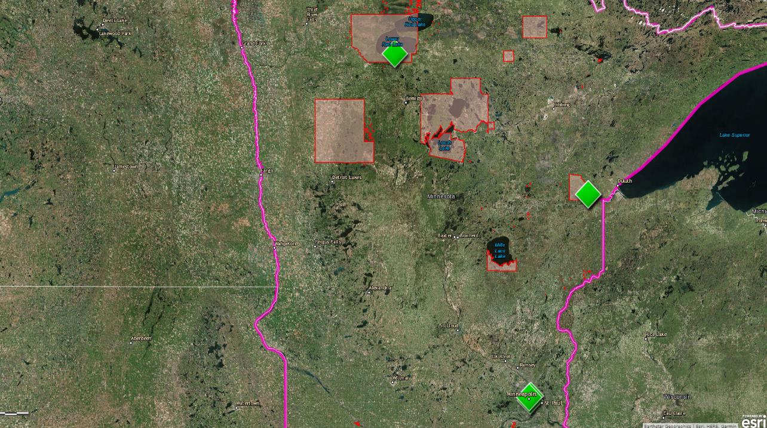
There are several Native homeless projects funded by the HUD Continuum of Care (CoC) program in Minnesota

Slide 22
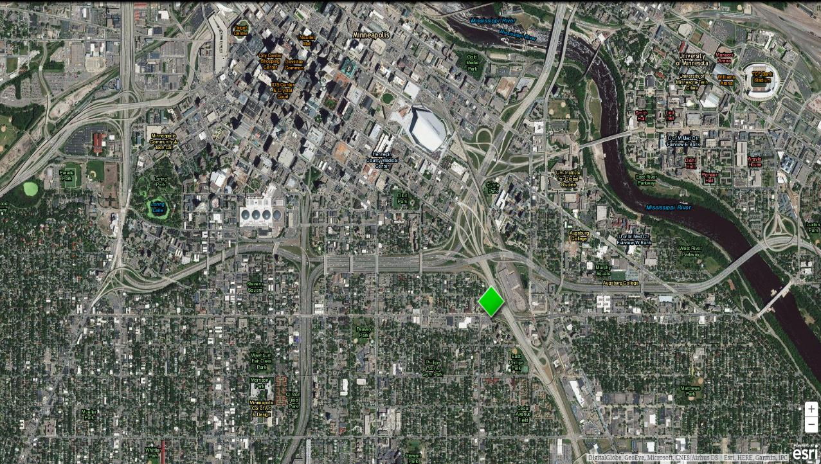
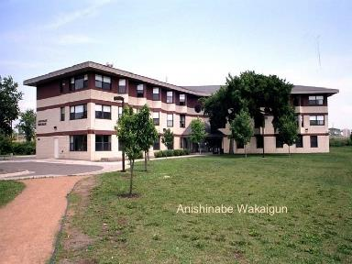
Anishinabe Wakiagun is managed by American Indian Community Development Corporation.
There are 44 units funded through the Continuum of Care program.
Funds were originally used for new construction.
The project continues to receive funding for supportive services.
Anishinabe Wakiagun in Minneapolis

Slide 23
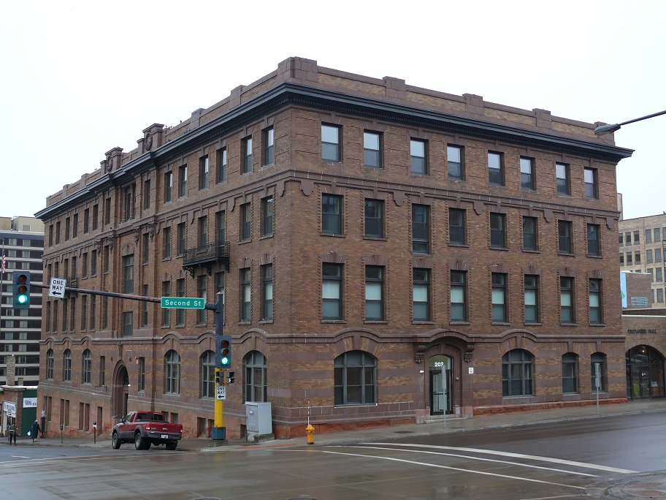
Gimaajii Mino-Bimaadiziyaan, located in Duluth, is managed by American Indian Community Housing Organization.
It has 3 units funded by the HUD Continuum of Care program.
Notes:
Me-No BIH mauhd dee zee yaun

Slide 24
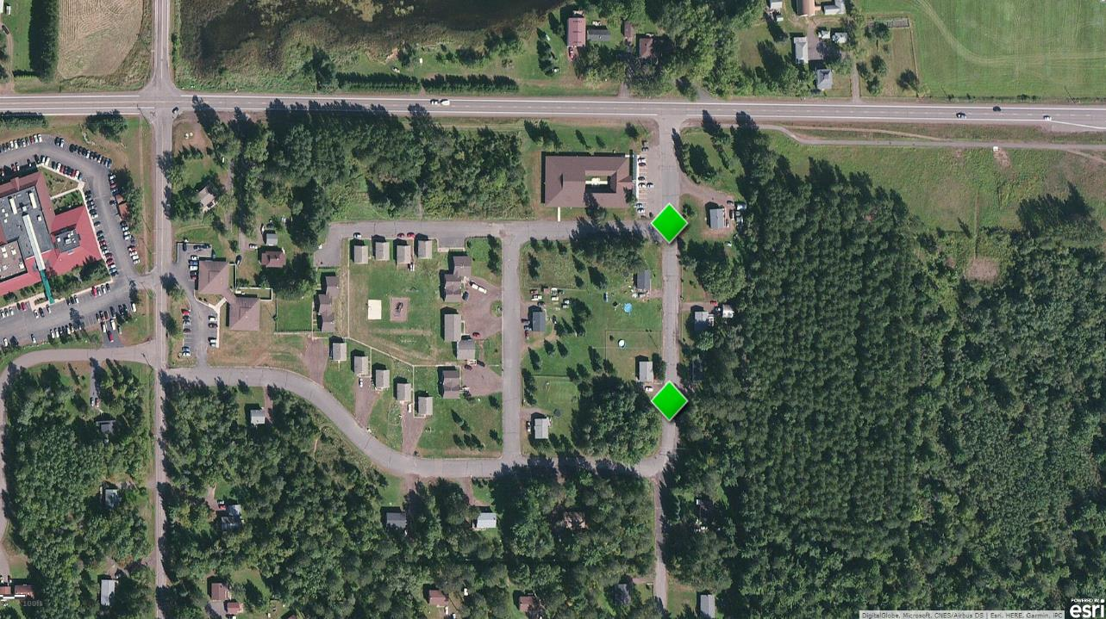
Fond Du Lac Supportive Housing and Fond Du Lac Veterans are managed by American Indian Community Housing Organization.
It has 3 units and 4 units respectively funded by the HUD Continuum of Care program.
Funds were originally used for new construction and the project continues to receive funding for supportive services.

Slide 25
Targeting Community Planning and Development (CPD) Funds
It is possible to use CPD funds (CDBG, HOME, ESG, HOPWA, CoC) for a housing project that targets Natives as long as the project is marketed widely (not just to Natives) and admissions policies do not discriminate against a “protected class” (race, color, national origin, sex, familial status, religion, disability). To ensure compliance with fair housing rules, it is best to contact HUD for technical assistance prior to investing funds in this type of project.

Slide 26
HUD Rental Assistance Programs
Public Housing
Project-Based Section 8 Housing
Section 8 Housing Choice Vouchers
HUD-VASH (Veterans Administration Supportive Housing)

Slide 27
Public Housing
Building-based rental assistance for low-income people
Buildings are owned and managed by a Public Housing Authority (PHA)
Applications are made through the local PHA
Some units are reserved for seniors or people with disabilities
In most cases tenants pay 30% of household adjusted income
Waiting lists can be long or closed
Notes:
HUD is not funding new Public Housing buildings

Slide 28
Project-Based Section 8 Housing
Building-based rental assistance for low-income people
Buildings are privately owned and managed
Applications are made at the individual buildings
Some units are reserved for seniors or people with disabilities
In most cases tenants pay 30% of household adjusted income
Waiting lists can be long or closed
Notes:
There is no new Project-based Section 8 available

Slide 29
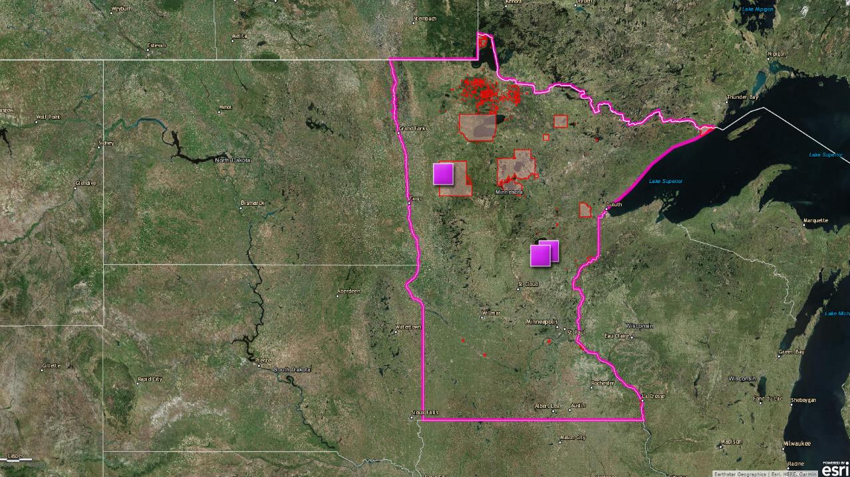
Project-Based Section 8 is used at several locations on reservations in Minnesota
Valley View Commons Mahnomen, MN (White Earth Reservation)
Oakwood Apartments Onamia, MN (Mille Lacs Reservation)
Isle View Apartments Isle, MN (Mille Lacs Reservation)

Slide 30
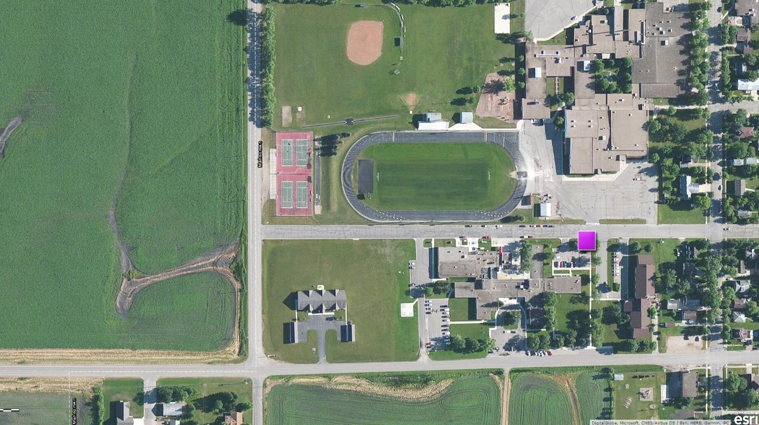
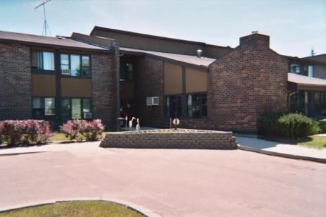
Valley View Commons is located on the White Earth Reservation
32 HUD assisted units
39% of residents are Native
76% of residents are elderly
Valley View Commons in Mahnomen, Minnesota

Slide 31
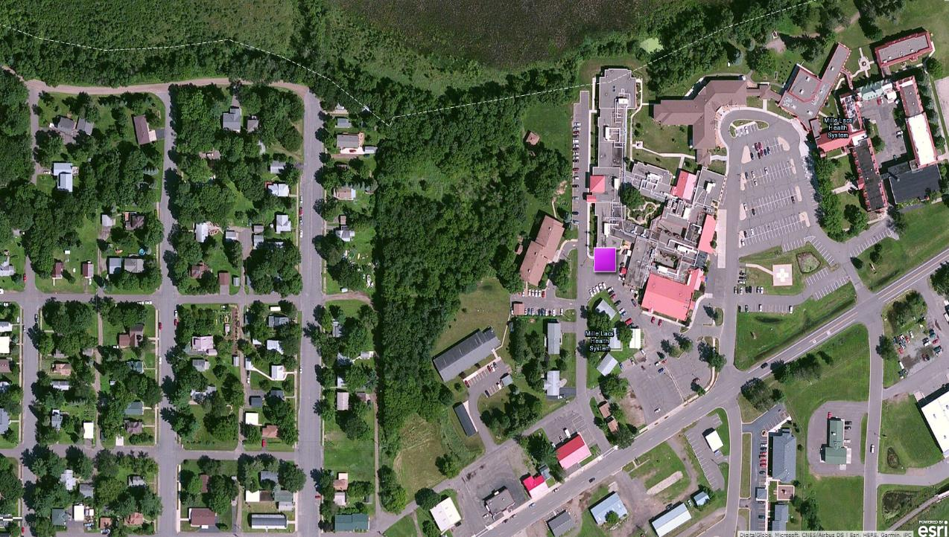
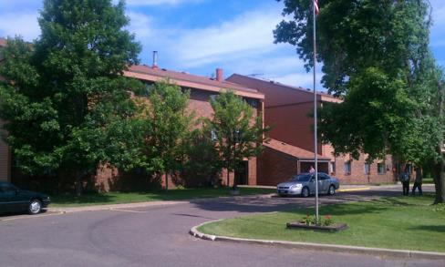
Oakwood Apartments is located on the Mille Lacs Reservation
33 HUD assisted units
27 total residents
59% of residents are elderly
Oakwood Apartments in Onamia, MN

Slide 32
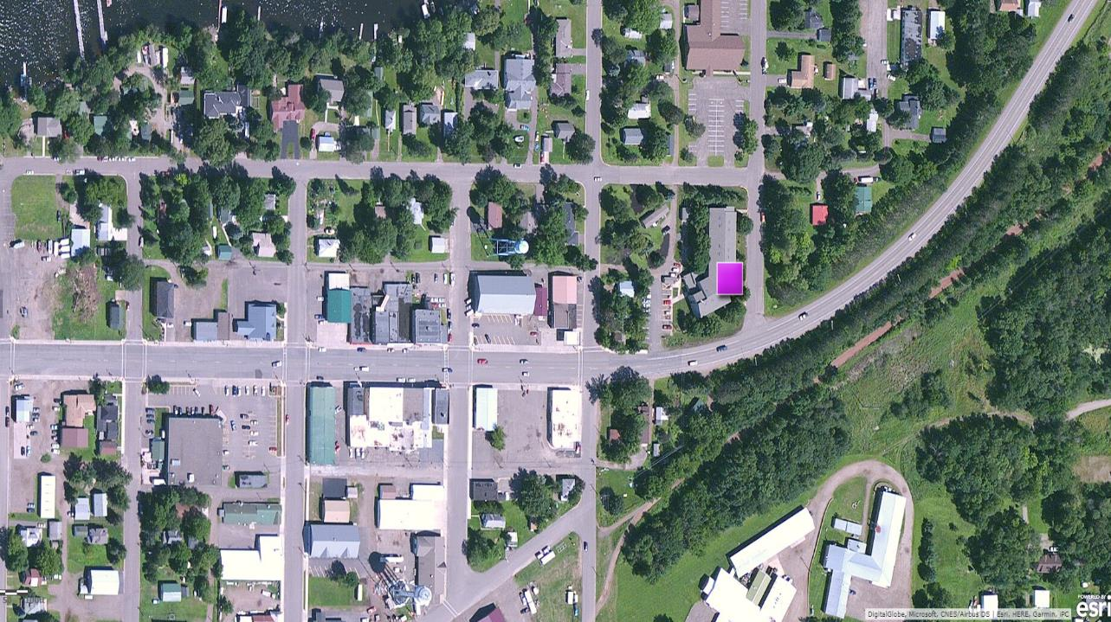
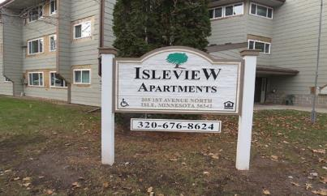
Isle View Apartments is located on the Mille Lacs Reservation
41 HUD assisted units
34 total residents
71% of residents are elderly
Isle View Apartments in Isle, MN

Slide 33
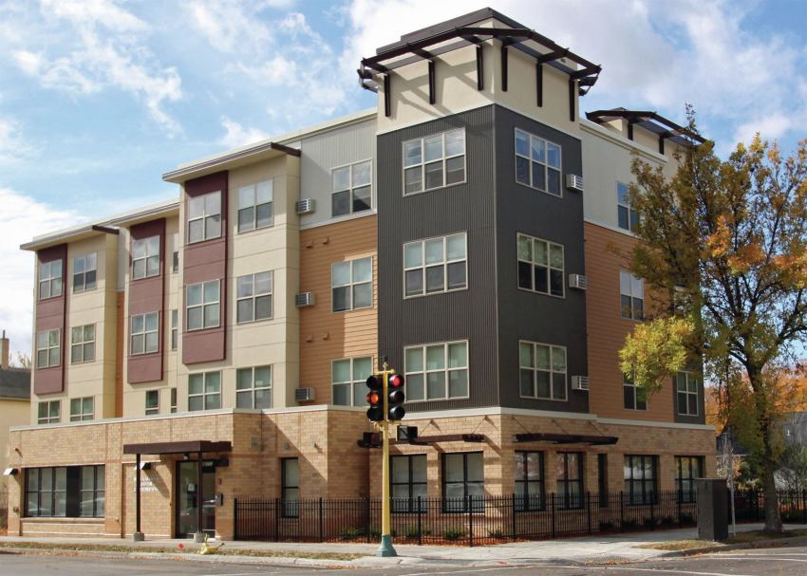
Bii Di Gain Dash Anwebi ("Come in. Rest." in Ojibwe) Elder Housing in Minneapolis
47 one-bedroom units
Senior only housing focusing on the Native community
Notes:
BEE dee gain dash awn weebi

Slide 34
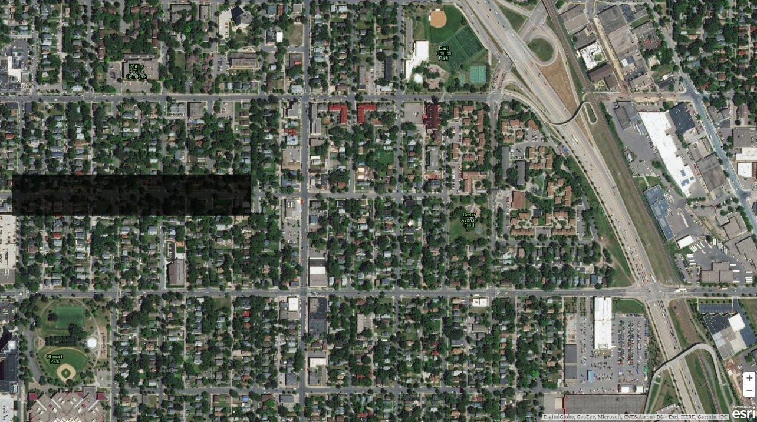
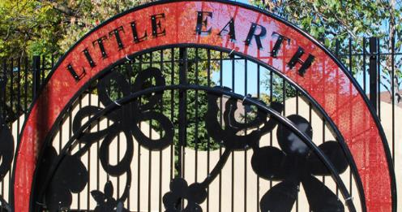
Little Earth of United Tribes
Located just south of downtown Minneapolis
Only property in the country with a Native preference that receives project-based Section 8
78 apartments
134 townhome units
Area contains among the highest concentration of urban Natives in the country

Slide 35
Section 8 Housing Choice Vouchers
Tenant-based rental assistance for low-income people
Tenant finds their own unit in a private building
Applications for the assistance are made at a local PHA
Rents are 30% to 40% of household adjusted income
Waiting lists can be long or closed
Vouchers can expire if you can’t find a unit within the established “shopping period”

Slide 36
Use of Section 8 Housing Choice Vouchers on Reservations
A tenant can use a Housing Choice Voucher to rent a unit on a reservation as long as that units is not Public Housing or “Indian Housing” (any housing funded through NAHASDA).

Slide 37
VASH Vouchers
Tenant-based rental assistance for people who are Veterans and are experiencing homelessness
Combines Section 8 Housing Choice Voucher (HCV) with case management and clinical services provided by the Department of Veterans Affairs (VA)
VA provides services at VA medical centers (VAMCs) and community-based outreach clinics
Applications are made through the local VA Homeless Program

Slide 38
Mortgage Insurance Programs
Rental and Cooperative Housing - Section 221(d)(4)
Residential Care Facilities Program - Section 232 and Section 232/223(f)
Notes:
Created under the National Housing Act . Provide mortgage insurance on loans made by FHA-approved lenders.

Slide 39
Rental and Cooperative Housing - Section 221(d)(4)
Insures lenders against loss on mortgage defaults
Mortgages are for the new construction or substantial rehabilitation of multifamily rental or cooperative housing
Eligible structures are detached, semidetached, row, walkup, or elevator-type rental or cooperative housing containing five or more units
Loans must be made through a HUD-approved MAP lender: https://www.hud.gov/sites/documents/APRVLEND.PDF
Notes:
It is through these lenders that you would get technical assistance. Multifamily Accelerated Processing (MAP)

Slide 40
Residential Care Facilities Program- Section 232 and Section 232/223(f)
Insures lenders against loss on mortgage defaults
Mortgages are for the purchase, refinance, new construction or substantial rehabilitation of a facility
Examples of “residential care facilities” are assisted living facilities, nursing homes, intermediate care facilities, and board and care homes
Loans must be made through a HUD-approved lender: https://www.hud.gov/sites/documents/APRVLEND.PDF

Slide 41
Use of FHA Financing on Reservations
There is no prohibition of using FHA financing for projects on reservations
Tribal entities would be eligible to borrow
Contact a HUD-approved lender for more information

Slide 42

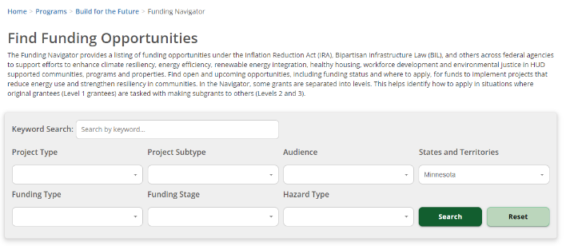

Build for the Future Funding Navigator
Filter and search for funding opportunities for your community.
Website Link
Notes:
https://www.hudexchange.info/programs/build-for-the-future/funding-navigator/
The Funding Navigator provides a listing of funding opportunities under the Inflation Reduction Act (IRA), Bipartisan Infrastructure Law (BIL), and others across federal agencies to support efforts to enhance climate resiliency, energy efficiency, renewable energy integration, healthy housing, workforce development and environmental justice in HUD supported communities, programs and properties. Find open and upcoming opportunities, including funding status and where to apply, for funds to implement projects that reduce energy use and strengthen resiliency in communities. In the Navigator, some grants are separated into levels. This helps identify how to apply in situations where original grantees (Level 1 grantees) are tasked with making subgrants to others (Levels 2 and 3).

Slide 43
Great Lakes Environmental Justice Thriving Communities Technical Assistance Center (Great Lakes TCTAC)
The Great Lakes TCTAC provides information on current federal funding opportunities, helps to navigate which opportunities match your needs, and offers guidance throughout the application process.
Sometimes, they can offer additional support by partnering with community organizations on concept development and planning, engineering consultation, GIS mapping, or post-award grant management.
Learn more about their services
If you are interested in receiving support from the Great Lakes TCTAC, please fill out this short intake form.
Email Great Lakes TCTAC Program Manager Sara Rummel at rummel@umn.edu with any questions.
Notes:
The mission of the Great Lakes Environmental Justice Thriving Communities Technical Assistance Center (Great Lakes TCTAC) is to support community organizations successfully navigate funding opportunities for climate and environmental projects from proposal concept to grant implementation. They help organizations that are leading community driven solutions in the clean energy transition, environmental health, climate resilience, and workforce development find and apply for the funding they need. They serve communities that have been disproportionately burdened by environmental hazards and historically have not had the resources to apply for environmental, climate or energy related grants.

Slide 44
For questions about this presentation….
….feel free to contact me.
Joel Manske
Acting Field Office Director, Minneapolis HUD
joel.manske@hud.gov
(612) 370-3000

