Slide 1
Building Community Through Collaboration
Leah Hall, Community Development Director

Slide 2
Our Mission Statement
MHP expands housing and community development opportunity for those most impacted by economic and racial disparities by leading collaborative work to promote systems change and grow equitable development capacity.

Slide 3
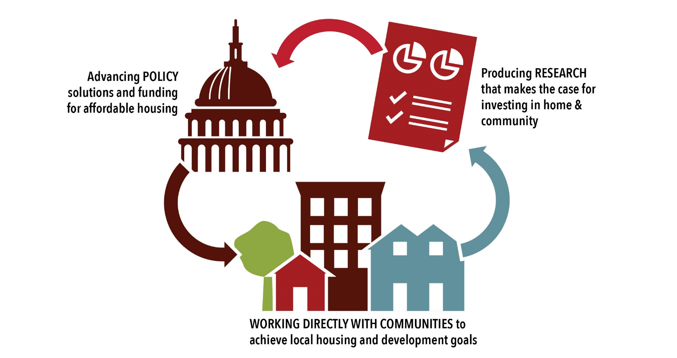
MHP Areas of Focus Research/Policy/Community Development

Slide 4
Community Development Assistance
MHP’s Capacity Building team staff have variety of backgrounds in community development & technical assistance may include:
Creation of housing projects and programs
Capital projects or supportive housing programs as examples
Organizational development and capacity building
Applying for funding (federal, state, foundation, etc.) & Compliance
Acquiring USDA RD515 housing projects (assistance & $10k predev)
And more…tailored workplans to fit what is wanted
Applications are now being accepted on a pipeline basis! (new funding starting fall 2024)

Slide 5
Technical Assistance Engagements
MHP has partnered with many Native Nations over the years including:
Red Lake, White Earth, and Leech Lake, Grand Portage, Mille Lacs, Boise Forte Reservations, MN
Lac du Flambeau, Mole Lake, and Menominee Reservations, WI (via nonprofit Northwoods NiiJii)
Pine Ridge Reservation, SD (via nonprofit Thunder Valley CDC)
Pawhuska Indian Village, Osage Nation, OK
Rosebud Indian Reservation, SD
International Sonoran Desert Alliance, Ajo, AZ (Colonia bordering Tohono O'odham reservation)
Spokane Tribe of Indians, WA
Jemez Pueblo, NM
Yankton Sioux Tribe, SD
Lower Sioux Indian Community
Leech Lake Community Planning Department

Slide 6
Overview of HUD PRICE Grant MHP Application June, 2024.
Preservation and Reinvestment Initiative for Community Enhancement (PRICE) Competition
U.S. Congress authorized 2023 and 2024 funding for HUD to issue the PRICE competition to preserve long-term housing affordability for residents of manufactured housing
Primarily benefiting low/moderate income residents (80% AMI)
$235 million total is available for competitive grants nationwide

Slide 7
MHP Proposal Purpose
Originally MHP was not certain it had a role with PRICE….
Approached by Northcountry Cooperative Foundation (NCF) to apply
MHP is currently a HUD grantee, uses DRGR (HUD reporting system) & has systems already set up for HUD compliance monitoring/project management
PRICE funds will be challenging to administer & a large request makes would be competitive = Regional Approach
Some Native Nations might be interested – MN-based conversations to start
Developed a 2 prong approach: NCF = Parks & MHP = Scattered Sites…

Slide 8
Brief Summary of the Need
Manufactured housing is a source of homeownership opportunity for many low/modest income households across the nation & within the Midwest Region.
Particularly true for residents from Native Nations and people of color
The Midwest (especially MN) has among the worst racial homeownership disparities in the United States
There are very limited options for comprehensive rehab

Slide 9
DREAM Initiative Objectives (Naming top 2)
Serve low/modest income households; improve quality of living conditions
Preserve manufactured housing and repair infrastructure
(MHP) Serve Native Nations by assisting with the administrative burden & add to capacity where it is wanted (tailor)
Increase opportunities for smaller-sized Housing Authorities/Tribal Governments to secure funds = 20-30 rehabs over 3+ years
Support local staff positions = local project managers (build capacity?)
Process payments/contractor draws, provide forms, provide HUD (CDBG-style) compliance support/other as needed

Slide 10
PRICE Application Overview
MHP and Northcountry Cooperative Foundation (NCF) requested $39,904,000 from HUD under the 2023-2024 PRICE Main competition.
$10,000,000 of this will specifically serve Native Nations.
If awarded, MHP and NCF will support projects benefitting manufactured home communities in Minnesota and Wisconsin and residents of Native Nations within Minnesota, Wisconsin, North Dakota and South Dakota via:
The D.R.E.A.M. Initiative
(Driving Resilience, Equity, and Affordability
through Manufactured Housing)

Slide 11
DREAM Initiative Activities
DREAM Tribal Rehabilitation ($10M): create collaborative programs with MHP to distribute owner-occupied manufactured home rehabilitation grants.
MHP will collaborate to co-create a Request for Proposal Process
Our estimate is that 5-7 locations/Nations can be selected as partners
Each Nation can hire a local Project Manager funded by PRICE (outreach, implementation)
Estimated up to $75,000 per unit in rehab funds and infrastructure repairs (20+ rehabs) with a timeline estimate of 3 years to complete activities (close out year 4).
Funds can also rehab manufactured housing owned by the Tribal Government and offered as low-income rental housing.
MHP’s role will be in the background as admin support/payment processing/compliance, etc.

Slide 12
Timeline
Grant submitted in June 2024
We hope that HUD will announce awards by October 2024
If MHP is successful, by fall/early winter, MHP will design the Request for Proposals with advisory partners
Initial RFP selection in first year of grant (2025)
Projects will be wrapped up by end of year four (technically PRICE has a 6-year grant period, but we hope to wrap up in 4)

Slide 13
A few final notes…
MHP wanted to also offer replacement for units older than 1976, but the cost was extreme & triggered other challenges
A thoughtful RFP design will be crucial to success = we will be reaching out for partners to do this
Are there other ways MHP can act as a vehicle for applying for large/collaborative funding pools? ….and/or
Are there opportunities MHP can offer to boost capacity for other organizations to apply for large funding pools like PRICE?

Slide 14
Questions? Please connect with MHP! Website: mhponline.org Twitter:@followMHP facebook.com/mnhousingpartnership
leah.hall@mhponline.org
Ph: 218-410-0122

