Slide 1


Community Investment & Diversity, Equity, & Inclusion
2024

Slide 2

The Federal Home Loan Bank System
FHLBank Overview
Chartered by Congress in the 1930’s to bolster homeownership
11 districts across the US
Each Bank is a member cooperative that provides liquidity to its members to support their housing and community lending activities
Regulated by the Federal Housing Finance Agency
Significant contributors to affordable housing and economic development initiatives across the nation
BOSTON
CHICAGO
NEW YORK
SAN FRANCISCO
DES MOINES
PITTSBURGH
TOPEKA
CINCINNATI
INDIANAPOLIS
ATLANTA
DALLAS
*Members include banks, thrifts, credit unions and insurance companies
Notes:
*Our membership includes over 650 financial institutions (commercial banks, cdfi’s, credit unions, insurance companies, etc)
We recognize that not everyone here falls into the Wisconsin category so I will have additional contact information at the end for some of our neighboring banks that cover Michigan, Indiana, Iowa and Minnesota.

Slide 3
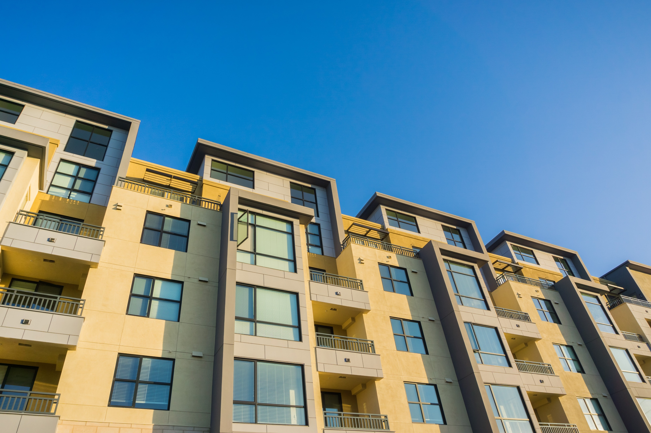

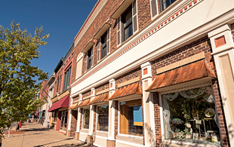

Community Investment Programs
Affordable Housing Program (AHP) General Fund
Downpayment Plus® (DPP®) Programs
Community Advances
Community First® Programs

Slide 4
10%
of prior year’s net earnings
Housing Grant Programs
In 2023:
DPP®
$35.6M allocated (35% plus additional funding)
3,500+ grant reservations
AHP
$33M allocated
44 awarded projects
Notes:
*update to include 2024 numbers
*10% is requirement for all banks and we go above (no need to differentiate)
*

Slide 5
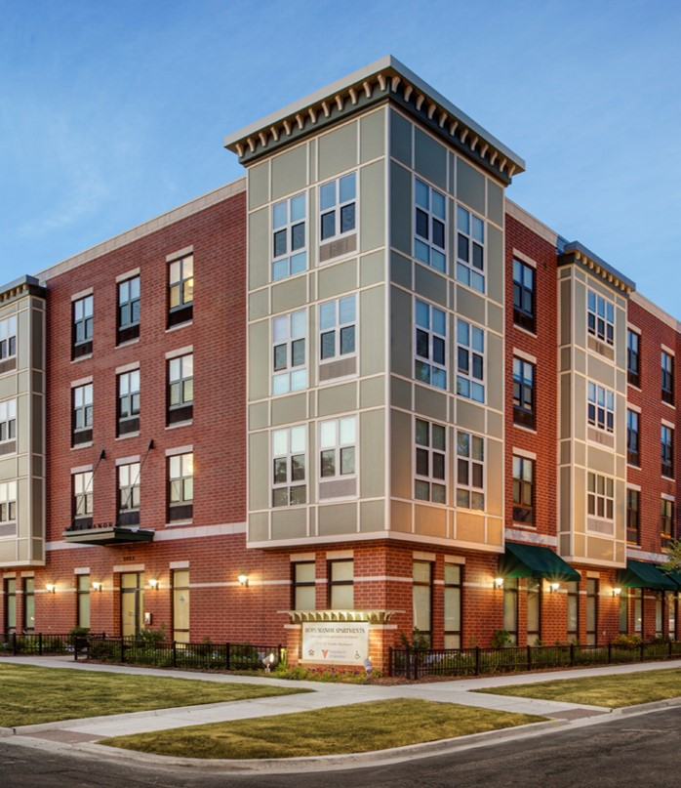
Affordable Housing Program (AHP) General Fund
Forgivable grants for purchase, construction, or rehabilitation of affordable multifamily or owner-occupied housing units
Member partners with community organizations, developers, or public entities to submit an application
Applications receive up to a maximum of $2,000,000 in AHP funds (new increase in 2024), based on assessed score and financial feasibility review
Photo Credit: Darris Lee Harris

Slide 6
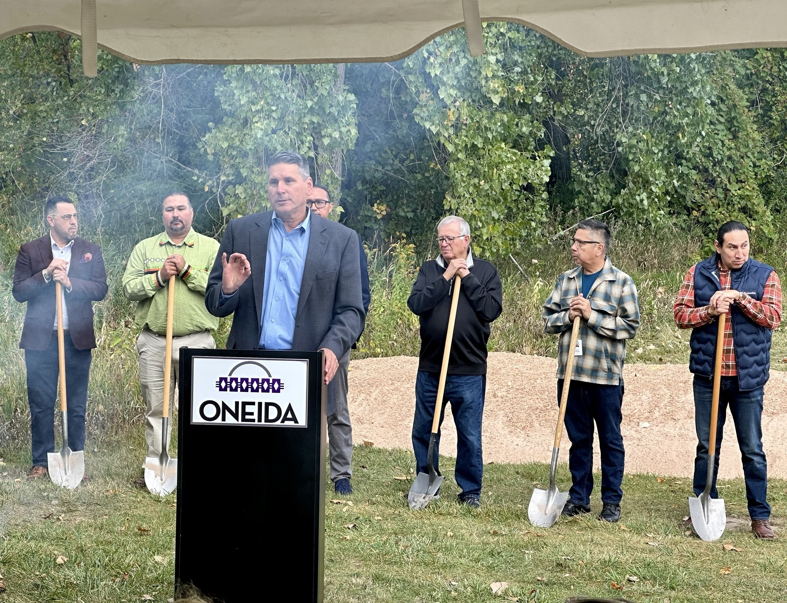
AHP Example: Red Willow Flats
Last fall, housing partners came together for the groundbreaking ceremony of Red Willow Flats on the Oneida Nation Reservation in Oneida, Wisconsin, marking a significant step in affordable housing solutions for tribal communities in our district. This transformative affordable housing project, bolstered by a $700,000 Affordable Housing Program (AHP) grant from FHLBank Chicago, sponsored by our member Bay Bank, highlights the power of collaboration in community development.
Red Willow Flats
Photos courtesy of Wisconsin Housing Preservation Corp & Liz Smith
Notes:
*make into bullets

Slide 7
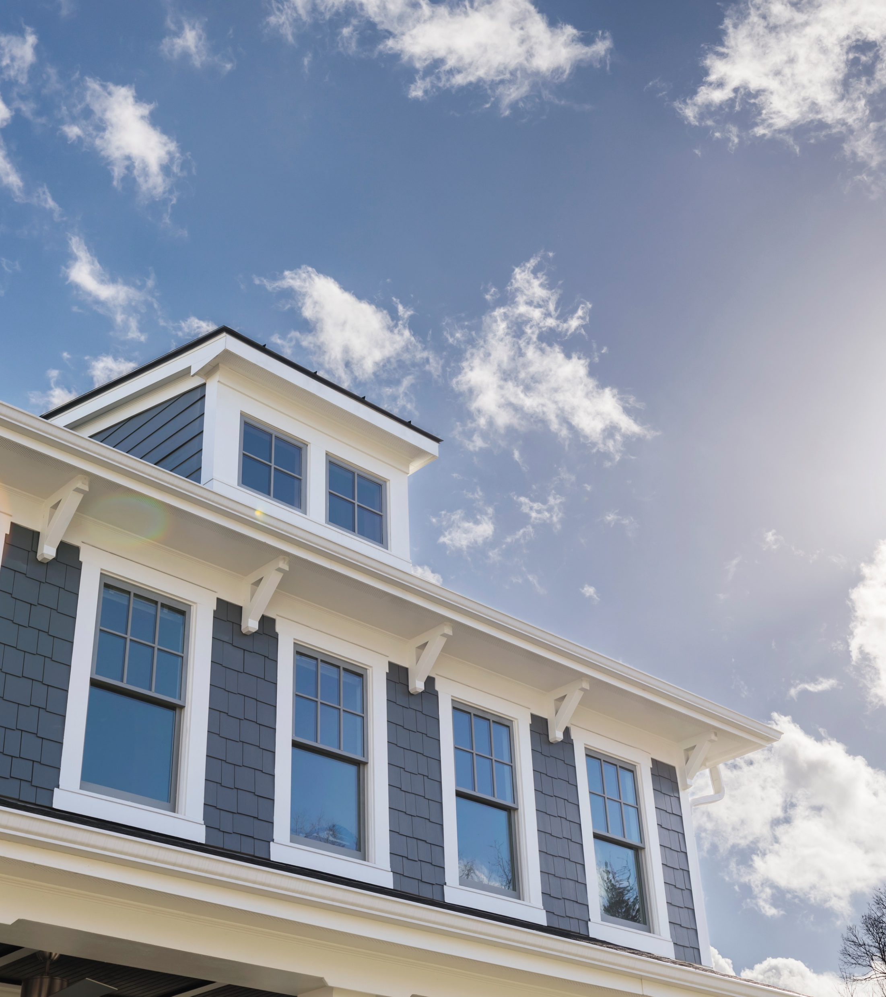
Downpayment Plus® (DPP)® Program
Forgivable grants to purchase a home for households at or below 80% AMI; not limited to first-time homebuyers
Member funds or originates the first mortgage
Non-competitive, up to $700,000 per member
2024 maximum grant/homebuyer: $10,000
Grant is forgiven monthly over 60 months (5 years); repayment rarely required
Grant is secured by a retention agreement
Downpayment Plus Advantage® (DPP Advantage®): Non-profit organization funds the first mortgage; FHLBank Chicago member submits grant reservation
Notes:
*highlight last bullet
*non-profit orgs that do lending can access this through members

Slide 8
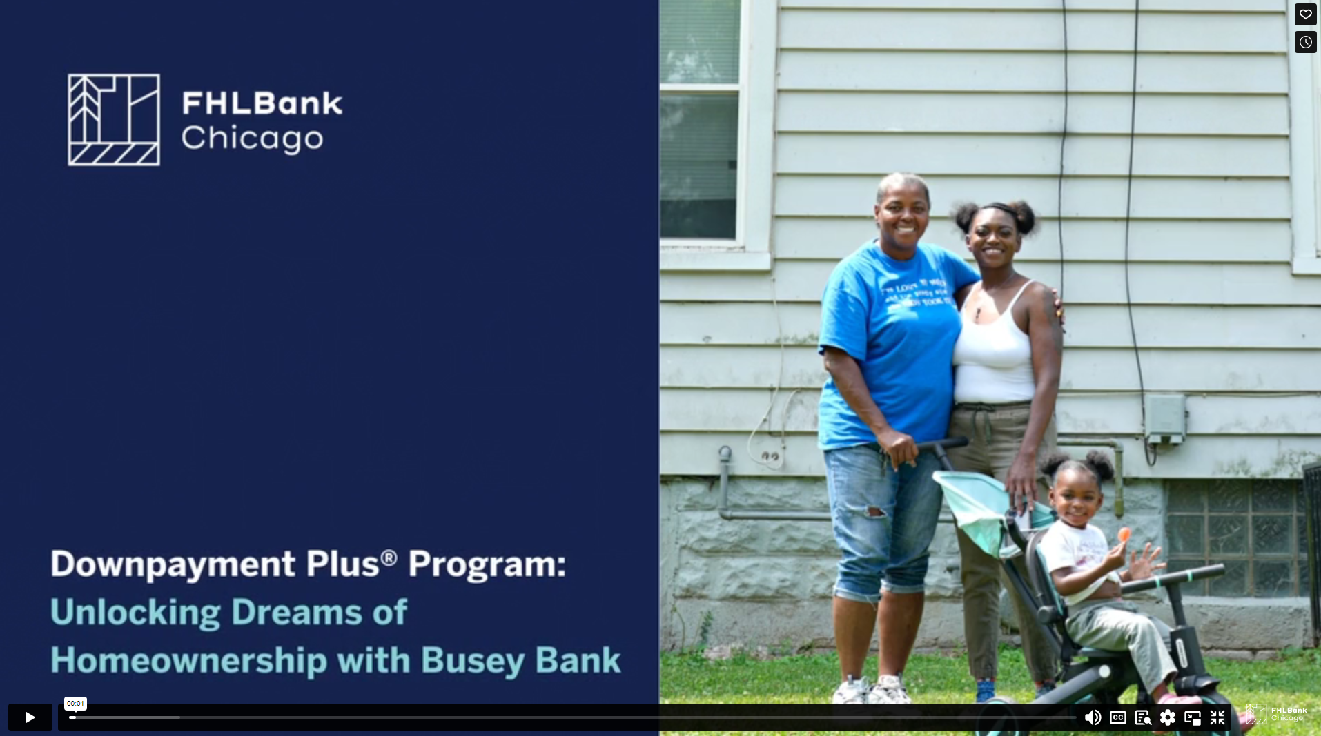
DPP Example
https://vimeo.com/901238176/0034a36983
Notes:
Purchased using $10,000 DPP grant
FHLBank Chicago Member: Busey Bank

Slide 9
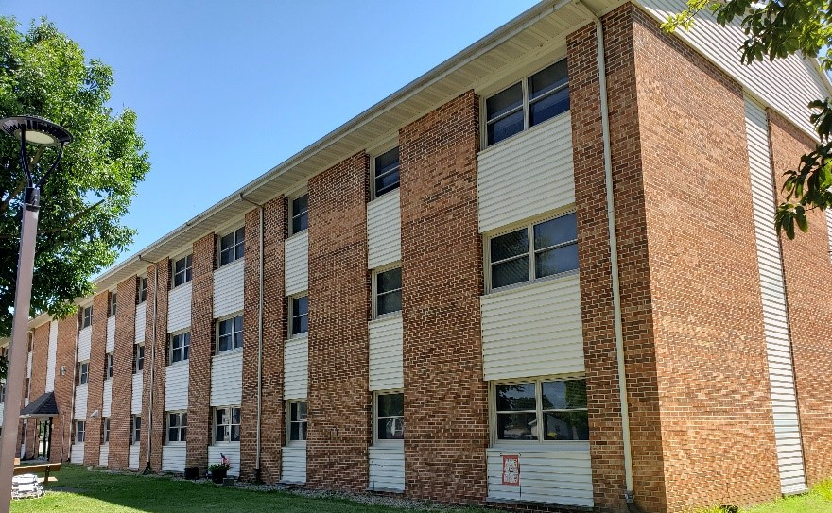
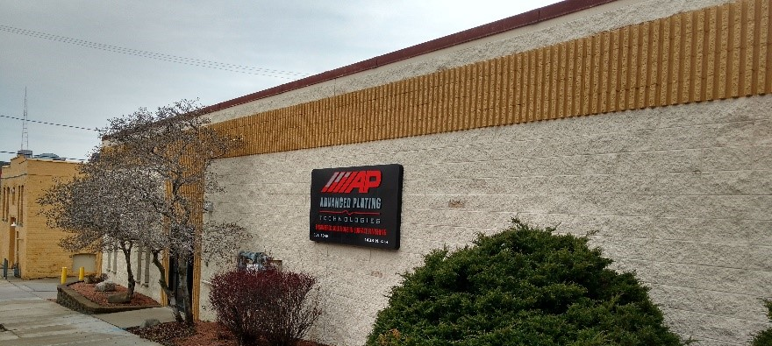
Community Advances
Discounted loans to our members, including 0% for eligible small business lending
Can support members’ existing lending activity:
Housing
Commercial
Small Business
Qualifying loans must have originated 90 days prior to drawdown of advance
Photo Credit: Effingham County Housing Authority
Photo Credit: Darris Lee Harris
Photo Credit: Impact Seven, Inc.
Notes:
*Advances = discounted loans
*include a visual: member can make a low-cost loan to the member → member can leverage it (everyone wins)

Slide 10
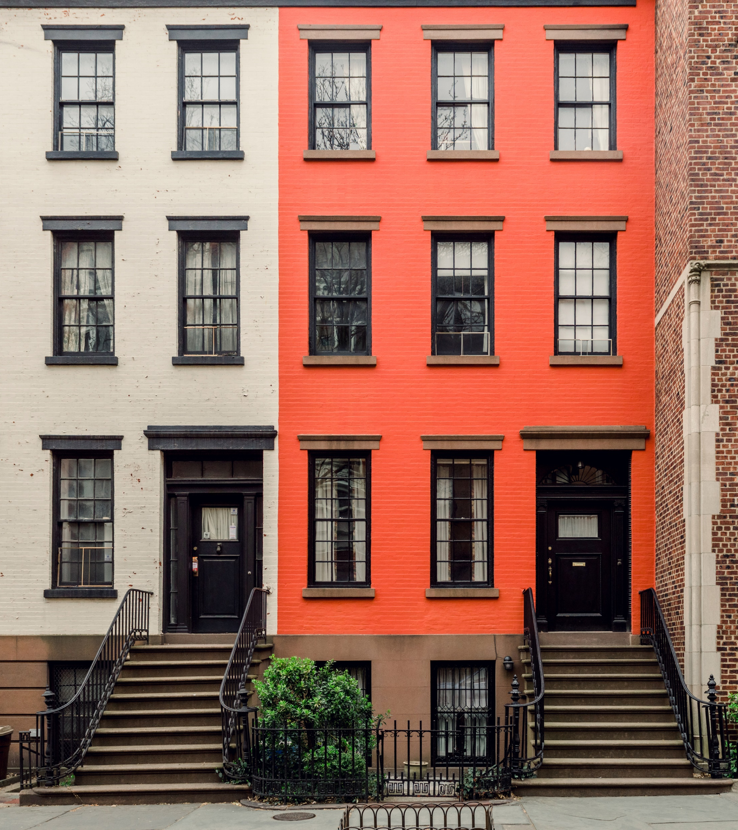
Community First® Diverse Developer Initiative
Grant funding for career and talent development initiatives that support diverse developers of affordable housing in Illinois and Wisconsin
Organizations apply in partnership with an FHLBank Chicago member
2024 Funding Track: TBA
Required impact reporting post-award

Slide 11

DDI Example
https://vimeo.com/941072816/909017e402
Notes:
Purchased using $10,000 DPP grant
FHLBank Chicago Member: Busey Bank

Slide 12

Community First® Housing Counseling Resource Program
Grants to housing counseling agencies to facilitate expanded services to underserved households
Program Administrators: Illinois Housing Development Authority (IHDA) and the Wisconsin Housing and Economic Development Authority (WHEDA)
21 agencies awarded in IL
9 agencies awarded in WI
Creating a pipeline of homebuyers in the market for FHLBank Chicago members and possible utilization of DPP

Slide 13
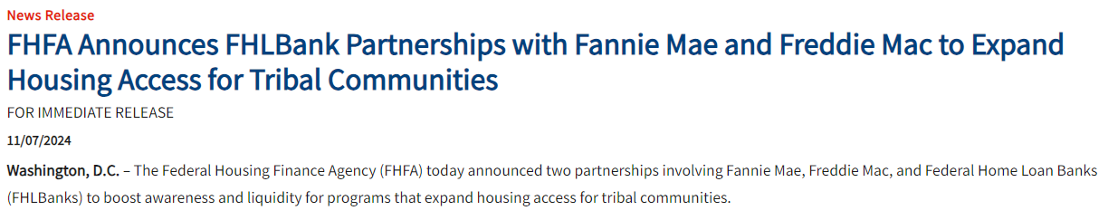
Notes:
FHLBank of Chicago — 11/7/24 - Through its Native American Conventional Lending Initiative, Fannie Mae will purchase loans originated through the MPF program that are provided to Native American borrowers and secured by tribal land trusts.
FHFA Announces FHLBank Partnerships with Fannie Mae and Freddie Mac to Expand Housing Access for Tribal Communities

Slide 14
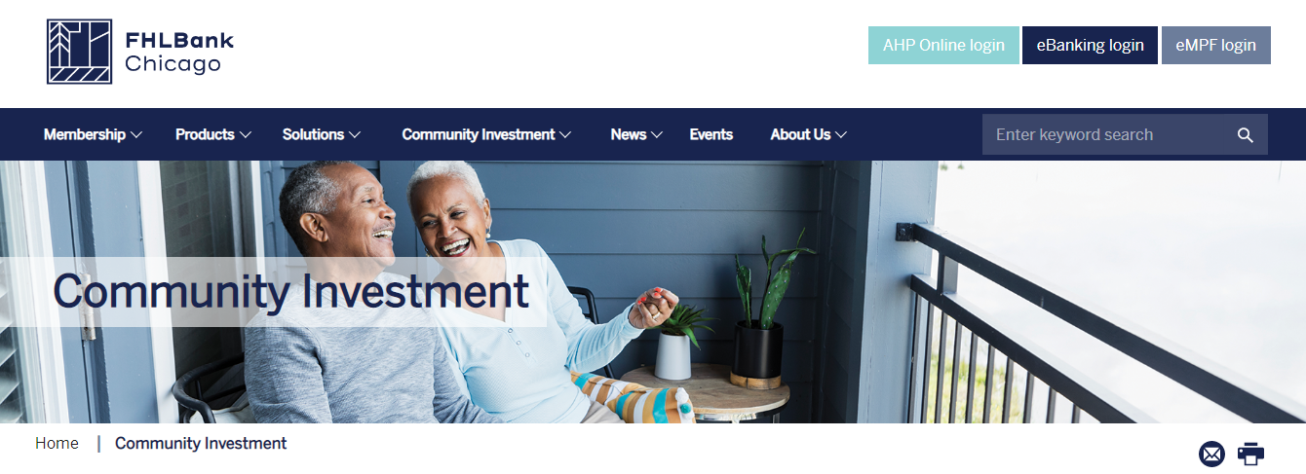
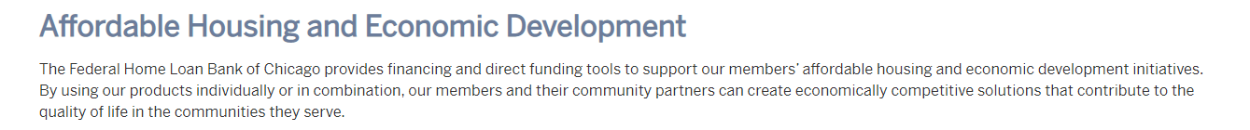
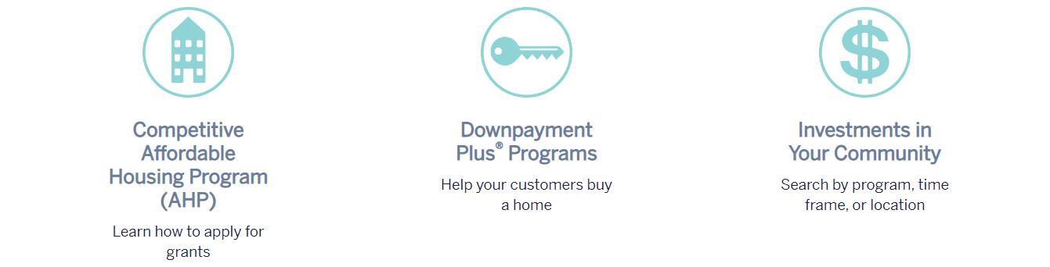
https://fhlbc.com/community-investment
Notes:
Include information on products that other banks with Great Lake states provide

Slide 15
Contact Information
Jess Grant-Domond (she/her)
Senior Community Outreach & Engagement Specialist
FHLBank Chicago
Email: jgrantdomond@fhlbc.com
Phone: 708-990-8372

Slide 16
Contact Information
Affordable Housing Program
Phone: 312-565-5824, Option 2 and 3
Email: ci@fhlbc.com
Downpayment Plus® (DPP®) Program
Phone: 312-565-5824, Option 1
Email: dpp@fhlbc.com
Community Lending and Community First® Programs
Phone: 312-565-5824, Option 4
Email: cica@fhlbc.com (Community Advances) or
ci@fhlbc.com (Community First)

