Slide 1


US Census Bureau and Great Lakes Indian Housing Association (GLIHA)
November 20, 2024
Marilyn A. Sanders, Chicago Regional Director
Bernadece Boda, MS/MPA
Tribal Relations Specialist/LTBB Odawa Citizen
U.S. Census Bureau
Bernadece.A.Boda@census.gov
301-466-5073

Slide 2
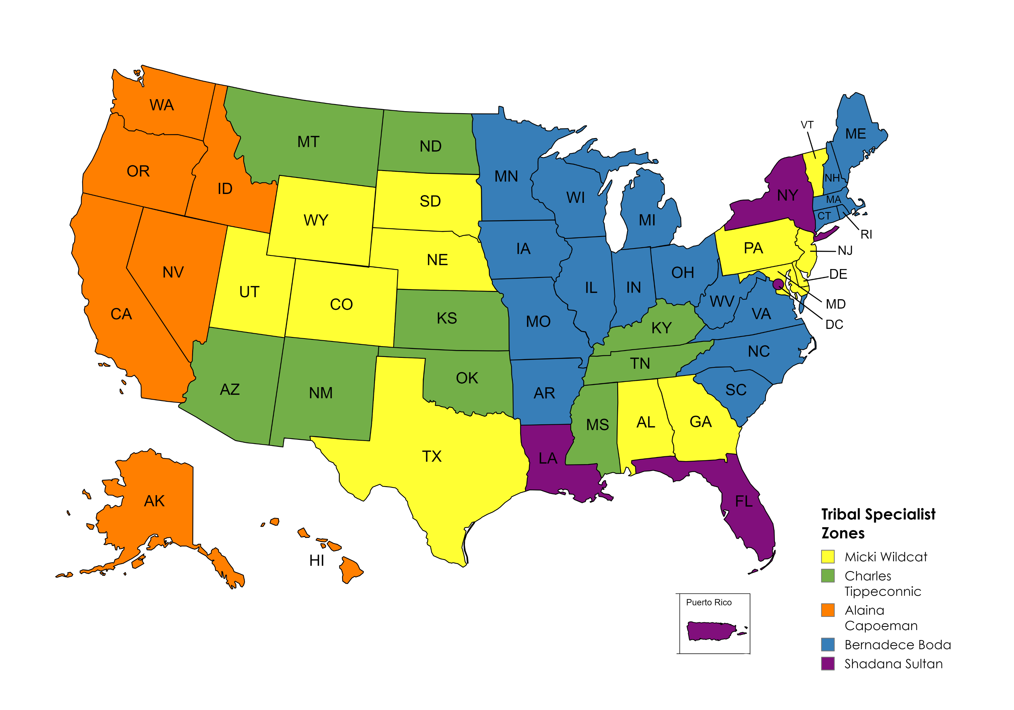

Tribal Relations Program Overview
- Tribal Data Tabulation
- Engage Partners
- Updates and resources for ongoing surveys
- Surveys & Upcoming 2030 Census
- Geographic Programs
- Cultural Awareness and Engagement
- Field and other Directorates

Slide 3

Why Census Data?
  …In addition to its use in fair voting representation, census data play a key role in the fair distribution of billions of dollars to tribes and AI/AN people across the nation. Federal funding for Indian schools, Indian education programs, Indian health programs, Indian housing programs, water and sewage projects, roads, and economic development are distributed based on data collected by the Census Bureau….
National Congress of American Indians website

Slide 4
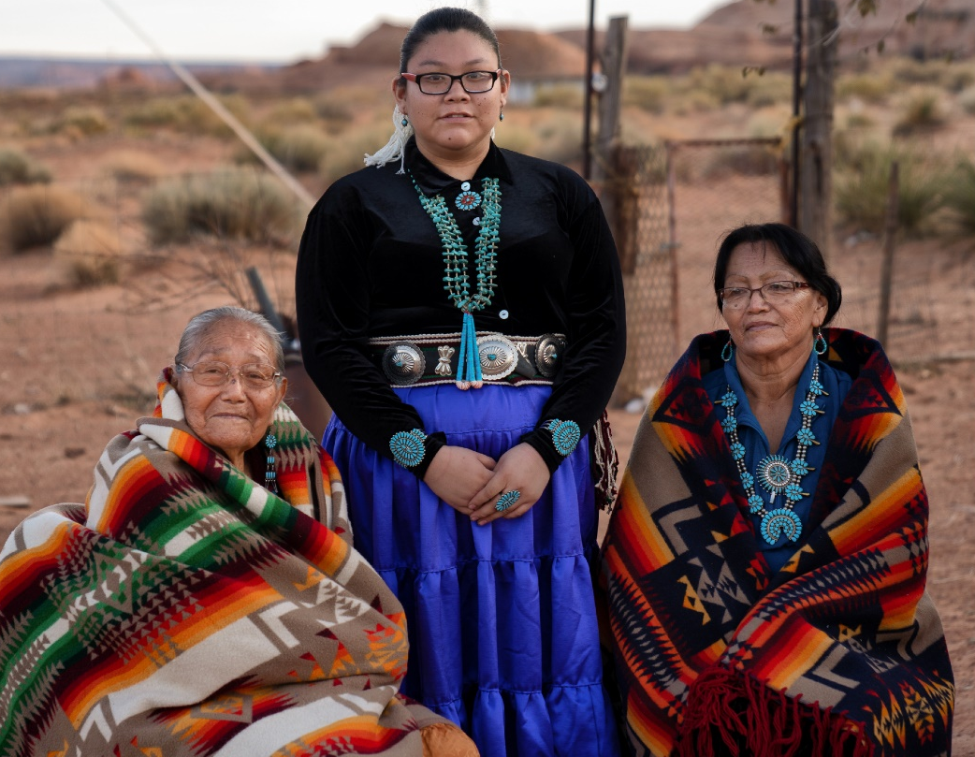
Tribal Data Tabulation
Geography
Where people live, not Enrollment.
Tribal Land and Urban counts
Race/Ethnicity
Self-identification
AIAN Category

Slide 5
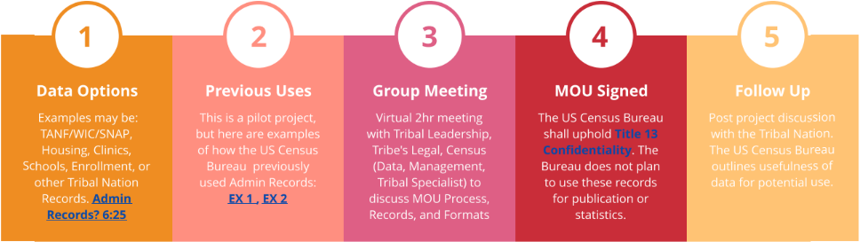
Administrative Records Pilot Project
  The Census Bureau Would Like to explore data (admin) records that Tribal Nations may provide to close gaps or improve data coverage for their Tribal Nation. The data is intended for use with 2030 Census planning, not ongoing surveys. Currently, we use administrative Records from agencies like IRS, IHS, etc.
The Tribal Nation does not have to create a special data set; just supply what's already available. Is there a certain time of year when the records are most up to date? The US Census Bureau thanks you in advance for consideration of this valuable partnership

Slide 6
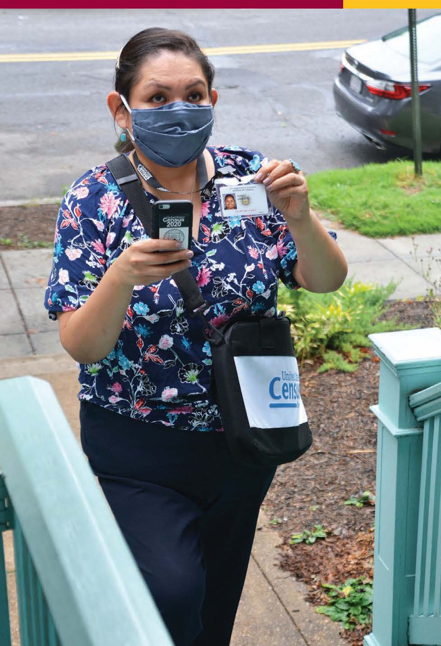
Surveys
130+ Surveys each year
Decennial
Post Enumeration Survey (PES)
Access/permissions
American Community Survey (ACS)
Household Pulse Survey
Current Population Survey
Economic Survey (Business Focus)
https://www.census.gov/programs-surveys/surveys-programs.html

Slide 7
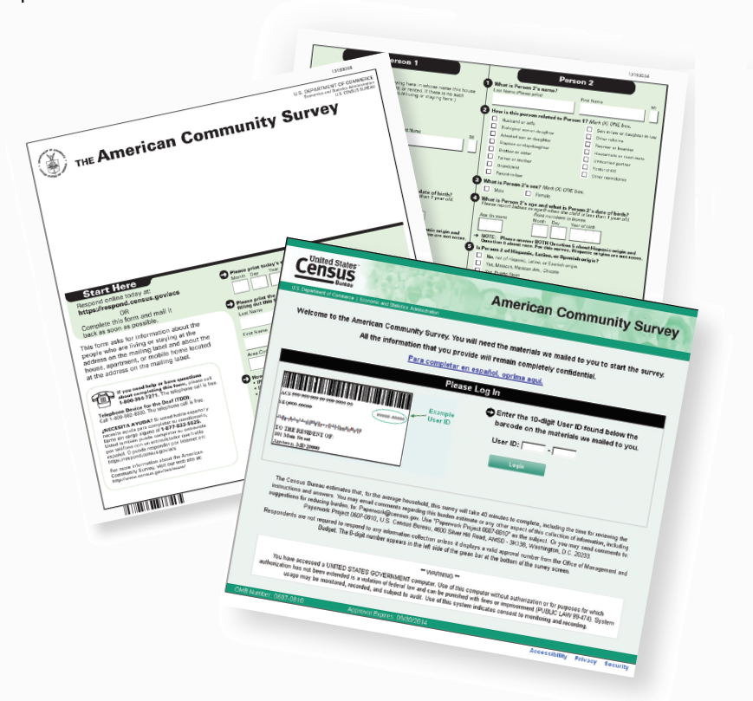
American Community Survey (ACS)
Features
3.5 million addresses
$675 billion Federal Spending
40 topics
300+ evidence-based Federal government uses
11 billion estimates each year
Three key annual data releases:
- 1-year Estimates (65K+ Population)
- 1-year Supplemental Estimates (20K+ Population)
- 5-year Estimates (all areas)

Slide 8

2020 Census Detailed Demographic and Housing Characteristics File A (Detailed DHC-A)
1,500 detailed racial and ethnic groups
(Tribal Groupings vs Tribal Affiliation)
Amount of data available depends on population size within a specific geography
(As much detail as possible while ensuring strong confidentiality protections).
Mapping capabilities with heat sensor
https://data.census.gov/table/DECENNIALDDHCA2020.T01001?t=-5000M&y=2020&d=DEC+Detailed+Demographic+and+Housing+Characteristics+File+A&tp=true

Slide 9
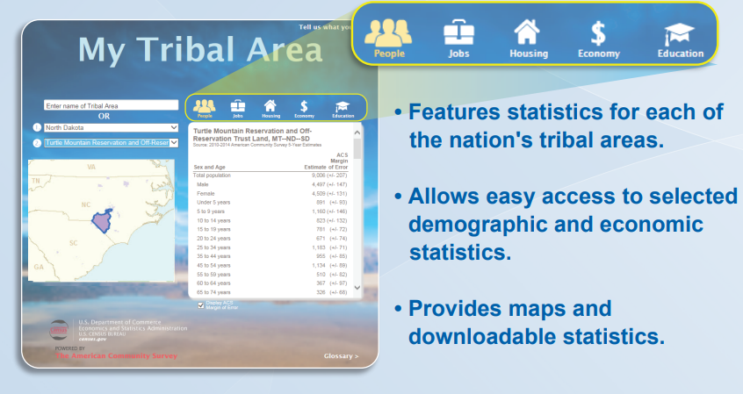
My Tribal Area
Demographic, social, economic, and housing Stats (ACS)
AIAN Lands (not Urban)
Community Planners
Grant Writers
Tribal Officers/Directors
Partners to Tribal Nations

Slide 10
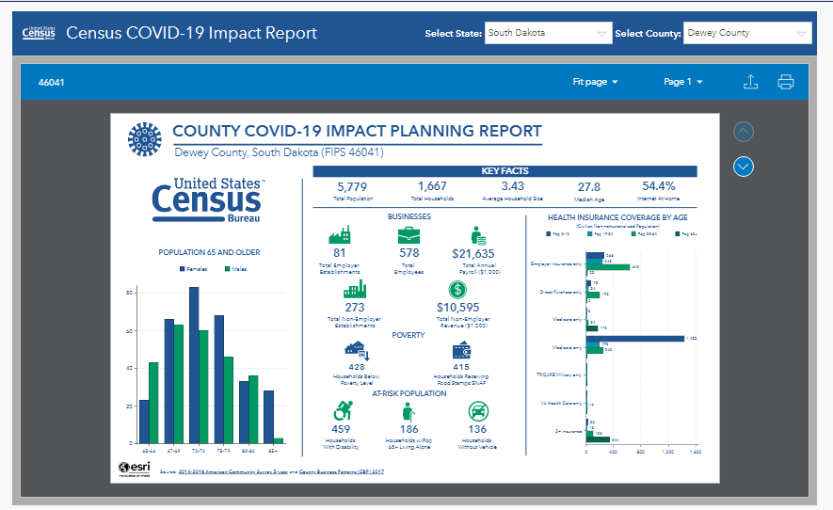
Pulse Survey CoVid19 Impact Report
Business and Household
Covid 19 Risk Factors
Health Directors/Officers
Tribal Clinics
Tribal Leaders
Community Planners

Slide 11
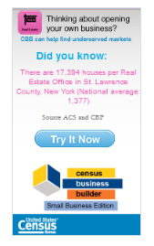
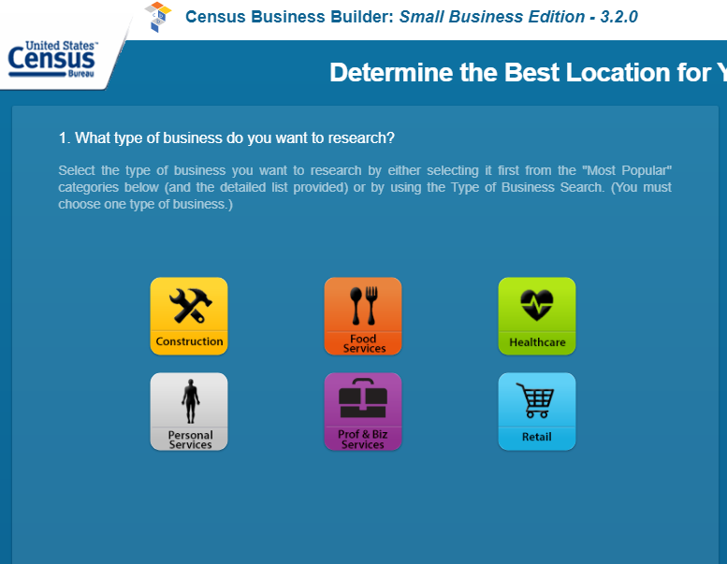
Census Business Builder
Data to help start or grow a business
Data to understand the business landscape for a region
Video Overview
Economic Development
Chamber of Commerce
TERO Offices
Economic Surveys helps populates this data

Slide 12
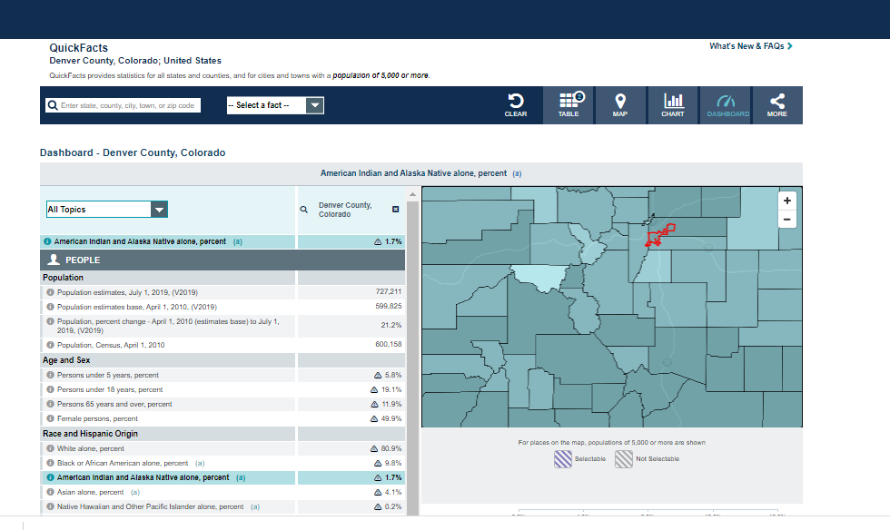
QuickFacts
The QuickFacts data access tool provides users with easy access to basic population, business, and geography statistics for all states and counties, and for cities and towns with more than 5,000 people.
Tables, maps, and charts
States, Counties, Cities & Towns (5K+ Pop)
Community Planners
Grant Writers/Nonprofits
Urban Tribal Partners
Tribal Enterprises
QuickFacts

Slide 13
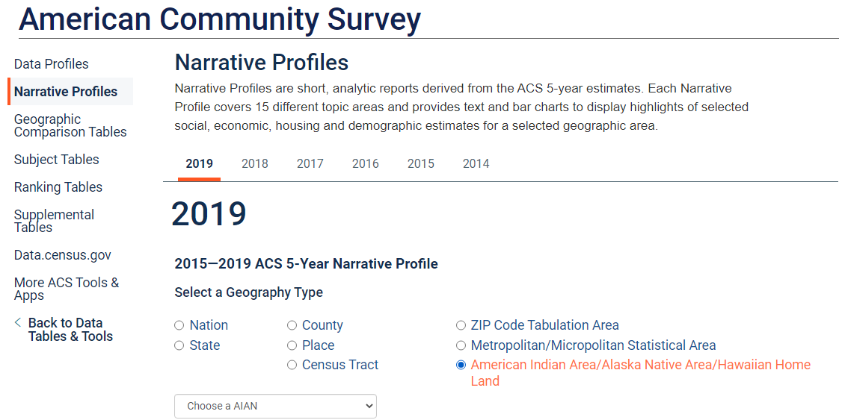
Narrative Profile
https://www.census.gov/acs/www/data/data-tables-and-tools/

Slide 14
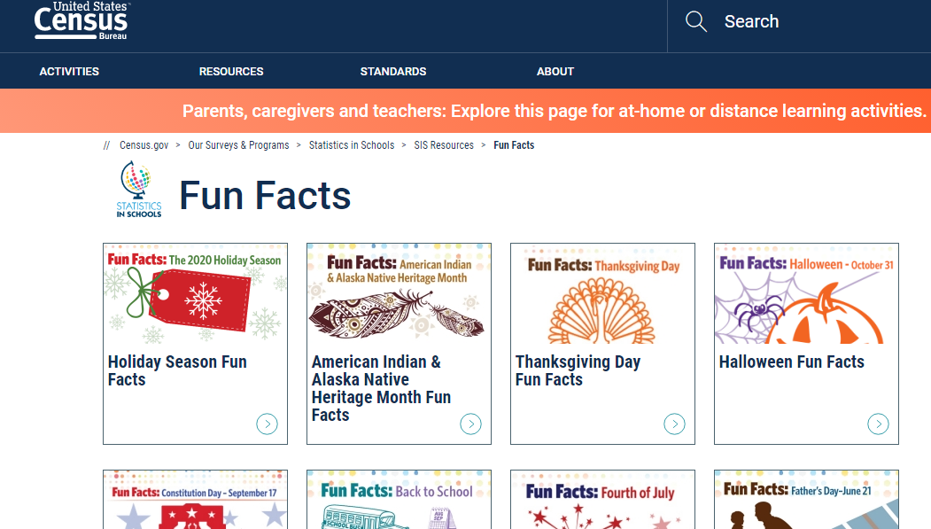
Statistics in Schools
Activities and materials
Reusable, yearly
Educators
Directors of Education
After school programs

Slide 15
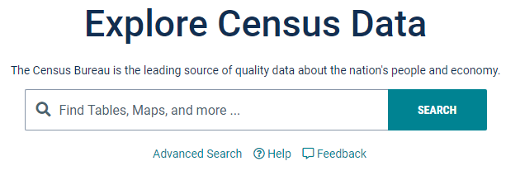
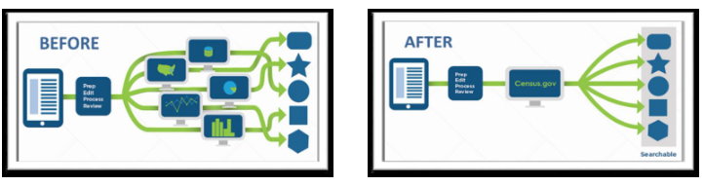
https://Data.Census.Gov/
Centralized data hub
Tribal Leaders/Officers
Community Planners
Grant Writers
Anyone needing data
DDS
1-844-ASK-DATA or census.askdata@census.gov

Slide 16
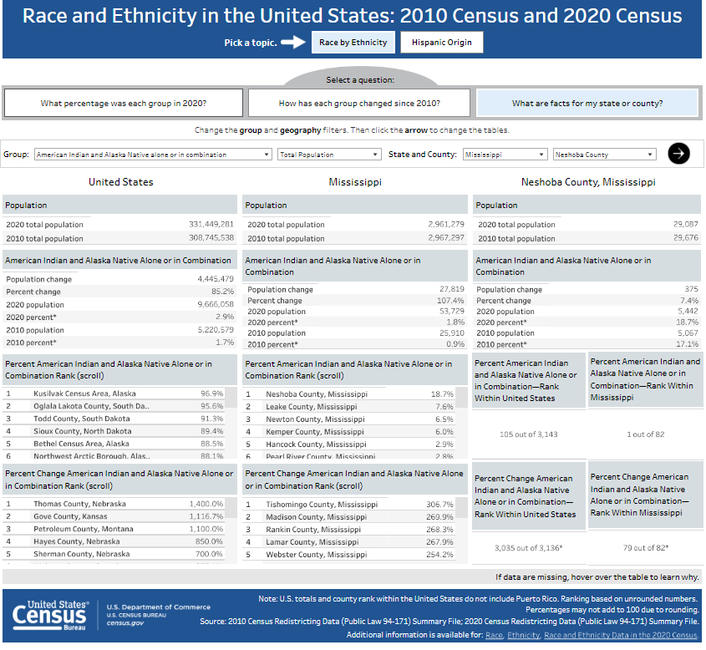
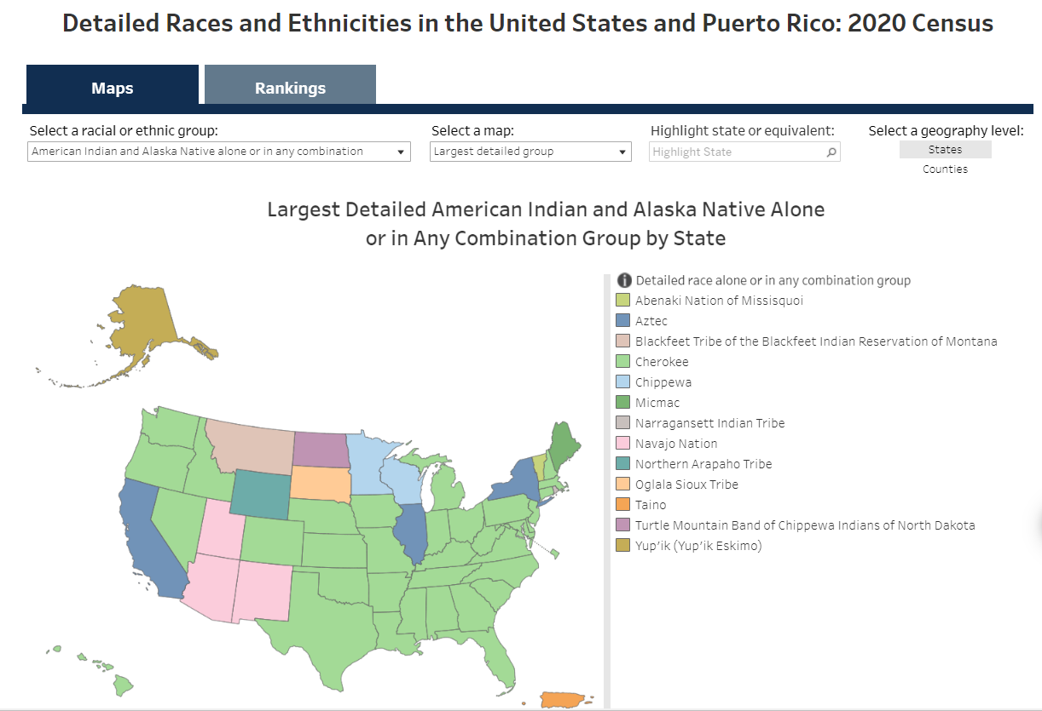
Tribal Overview 2020 Census
*click graphics to route to links
Notes:
**All graphics are hyperlinked to the data.census.gov resource that is interactive. You can zoom in maps and click on items in the maps for more info.
There are Twenty-Two (22) Federally Recognized Tribal Nations in Arizona including the Navajo Nation which is the largest Tribal Nation by population and by land area. The Navajo Nation also extends into the States of Utah and New Mexico.
This map on the left reflects the AIAN Alone or in Combination with other Races numbers on Tribal Areas within Arizona according to the 2021 5yr ACS release. These numbers are for all AIAN that live in these areas, not just those enrolled in these specific Tribal Nations.
These are the AIAN Tribal Groupings for the State of Arizona. According to the 2021 5yr ACS Release, there are 453,651 AIAN alone or in combination with other races in Arizona. This is a breakdown of Tribal Groupings represented.
This map on the right reflects the AIAN alone or in combination with other races in Metro Statistical areas of Arizona, according to the 2021 5yr ACS Release. *click on any of the areas to show the numbers

Slide 17
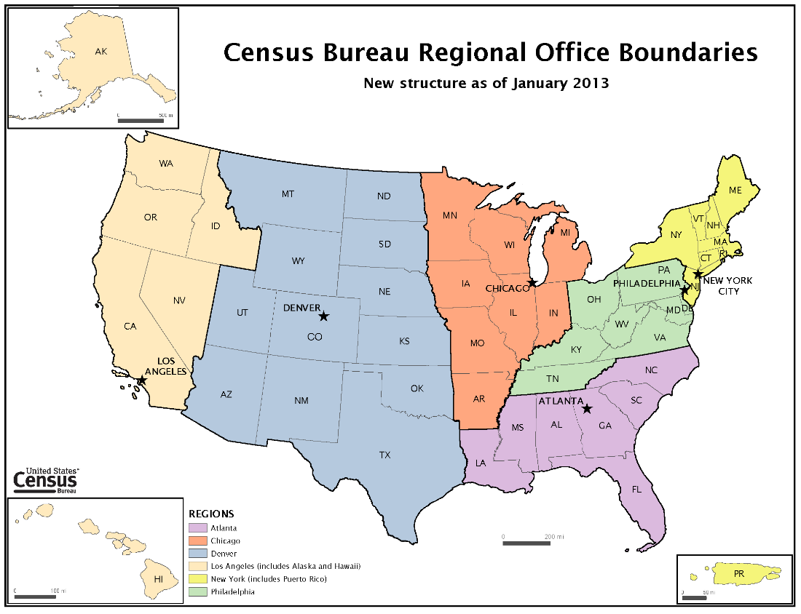
Recruiting: Finding Local Community Jobs
Census.gov/community jobs
Jobs in Your Community (census.gov)
Select State – link takes you to USAJobs
Create a profile which includes a resume
Field Representative Jobs – open continuous
Notes:
The U.S. Census Bureau is comprised of talented and innovative people who are passionate about their work. In addition to conducting a census every 10 years, we conduct surveys on virtually every aspect of life in the United States.
Pursue a career that counts with the Census Bureau.
In addition to the field positions we routinely promote, there are career opportunities for many different skill sets. From Statisticians, Data Scientists, and Economists to maintenance and material handling there are many opportunities to support the Census Mission in providing quality data about the nation’s people and economy.
Apply for a role that allows you to influence the lives of millions of Americans by collecting or analyzing impactful data. As a valued member of the Census Bureau team, you will be responsible for contributing to the fabric of our nation—where everyone counts!

Slide 18

Professional
& Career Positions - Locations
. Census Bureau Headquarters
  Suitland, MD (just outside of D.C.)
Regional Offices
  NY, Philadelphia, Atlanta, Chicago, Denver, LA
Job Types
  (Entry level – to Executive, *= RO & HQ)

Slide 19

Types of Jobs
Entry level to Executive
*= RO & HQ
HR Specialist/ Admin Specialist (RO)
Survey Statistician*
Math Statistician
Geographer
Data Scientist
IT/Computer Specialists*
Program Analyst
Economist
Accountant
Clerical*

Slide 20

Temporary Decennial Positions
Everywhere
  Few beginning in 2028
  Many in late 2029 & first half of 2030
Much more numerous
2 years – 6 weeks
Job Positions
Supervisors Enumerators (interviewers)
Partnership Specialists Outreach Assistants (new 2030)

Slide 21
Office of Intergovernmental Affairs: Tribal Affairs
The race and ethnicity standards defined by OMB was released last Thursday. The SPD 15.
SPF project. Looking Ahead to 2024 on Our Collective Journey to Excellence (census.gov)
Phone
301-763-6100
Email
ocia.tao@census.gov
Intergovernmental Affairs Office
Dee A. Alexander, Intergovernmental Tribal Affairs Specialist
Office: (301) 763-9335
Fax: (301) 763-8327
Email: dee.a.alexander@census.gov
Notes:
SPF project. This is where if they need any statistics we don't produce or do what are they? Let them know we have staff to discuss more in detail if needed. Looking Ahead to 2024 on Our Collective Journey to Excellence (census.gov)
spd15revision.gov
Standards for Maintaining, Collecting, and Presenting Federal Data on Race and Ethnicity
This Statistical Policy Directive provides the standards for maintaining, collecting, and presenting race and ethnicity data for all Federal information collection and reporting purposes. The categories in these standards are understood to be socio-political constructs and are not an attempt to define race and ethnicity biologically or genetically. They are not to be used as determinants of eligibility for participation in any Federal program. The standards do not require any agency or program to collect race and ethnicity data; rather they provide a common language for uniformity and comparability in the collection and use of race and ethnicity data by Federal agencies.
The standards have seven minimum categories for data on race and ethnicity: American Indian or Alaska Native, Asian, Black or African American, Hispanic or Latino, Middle Eastern or North African, Native Hawaiian or Pacific Islander, and White.
1. Categories and Definitions
The minimum categories for data on race and ethnicity for Federal statistics, program administrative reporting, and civil rights compliance reporting are defined as follows:
American Indian or Alaska Native. Individuals with origins in any of the original peoples of North, Central, and South America, including, for example, Navajo Nation, Blackfeet Tribe of the Blackfeet Indian Reservation of Montana, Native Village of Barrow Inupiat Traditional Government, Nome Eskimo Community, Aztec, and Maya.
2. Question Format
Combined question: A combined race and ethnicity question is required for both self-response and proxy data collection. Respondents shall be offered a single combined race and ethnicity question that allows them to select one category or multiple categories. A single selection will be considered a complete response ( e.g., Hispanic or Latino respondents are not required to select an additional category).

Slide 22
On-going Connection
Chicago Regional Office
  1111 22nd St, Ste 400
  Oakbrook, IL 60523
1-800-865-6384
Chicago.Regional.Office@census.gov
Bernadece Boda - Tribal Relations Specialist
301-466-5073
Bernadece.A.Boda@census.gov

