Slide 1


Healthy-living Inspections for Everyone (H-LIFE):
Policy to Improve Community Health Outcomes

Slide 2







67.9
life expectancy compared to 77.5 years for non-Hispanic White adults
21.8%
1.5x
more likely to be diagnosed with diabetes than non-Hispanic Whites
reported being in poor or fair health, the highest rate among all racial groups
According to National Health Center Statistics and Office of Minority Health population health data, American Indians and Alaska Natives are…
Health Stats
4.5%
3.4x*
to have a diagnosis of cancer compared to 11.7% in non-Hispanic White adults but there are disparities in type of cancer
males likely to die from chronic liver disease or cirrhosis
2x
25.1%
regularly had feelings of depression compared to non-Hispanic White adults
diagnosed hypertension which is 10% LESS likely than non-Hispanic White adults
2x
10%
more likely to have asthma than non-Hispanic white adults
likely to have an asthma attack
Source: National Center for Health Statistics. Percentage of six or more workdays missed due to illness, injury, or disability in the past 12 months for adults aged 18 and over, United States, 2023. National Health Interview Survey. Generated interactively: Nov 07 2024 from https://wwwn.cdc.gov/NHISDataQueryTool/SHS_adult/index.html
Notes:
2023 data except * = 2021 data

Slide 3







$6,487
average repair costs per unit for housing deemed severely inadequate compared to $847 for adequate
47.7%
$4,903
average repair costs per unit. Highest repair costs among all racial groups. Estimates from 2023.
repair needs for AI/AN compared to 38.8% nationally. Estimates from 2023
Housing stats
$72.1b
According to the Federal Reserve Bank of Philadelphia….
56.8%
aggregate repair costs for structural repairs.
of aggregated repair costs were for structural repairs
2x
25.1%
Likely to have persistent repair needs if income below the federal poverty line
of aggregated repair costs were from leaks and mold
$1,556
$31.7b
median repair costs if income is below federal poverty line
Aggregate repair costs for leaks and mold
Source: Wallace, E., Divringi, E., Wardrip, K. & Nash, E. (2019). Technical Appendix: A Repair Cost-based Index of Housing Quality. Federal Reserve Bank of Philadelphia. https://www.philadelphiafed.org/-/media/frbp/assets/community-development/reports/measuring-and-understanding-home-repair-costs/0919-home-repair-costs-technical-appendix.pdf
Source: Divringi, Eileen. (2023) Research Brief: Updated Estimates of Home Repair Needs and Cost. https://www.philadelphiafed.org/-/media/frbp/assets/community-development/reports/23-02-home-repairs-update.pdf

Slide 4


G
Role of Public Health in Housing
Recognition of the trifecta: health of mother earth begins in the health of the home and the health of the home begins with the individual. There is a need to better integrate these two systems.
2022
Substandard Housing Stock
2023
Must build more homes to combat the historic neglect and de-prioritization of abundant and quality housing in Indian Country while also advancing efforts to improve the current housing stock.
Inspections and Maintenance
Innovation in the performance of inspections and maintenance can lead to positive changes in how housing authorities can promote healthy homes and improve communication across sectors.
2024

Slide 5
Related to Health. These are the core beliefs of how we wanted to reimagine what an individuals’ health could look life with reintegration.
Wholistic
Stabilize
Related to Housing Inspections and Maintenance. These are the core beliefs of how inspections and maintenance should be performed to reimagine how they can promote healthy homes and improve communication across sectors.
Thorough
Frequent
Quality
Relief
Collaborative
Quality
Communication

Slide 6
Challenges
Solutions
Low quality of life and housing
Prioritize health in housing
Communities are burdened with preventable (mental) health conditions and chronic disease
Drive housing decisions through a health lens ⬆️ QoH = ⬆️ QoL
Retroactive housing inspections
Redesign housing inspections
Inspections currently prioritize problems based on urgency rather than prevention
Update workflows, policies, and procedures to be collaborative, frequent, and thorough.
Fragmented relationships
Multi-directional communication
Deficit in shared responsibility, accountability, and investment in prevention.
Raise awareness, education, and engagement with residents, health and housing staff.

Slide 7
Raise your hand if…
You caught an issue in the home before the resident reported it
You explained to a resident how their health is impacted by the conditions in their home
You told a resident more than 3x to fix a problem in their home
You have ever talked to a healthcare provider about ways to prevent certain problems

Slide 8




















INPUTS
OUTPUTS
OUTCOMES
Situation
Inadequate inspection and maintenance to
prevent negative community health outcomes
What we Do!
Who we Reach!
residents
housing staff
health professions
government
Short-
Medium-
Long-
What we Invest!
time
money
partners
information exchange
experience
Change in:
Change in:
resident behaviors
inspection and
maintenance practices
Change in situation:
sustained healthy home behaviors
quality of housing
quality of life
collaboration btwn sectors
trainings
update inspection and maintenance policies and practices
community events
relationship building
knowledge
skills
attitude
motivation
awareness
communication
External Influences, Environmental, Related Programs
Substandard housing stock, chronic disease, limited financial resources, staff capacity, government politics, organization structure and politics, data utility

Slide 9
 | Model (Principles) | Program (Intervention) | Policy (Guidelines)
Healthy homes | X
Housing for Health Programs |  | X
Collaborative Compliance | X
Proactive Rental Inspection Programs (PRI) |  | X
H-LIFE |  |  | X

Slide 10


Sample Intervention: Implementation Plan for Improving Communication
Goal: Promote multi-directional communication by improving education among residents, housing staff, and health professionals.
Objectives
Activities
Partners involved
Associated costs
Distribute materials that describe relationship between individual behaviors, conditions in the home, and steps to remediate Distribute materials that describe the relationship between inspection checklist items and health | Residents Housing staff | Marketing of materials
Conduct trainings Host orientation for incoming residents Integrate into onboarding process for new staff Host annual review of materials for housing staff | Residents Housing staff | Training materials Staff time
Share educational materials with other organizations supporting health and/or housing Establish a relationship with healthcare teams or clinic Explore a “resident chart” Host annual community events and invite healthcare teams | Residents Housing staff Health | Recruitment of new partnerships Technology for resident chart Event-related needs
Tailor educational materials
Apply knowledge
Share information
H-LIFE Policy

Slide 11

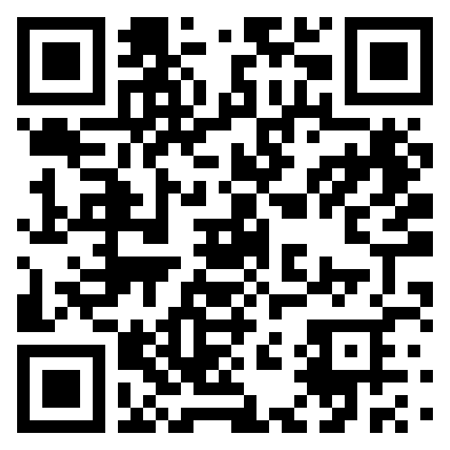

1. Provide feedback on the policy standards
Now
2. Discuss a pilot project in your region

Slide 12


Jeff Ackley Jr.
Great Lakes Consulting Owner
Email: jeffackleyjr@gmail.com
Ph: (715) 622-0540
Hailey Hernandez, MPH
Email: hhern.consulting@gmail.com
Ph: (224) 336-8065
/haileyhern

