Slide 1


The Seminole Tribe of Florida Native Learning Center

Slide 2
Who We Are
The Native Learning Center (NLC) is a department of The Seminole Tribe of Florida.
We are a model activities program, federally-funded through NAHASDA.
We were established in cooperation with the Department of Housing and Urban Development and the Eastern Woodlands Office of Native American Programs in 2008.

Slide 3
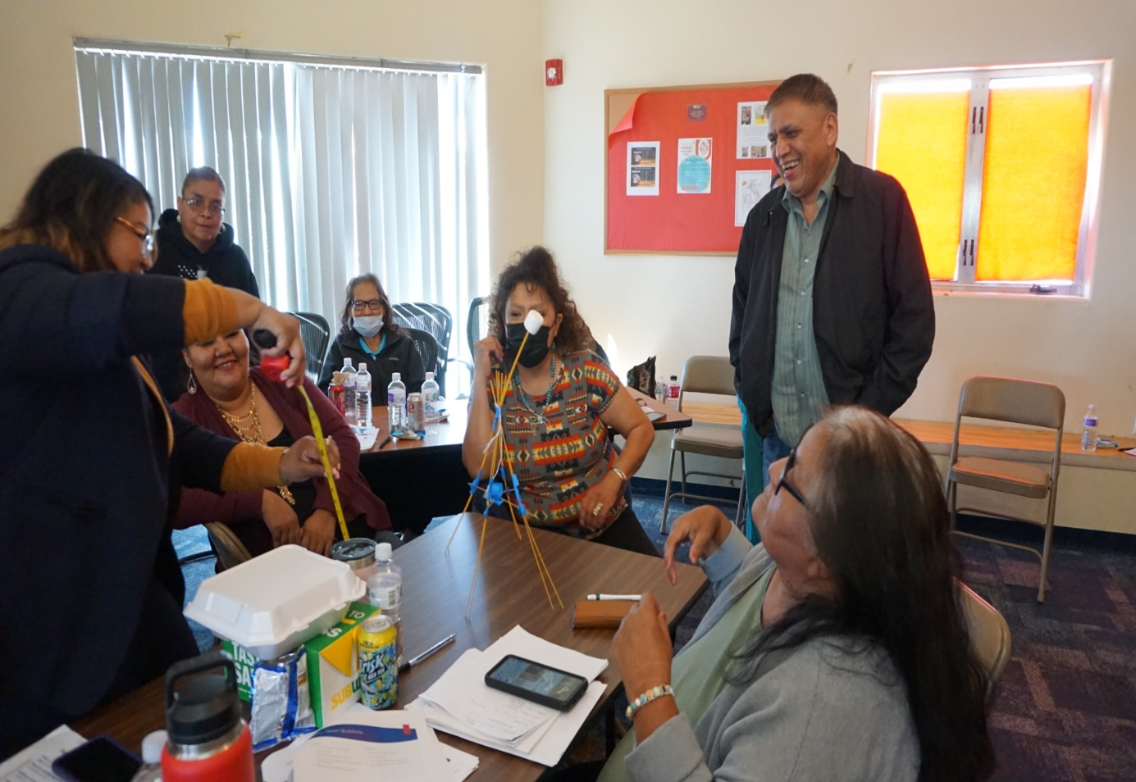
What We Offer
The Native Learning Center offers free Training and Technical Assistance to Native Americans and those working within Indian Country.
Our training promotes the essentials of NAHASDA for Tribal Members and their communities.
We develop curriculum that achieves the primary objectives of NAHASDA and supports the EWONAP’s mission of promoting the development of Native housing and housing related activities.

Slide 4
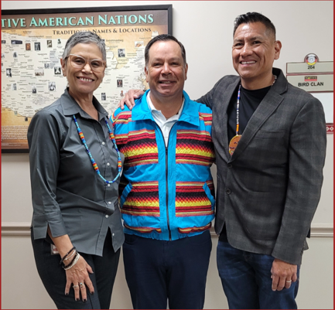
Why I’m Here Today
Another function we serve is planning Chairman Marcellus W. Osceola, Jr.'s annual tribal energy conference.

Slide 5

The 8th Annual Renewable Energy & Sustainability Conference

Slide 6



Slide 7
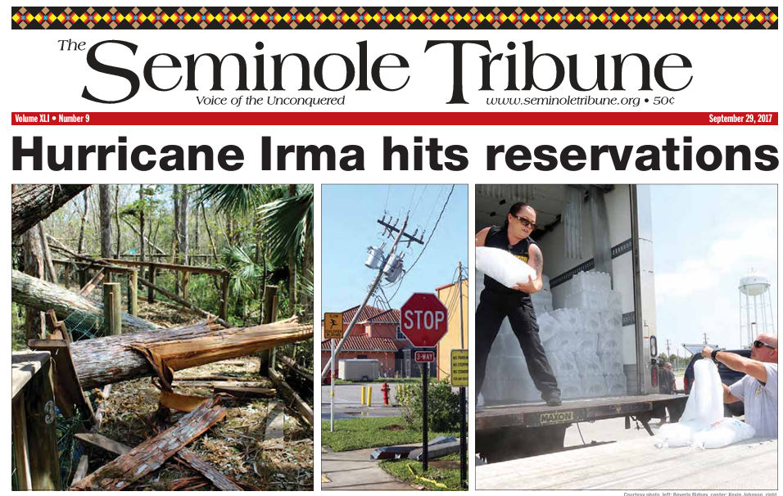
Some Background
The devastation of Hurricane Irma in 2017 affected all Seminole Reservations, especially regarding generators.
There was a post-storm regrouping that led to the Seminole Tribe of Florida applying for and being awarded their first energy grant.
Chairman Osceola saw the need for a forum between Tribes to communicate ideas and help one another with best practices in developing renewable energy on Tribal lands.
Chairman Osceola asked the Native Learning Center to facilitate such a conference in December of 2017, and the 1st annual conference was held in February 2018.

Slide 8






We are Very Proud of this Event

Slide 9
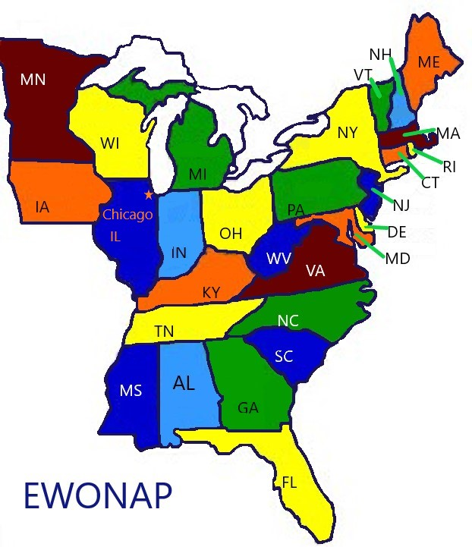
We Want to Invite You to be a Part of It
We want to have our Eastern Woodlands family represented at the conference in January.
We hope to showcase some of the energy projects currently being developed and carried out within Indian Country.

Slide 10
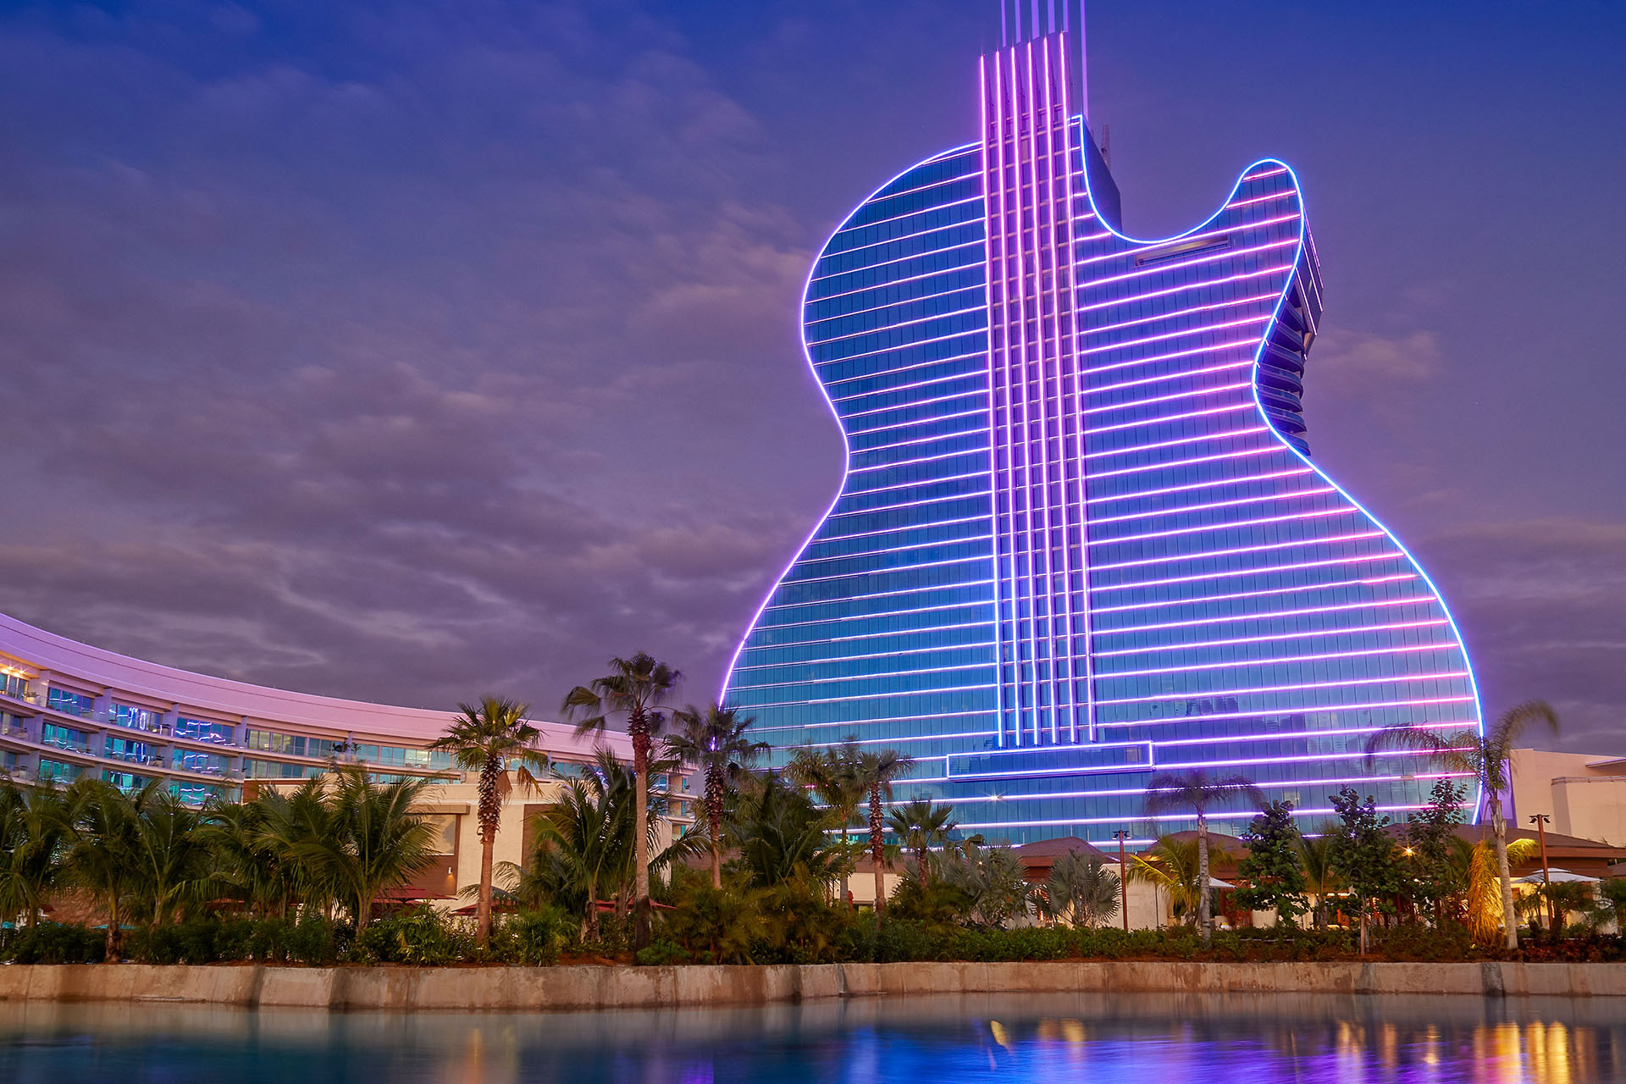
Benefits for You
You will have the opportunity to:
Share your expertise with a diverse audience of influential leaders
Network with other experts in the field
Receive well-deserved recognition as a thought leader in Tribal renewable energy and sustainability

Slide 11
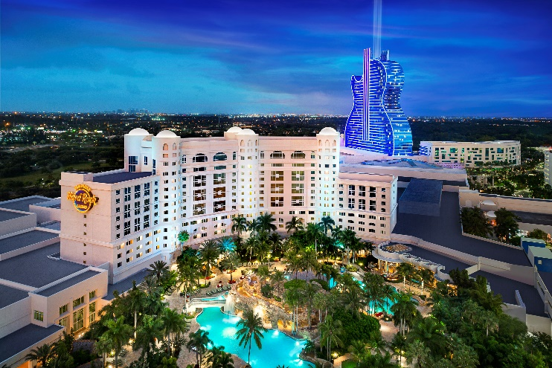
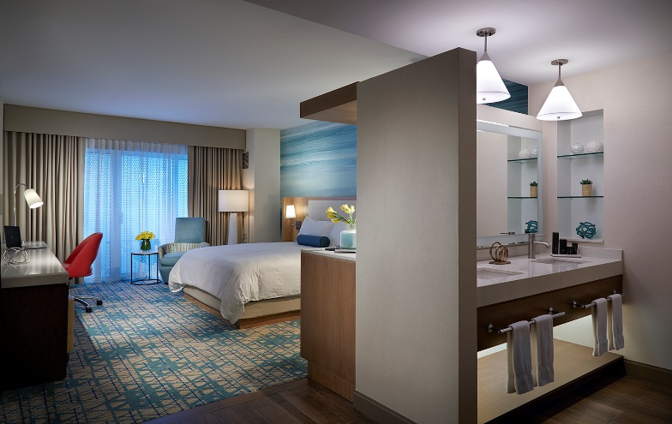
We hope you’ll be able to attend the conference this year!
Registration for this event is FREE!
Rooms at the Hard Rock are limited and must be booked by December 29th.
More information (along with the link to register) can be found here:
https://www.nativelearningcenter.com/2025/09/24/8th-annual-seminole-tribe-of-florida-renewable-energy-sustainability-conference-january-26-28-2026/

Slide 12

If you’re interested in attending the conference…
Let’s connect!
I’d love to connect with you! ☺ Please feel free to reach out to me by phone or email:
jasminerahming1@semtribe.com
(954) 966 – 6300

Slide 13
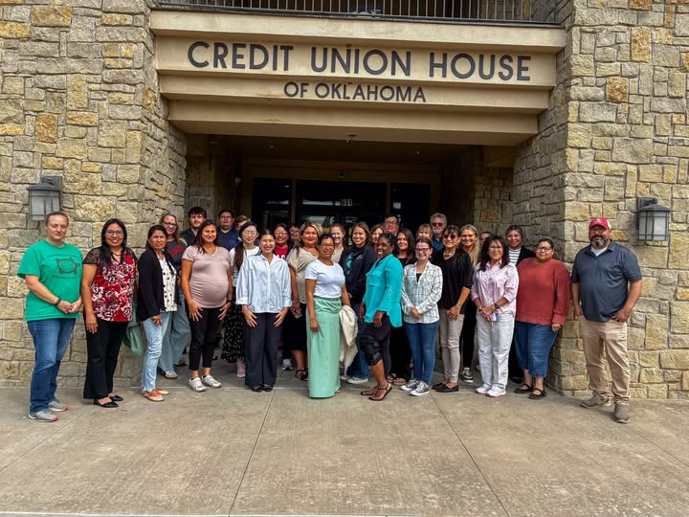
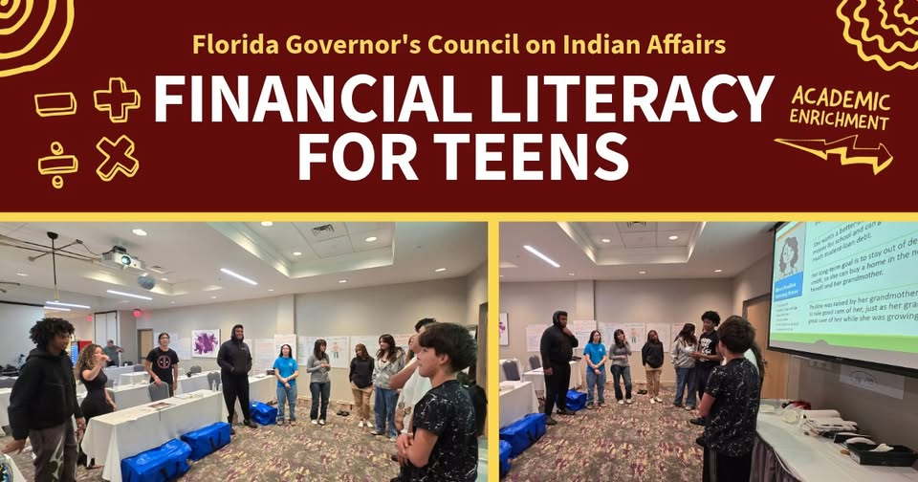
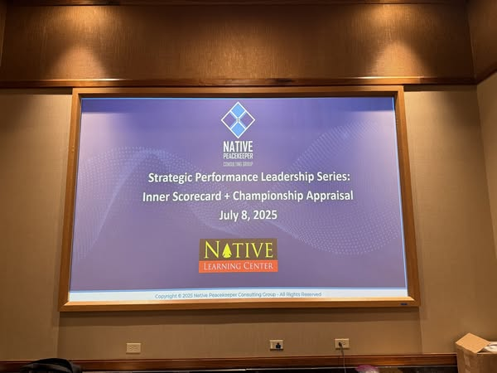
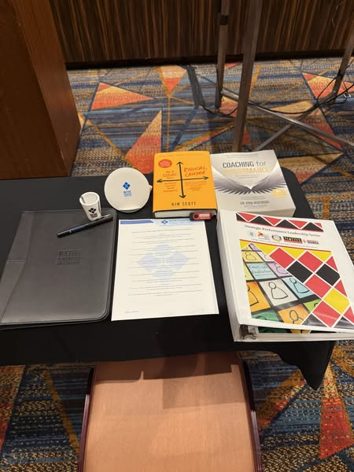
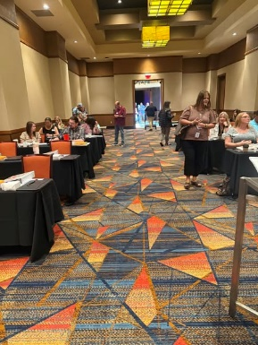
We host a variety of trainings and offer free technical assistance
September 15-16, 2025
Grant Writing & Grant Management Training - Southern Plains Tribal Health Board in Oklahoma City, OK!
July 15-16, 2025
July 8, 2025
Financial Literacy training with the Florida Governor’s Council on Indian Affairs in Tallahassee, FL!
Strategic Performance Leadership Series with the Southern Plains Indian Housing Association!

Slide 14
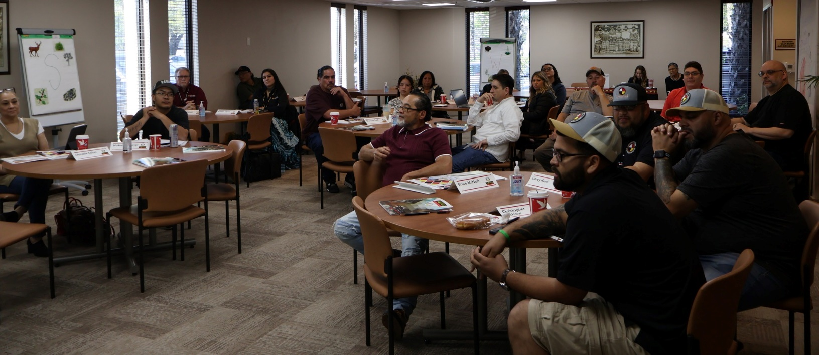
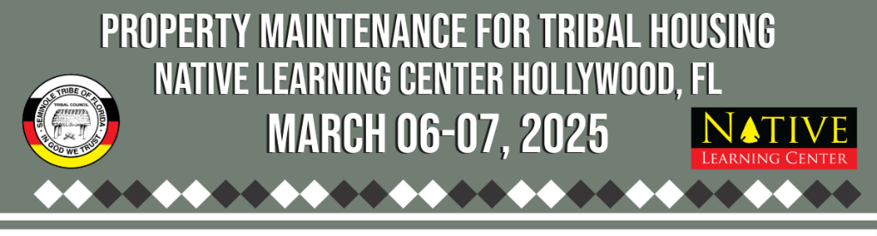
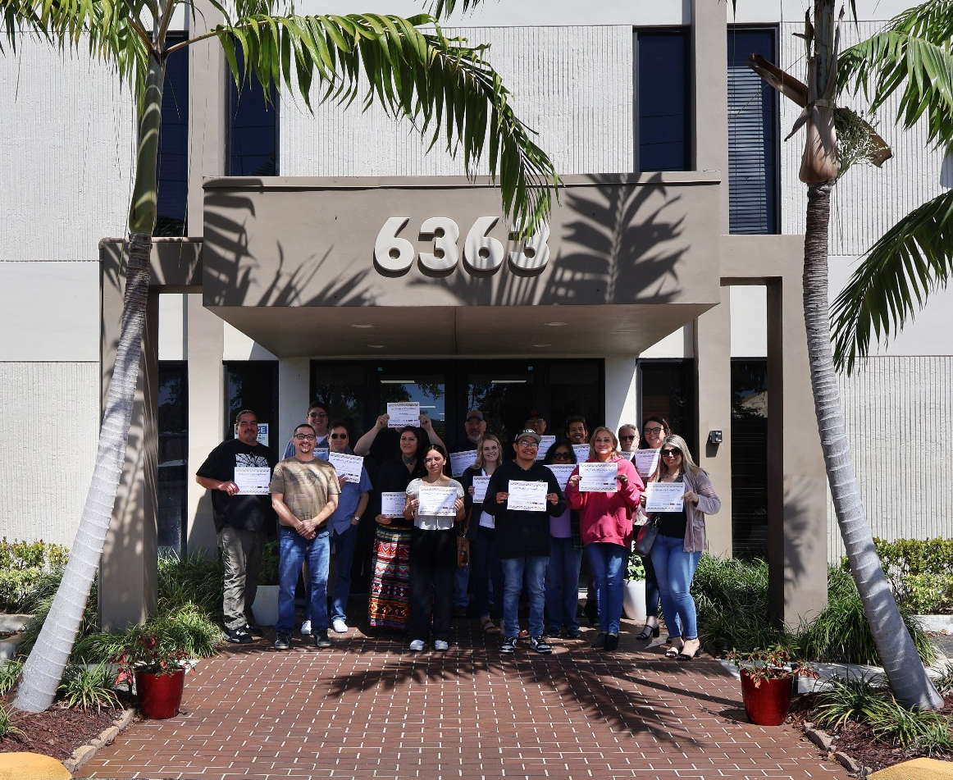
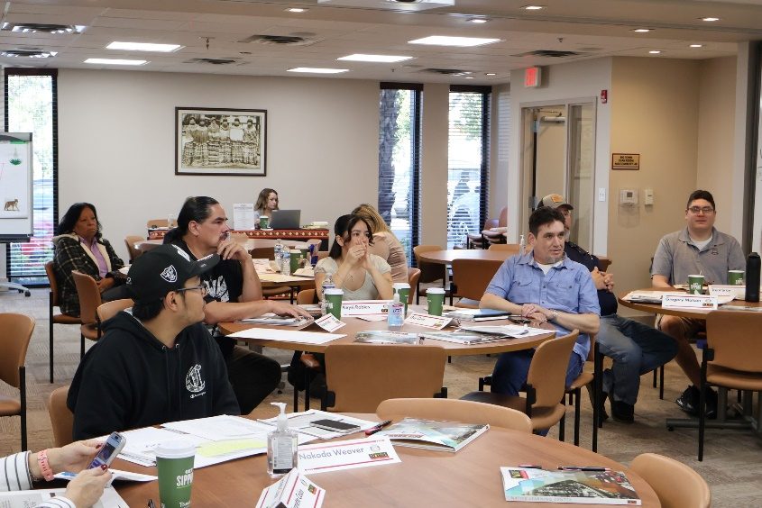
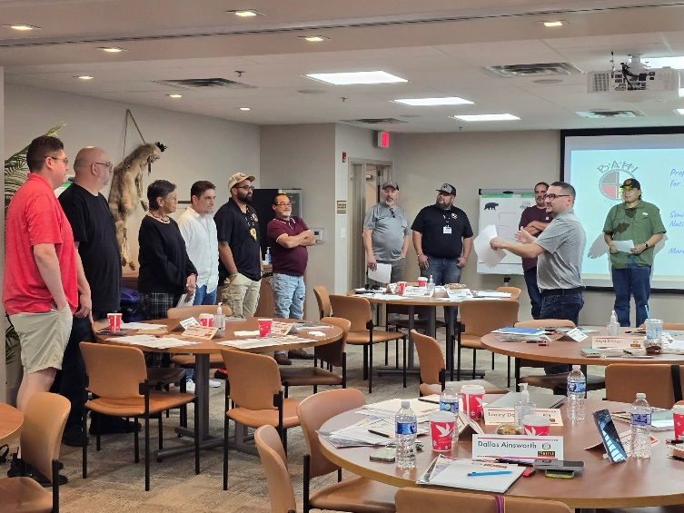
March 6-7, 2025
Property Maintenance for Tribal Housing at the Native Learning Center in Hollywood, FL!

Slide 15

Some Upcoming Trainings of Interest to You…
https://www.nativelearningcenter.com/the-pre-planning-advantage-oct-21-2025/

Slide 16
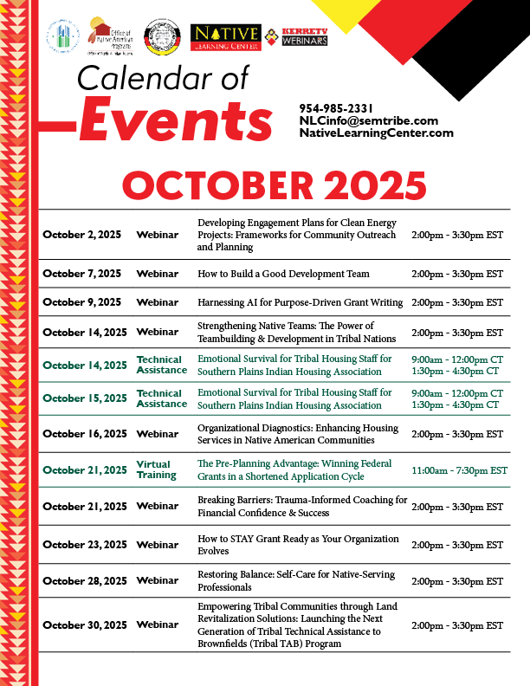
Some Upcoming Webinars of Interest to You…
https://www.nativelearningcenter.com/training-events/

Slide 17
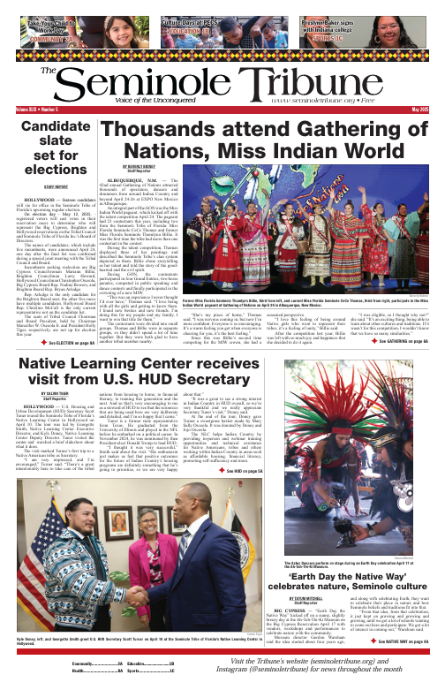
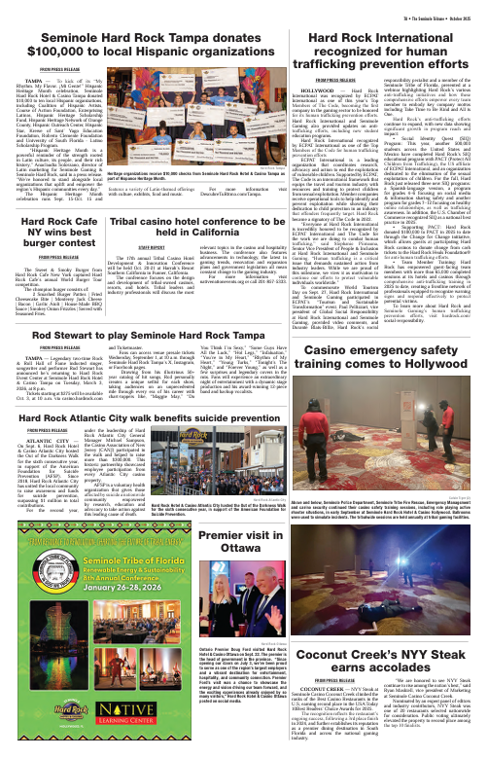
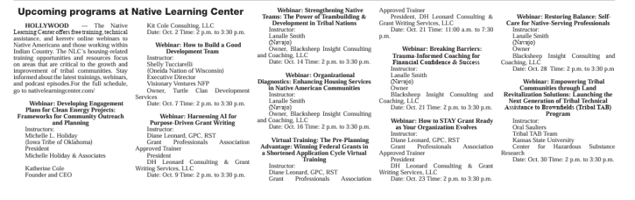
We are Very Proud of the work we do

Slide 18
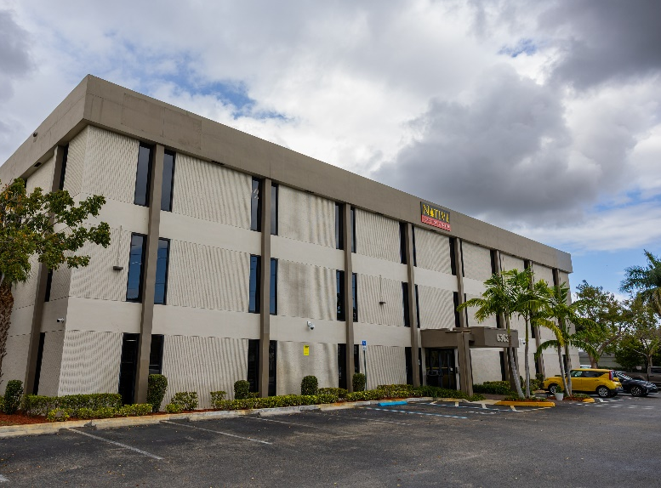
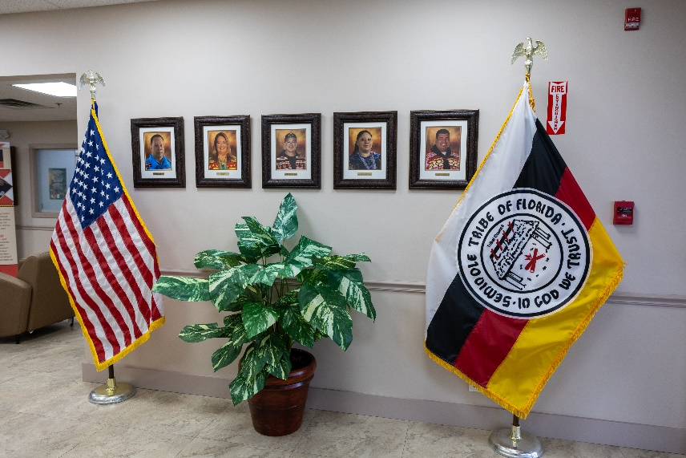
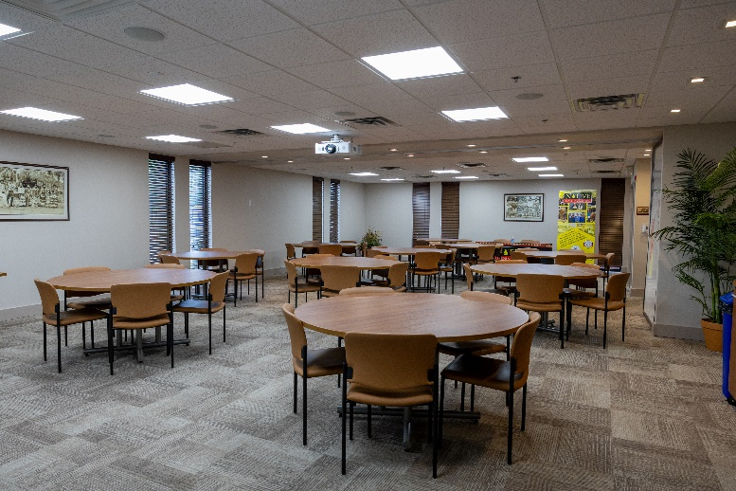
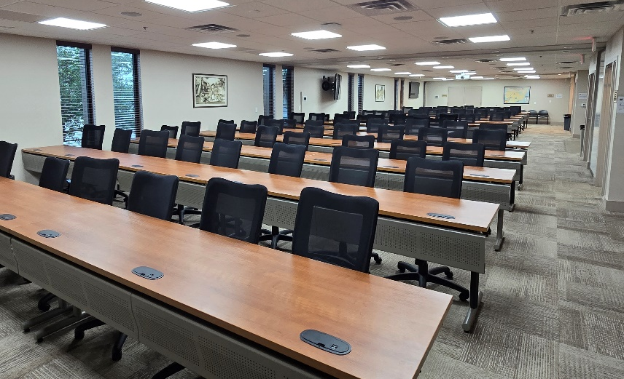
My Contact Information: jasminerahming1@semtribe.com (954) 985-2331
Thank you from the
Native Learning Center!

