Slide 1


EASTERN/WOODLANDS
2025

Slide 2
Build America, Buy America Act (BABA)
The Build America, Buy America Act (BABA) requires the use of American-made iron, steel, manufactured products, and construction materials in federally-funded infrastructure projects, including those funded by HUD's Office of Native American Programs (ONAP).
HUD issued a waiver in January 2025, exempting awards and subawards up to $2.5 million from BABA requirements, allowing the purchase of non-compliant manufactured products for FFA obligated by September 30, 2026.
Notes:
To get us started, I want talk about BABA or the Buy America Build America Act. The Build America, Buy America Act, or BABA, mandates the use of American made iron, steel, manufactured products, and construction materials in federally funded infrastructure projects. This includes projects funded by HUD’s Office of Native American Programs, or ONAP.
However, in January 2025, HUD issued a waiver that exempts awards and subawards up to $2.5 million from these BABA requirements. This waiver allows the purchase of non-compliant manufactured products for funding agreements obligated by September 30, 2026.
This waiver provides flexibility for smaller projects while still supporting the overall goals of the Build America, Buy America Act.

Slide 3
Build America, Buy America Act (BABA)
Clarification on housing projects: Housing projects with 1-4 dwelling units are considered private homes and aren't subject to BABA. Projects with 5 or more dwelling units are considered public infrastructure and are subject to BABA.
Indian Housing Block Grant (IHBG): BABA applies to many Tribal housing projects funded by IHBG, requiring the procurement of American-made materials.
It's important to consult the official HUD BABA website and relevant Notices (like Notice CPD-23-12, PIH 2025-06, and PIH 2024-35) for the most up-to-date and specific guidance regarding BABA implementation and waivers for ONAP programs. You can also contact your local ONAP or email BuildAmericaBuyAmerica@hud.gov for specific questions.
Notes:
Now, let’s clarify how BABA applies to housing projects.
Housing projects with one to four dwelling units are considered private homes and, therefore, are not subject to BABA requirements. However, projects with five or more dwelling units are classified as public infrastructure and must comply with BABA.
For many Tribal housing projects funded through the Indian Housing Block Grant, or IHBG, BABA applies, meaning American-made materials must be procured.
To ensure compliance, it’s important to regularly consult the official HUD BABA website and review relevant Notices For any specific questions about BABA implementation or waivers related to ONAP programs, you can reach out to your Grants Management or Evaluation Specialists at EWONAP, or your local ONAP office if you are joining us from another ONAP Region. You can also email your queries to BuildAmericaBuyAmerica@hud.gov.

Slide 4
FY 26 House THUD-Appropriations
Indian Housing Block Grant – Formula: $1,111 million
Indian Housing Block Grant – Competitive: $150 million
Indian Community Development Block Grant: $75 million
$70 million for ICDBG Single Purpose Grants Up to $5 million for ICDBG Imminent Threat grants
Native Hawaiian Housing Block Grant: $18.3 million, this is a $4 million cut from FY25
Tribal HUD-VASH: up to $10 million for renewal grants (from the TBRA account)
Section 184: $1.7 million in budget authority and $1.8 billion in loan limitation, $400K of this amount is for administrative and contract expenses This is a $200K increase from FY25
Section 184A: No budget authority (the credit subsidy is negative) and $28 million loan limitation
Includes refinance authority
Title VI: $1 million in budget authority and $50 million in loan limitation
Training and Technical Assistance: $7 million, of which $2 million is reserved for NAIHC
Notes:
Here’s a summary of the Fiscal Year 2026 House Tribal HUD appropriations relevant to Tribal housing programs: As a reminder these numbers are the current proposed appropriations. We will learn the official appropriation amounts once the appropriations bill is finalized and passed by both the House and the Senate.
The Indian Housing Block Grant formula funding is set at $1.111 billion.
The Indian Housing Block Grant competitive program is allocated $150 million.
The Indian Community Development Block Grant, or ICDBG, receives $75 million total—$70 million for single purpose grants and up to $5 million for imminent threat grants.
The Native Hawaiian Housing Block Grant is funded at $18.3 million, including up to $1 million for technical assistance covering both NHHBG and Section 184A. This represents a $4 million cut compared to FY25.
Tribal HUD-VASH has up to $10 million available for renewal grants, funded through the Tenant-Based Rental Assistance account.
Section 184 receives $1.7 million in budget authority and $1.8 billion in loan limitation. Of this, $400,000 is allocated for administrative and contract expenses, which is a $200,000 increase from FY25.
Section 184A has no budget authority due to negative credit subsidy but includes $28 million in loan limitation, which covers refinance authority.
Title VI is funded at $1 million in budget authority and $50 million in loan limitation.
Training and Technical Assistance is allocated $7 million, with $2 million reserved specifically for the Native American Islander Housing Coalition.

Slide 5
FY 26 Senate Appropriations
Indian Housing Block Grant – Formula: $1,111 million
Indian Housing Block Grant – Competitive: $100 million
Indian Community Development Block Grant: $125 million
Tribal HUD-VASH: up to $10 million for renewal grants Title VI: $1 million in budget authority and $60 million in loan limitation
Training and Technical Assistance: $7 million
Section 184: $1.4 million in credit subsidy and $1.2 billion in loan limitation,
Native Hawaiian Housing Block Grant: $22.3 million
Section 184A: Provides $28 million loan guarantee commitment, includes refinance authority.
Notes:
The Senate’s FY 2026 appropriations proposal includes strong support for Tribal housing programs, with some key highlights:
$1.111 billion is proposed for the Indian Housing Block Grant formula—matching the House level.
$100 million is allocated for competitive IHBG, which is lower than the House proposal.
The Indian Community Development Block Grant receives a significant boost, with $125 million proposed—$50 million more than the House.
Up to $10 million is included for Tribal HUD-VASH renewal grants, consistent with the House version.
Section 184 receives $1.4 million in credit subsidy and $1.2 billion in loan limitation—less than what the House proposed.
For Title VI, the Senate maintains $1 million in budget authority but increases the loan limitation to $60 million, compared to the House’s $50 million.
Training and Technical Assistance is funded at $7 million, though the Senate doesn’t specify set-asides like the House does.
Overall, the Senate offers more for ICDBG and Title VI loans, but less for Section 184 and competitive IHBG compared to the House.

Slide 6
FY 26 Appropriations Comparisons
Program | House Appropriation | Senate Appropriation | Difference
IHBG – Formula | $1.111 billion | $1.111 billion | Same
IHBG – Competitive | $150 million | $100 million | Senate is $50M less
ICDBG (Total) | $75 million | $125 million | Senate is $50M more
Tribal HUD-VASH | Up to $10 million (renewals) | Up to $10 million (renewals) | Same
Section 184 | $1.7M subsidy / $1.8B loan limit | $1.4M subsidy / $1.2B loan limit | Senate is lower
Title VI | $1M subsidy / $50M loan limit | $1M subsidy / $60M loan limit | Senate allows $10M more
Training & Technical Assistance | $7M (incl. $2M for NAIHC) | $7M (no specific set-aside) | House specifies $2M for NAIHC
Notes:
This table compares the FY 2026 House and Senate appropriations for key Tribal housing programs.
Both chambers propose $1.111 billion for IHBG formula grants.
The House allocates $50 million more than the Senate for competitive IHBG grants.
The Senate provides $125 million for ICDBG—$50 million more than the House.
Tribal HUD-VASH funding is identical in both versions at up to $10 million for renewal grants.
For Section 184, the House provides more funding—$1.7 million in credit subsidy and $1.8 billion in loan authority, compared to $1.4 million and $1.2 billion from the Senate.
Title VI loan authority is higher in the Senate: $60 million versus $50 million in the House.
Training and Technical Assistance is level at $7 million, though the House specifies that $2 million is reserved for NAIHC.
These differences will be important to track as the final FY 2026 budget is negotiated.

Slide 7
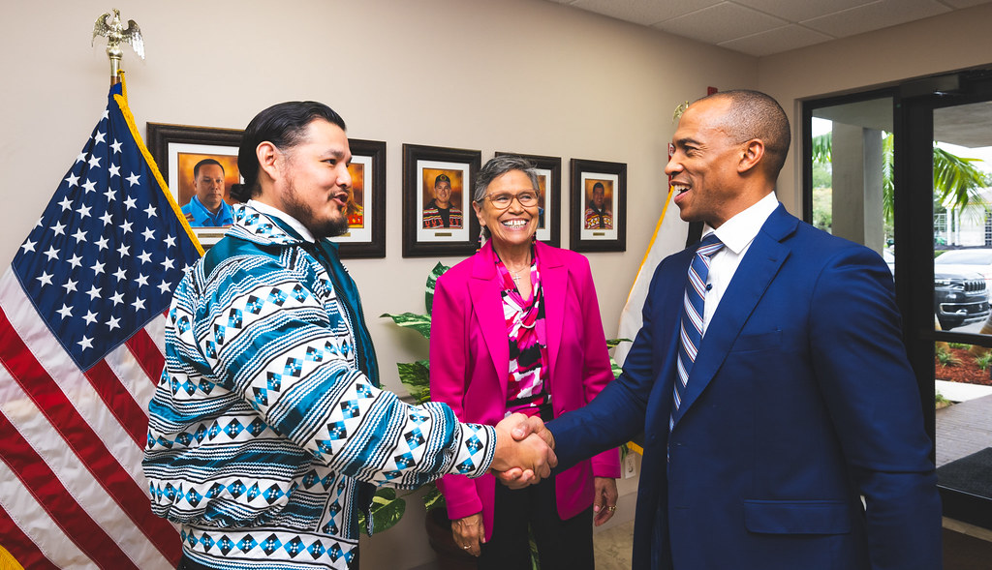
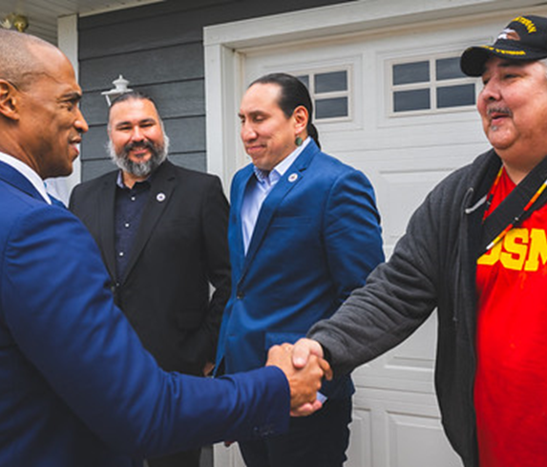
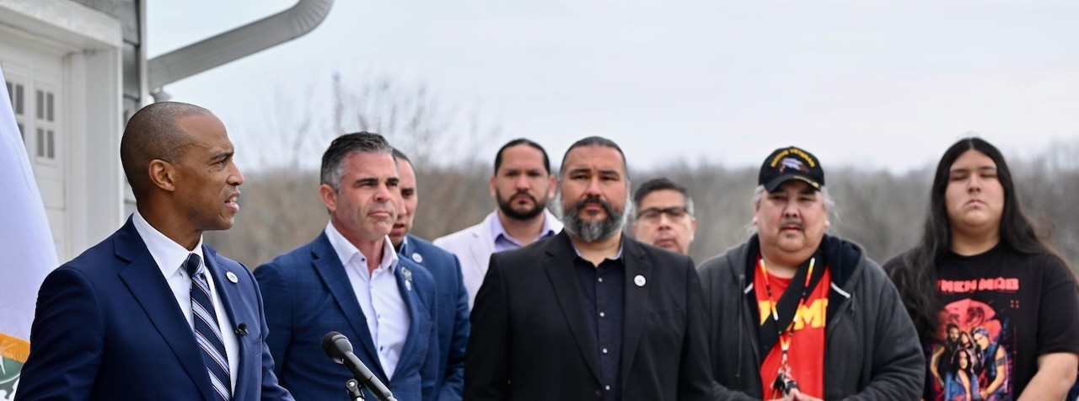
Secretary Scott Turner
Notes:
Secretary Scott Turner, HUD’s current leader, has emphasized strong support for Indian Country. His recent visits to the EWONAP Region included, Oneida Nation and Seminole Tribe of Florida reflect HUD’s commitment to strengthening tribal partnerships. He recently visited the Alaska Region visiting Tribes and Villages.
The Secretary is focused on expanding homeownership through the Section 184 loan program—widely seen as a vital tool for tribal families.
He’s also expanding Tribal HUD-VASH, with $2.2 million in funding for Native veteran housing and services.
Turner has engaged tribal leaders on environmental regulation reform, aiming to reduce administrative barriers.
Sec. Turner has stated his commitment to providing housing to our forgotten populations and to those that need it most. He has affirmed that Indian Country is a vital part of HUD’s mission and recognizes the unique challenges faced by tribal communities in accessing housing for Tribal members, while advocating for reduced regulatory barriers to achieve housing progress.

Slide 8
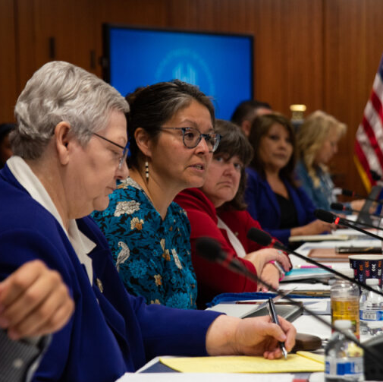
HUD Tribal Intergovernmental Advisory Committee (TIAC)
HUD is committed to continuing TIAC, and will be scheduling meetings to facilitate communication, consultation, and collaboration between the Department of Housing and Urban Development (HUD) and Tribal governments. These meetings aim to address policies and activities impacting Indian Country, as well as to gather input and recommendations from Tribal leaders.
Notes:
HUD’s Tribal Intergovernmental Advisory Committee, or TIAC, will be reconvening soon. A Dear Tribal Leader Letter invited nominations for new committee members, and the nomination period closed on July 18th.
TIAC has provided HUD with a wealth of input that has informed progress in several key areas—including the potential expansion of the Section 184 loan program, improving the environmental review process, and promoting greater inclusion of Tribes in broader HUD programs. This engagement has also led to increased interest from HUD leadership beyond ONAP.
HUD is committed to continuing TIAC and will be scheduling upcoming meetings to support communication, consultation, and collaboration with Tribal governments. These meetings serve as a critical space for shaping policies that impact Indian Country.

Slide 9

Tribal HUD-VASH (TVH) Expansion FY 25 Expansion Grant Application Period Closed
THV grants provide rental assistance and administrative fees to Eligible Indian tribes and Tribally Designated Housing Entities (TDHEs) that meet applicable program requirements established in the 2015 Implementation Notice and the 2018 Consolidation Notice, based on need and administrative capacity.
Approximately $2.2 million is available.
Estimated award date: mid-December 2025

Slide 10
FY 25 IHBG Competitive NOFO
The FY 2025 Indian Housing Block Grant (IHBG)
Is out, please follow the links from Codetalk to Grants.gov. EWONAP is not allowed to answer IHBG Comp NOFO questions while the grant is open.
EWONAP Region did very well in this grant competition last year.
Great grant opportunity for new construction of affordable housing units.

Slide 11
FY 25 ICDBG NOFO
ICDBG FY 25 NOFO is out please follow the links to Grants.gov. EWONAP is not allowed to answer NOFO questions while the NOFO is out. National training dates will be announced soon.
We anticipate that Eastern / Woodlands will be making awards to 3 Tribes based on allocation of funding of 5.3 million

Slide 12
Indian Housing Block Grant Formula Response
Annual formula response deadline was August 1st. Next formula response forms will be sent out at the end of May 2026. Review your data this year if your Tribe see any information that does not match your Tribal data.
FY 2026 Formula Response Form
FY 2025 Allocation and Formula Data

Slide 13
*Formula Data FY 2026
Please note FY 2026 Formula Data is going to look different this year. FY 2026 transitioned to utilizing the 2020 census into the data sets used for the calculation of annual IHBG formula.
Notes:
As a continuation on the Formula Data for FY 2026, it's important to note that the data will look different this year. That’s because HUD has transitioned to using the 2020 Census data in the IHBG formula for the first time.
We strongly encourage you to review your FY 2026 Formula Response Form carefully. If something doesn’t look right, please still contact the Formula Center for guidance. And of course, if you have any questions or need help understanding the changes, the IHBG Formula Customer Service Center is there to support you.
This is a pretty big change. In previous years, the formula used data from the 2010 Census along with information from the American Community Survey. Now that we’re using the 2020 Census, key numbers like how many IHBG-eligible households there are, income levels, and overcrowding rates have all been updated. These changes directly affect how much funding Tribes receive through the formula.

Slide 14
Section 184 Skilled Workers Demonstration
https://www.hud.gov/section184
New (not so new) Section 184 Skilled Workers Demonstration
Under the Demonstration, Tribes and Tribally Designated Housing Entities may obtain a loan from a Section 184 approved Lender for the construction of rental housing for Skilled Workers. Tribes/TDHEs may utilize the Demonstration to construct one to four family dwelling unit(s). The Section 184 program allows Tribes/TDHEs to obtain multiple Section 184 loans, subject to underwriting requirements, to construct Skilled Workers housing within their communities.
As an incentive for Tribes/TDHEs to participate in the Demonstration, the Demonstration reduces the Section 184 Upfront Fee to $1 and eliminates the Annual Guarantee Fees.
Section 184 Skilled Workers Demonstration Program | HUD.gov / U.S. Department of Housing and Urban Development (HUD)
Notes:
Next, let’s talk about the Section 184 Skilled Workers Demonstration. This is something new that we have been trying to share with Tribes, an important opportunity for Tribes and Tribally Designated Housing Entities. How many times have your Tribal Leaders asked, why there is no housing available for families over income guidelines, for Tribal Members looking to relocate and work for their Tribes, but no housing options are available to them. Here is an opportunity to provide housing options for your members. This is a way to build rental units without income limitations.
Under this Demonstration, Tribes and TDHEs can get a loan from a Section 184 approved lender specifically for building rental housing for skilled workers. The program allows construction of one to four family dwelling units. Plus, Tribes and TDHEs can take out multiple Section 184 loans—subject to underwriting requirements—to develop skilled worker housing within their communities.
This also provides an opportunity to offer rental units to working families who earn above the Area Median Income, as long as the Tribe is not using HUD or IHBG funds to cover the loan payments.

Slide 15
Title VI
https://www.hud.gov/helping-americans/public-indian-housing-title-vi-loan-guarantee-program
The Title VI Loan Guarantee program allows IHBG recipients to use current and future fund allocations as leverage to obtain HUD guaranteed financing. Title VI guaranteed loans permit borrowers to develop their project at today's cost; without needing to save funds over several years and risking potential cost increases. The maximum loan amount is approximately five times the need portion of the annual IHBG allocation. There is no minimum loan size.
Tribes, or TDHEs (with tribe approval) collaborate with an approved lender to prepare and submit required documents for HUD review.
HUD will provide the lender with the loan guarantee and the borrower can start the intended project.
Proceeds from a Title VI guaranteed loan may be used to:
Create new housing
Rehabilitate housing
Build infrastructure
Construct community facilities
Acquire land to be used for housing
Prepare architectural & engineering plans
Fund financing costs
Notes:
Another great loan program from ONAP’s Office of Loan Guarantee is the Title VI Loan Guarantee Program. This program gives IHBG recipients a way to use both current and future funding as leverage to get HUD-guaranteed financing.
The big benefit here is that it lets you move forward with your project now, at today’s construction costs—without having to wait years to save up funds and risk prices going up. The loan amount can be up to about five times the need portion of your annual IHBG allocation, and there’s no minimum loan size, which makes it flexible for a variety of project types.
To get started, Tribes or TDHEs with Tribal approval, work with a HUD approved lender to submit the required documents for review. Once approved, HUD guarantees the loan, and you’re ready to move forward with your project.
You can use Title VI funds for a range of activities, like building new housing, rehabbing existing homes, putting in infrastructure, constructing community facilities, buying land for housing, and preparing architectural and engineering plans

Slide 16
Training and Technical Assistance T/TA
Indian Housing Plan
Procurement
Capacity Building
Environmental Reviews
Construction
Crime Prevention
Board of Commissioners Training
Tax Credits and Title VI
Program Income
Financial and Fiscal Management
NAHASDA Essentials
Home Buyer Education
Renewable Energy
And More!
Notes:
This is one of the most underutilized services that HUD offers — free training available to your Tribe and Tribal Designated Housing Entities. If you have any community or housing-related training ideas, you can submit your requests to Mary White. We’ll work with you to find or create a training that fits your needs.
These trainings can be held in person right in your community or virtually, whichever works best for you. Some of the available topics include Indian Housing Plans, Procurement, Capacity Building, Environmental Reviews, Construction, Crime Prevention, Board of Commissioners Training, Tax Credits and Title VI, Program Income, Financial and Fiscal Management, NAHASDA Essentials, Home Buyer Education, Renewable Energy, and more.
We encourage you to take advantage of these resources to strengthen your programs and build capacity. Who are you going to call? MARY WHITE, please take advantage of this opportunity.

Slide 17
Upcoming Training
Codetalk Calendar of Events: https://www.hud.gov/helping-americans/public-indian-housing-calendar

Slide 18
General Contact Information
EWONAP Specific Website: https://www.hud.gov/program_offices/public_indian_housing/ih/codetalk/onap/ewonap
Nathaniel Johnson, Nathaniel.johnson@hud.gov
Neil Whitegull, Neil.a.Whitegull@hud.gov
Ph. 312 913 8494.
Notes:
To wrap things up, here’s our general contact information. If you have any follow-up questions or need additional support, feel free to reach out. In addition to your GM and GE specialists, you can also contact me or Deputy Administrator Nathaniel Johnson directly by email — our contact info is listed here on the slide.
Thank you so much for the opportunity to be here with you today. If you have any questions, please don’t hesitate to reach out to us.
Pinagigi I truly appreciate your time and the important work you are doing for your Tribes. EWONAP looks forward to continuing to serve your Tribe and communities. Your success is our success!

