Slide 1



ONAP
Office of Loan Guarantee
South Dakota Native Homeownership Coalition| June 2026
Notes:
Good Morning - Thank you for the introduction
It is good to be with all of you here to talk about what’s facing Tribes today and to explore ways we can work together to advance self-determination to expand economic opportunities through housing stability
My name is Tonya Plummer and I am the Director of the Office of Loan Guarantee in HUD’s Office of Native American Programs overseeing the Section 184 and Title VI programs
I am an enrolled member of the Sisseton Wahpeton Oyate, I am Dakota, Assiniboine and Cree.
I was born in Montana where I raised my children, and about a year and a half ago I moved to Washington DC to enter federal service, where I bring experience from the private sector in for-profit finance and mortgage banking, non-profit Native CDFIs, and Tribal housing, policy and economic development to HUD.
It’s been an honor to lead a team of committed professionals to best serve Tribal communities and we remain committed to that endeavor daily.

Slide 2
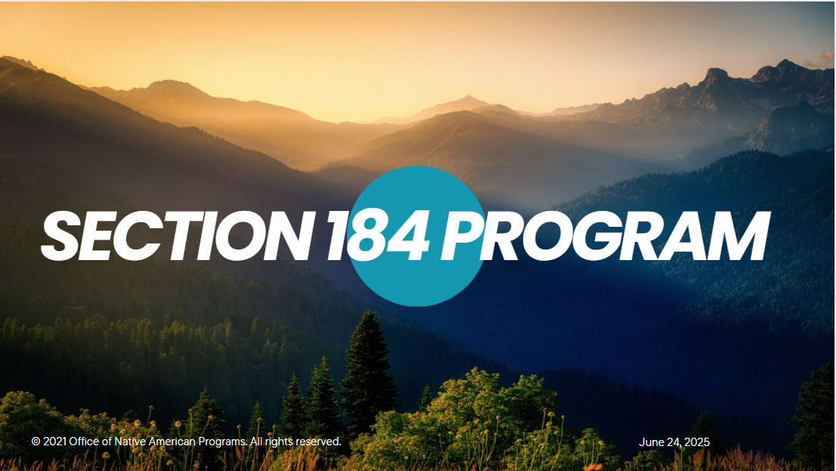

Notes:
The Section 184 Program was statutorily authorized through the Housing and Community Development Act of 1992.
It is the premier tool for Tribal mortgage finance and has become synonymous with homeownership in Indian Country.

Slide 3

Section 184
Purpose and Mission
Authorized by Housing and Community Development Act of 1992
Credit Enhancement Tool to create a no-risk environment for lenders to encourage access to homeownership capital for Tribal borrowers
Why It Works
100% Federal Loan Guarantee
Low upfront cost
No annual mortgage insurance
Flexible land types (fee simple + Tribal lands)
Flexible underwriting
Opened the flow of access to homeownership capital of over $11 billion since 1992 while maintaining a <2% default rate
Notes:
In comparison to available mortgage and housing development finance tools available today, Section 184 simply works best, with features designed specifically for Tribal borrowers and communities
The very low upfront cost, no annual MI, flexible manual underwriting and ability to be used on and off Tribal lands make more accessible than other products
Eligible Tribal borrowers include individual Tribal members of federally recognized Tribes, as well as the Tribe and/or TDHE or THA itself
It is incredibly diverse in the ways it can be used for acquisition of existing homes, rehab and renovation of existing homes, new construction of individual homes in scattered sites, or to construct entire subdivisions of homes for the Tribal members or skilled workers serving the Tribe
It boasts an incredibly low default rate – just under 2% - better than every other mortgage product on the market today.

Slide 4

  What’s in it for the lender?
  Low Risk 100% Federal loan guarantee
  Exceptionally low default rate – less than 2%
  High Impact Over 11 Billion in Tribal homeownership since program inception
  Strong Return Section 184 mortgages are typically held for 15-30 years, performing well in MBS pools
What’s in it for the borrowers?
Homeownership Equity access
Housing Stability for Tribal members
Economic retention and resilience trough housing stability for Tribes
Numerous health, education, cultural, social and economic benefits for all
Notes:
Section 184 is one of the lowest risk, highest impact mortgage products available today to help Tribal borrowers build equity and create generational wealth. It’s a good deal for borrowers, but its also a good deal for lenders and investors. Because of it’s less than 2% default rate and the fast that most Tribal borrower remain in their homes much longer, 184 loans perform well in mortgage back securities, making them highly sought after by investors. This means the Tribal lending ecosystem is ripe and working together, homeownership is more possible than ever before.

Slide 5
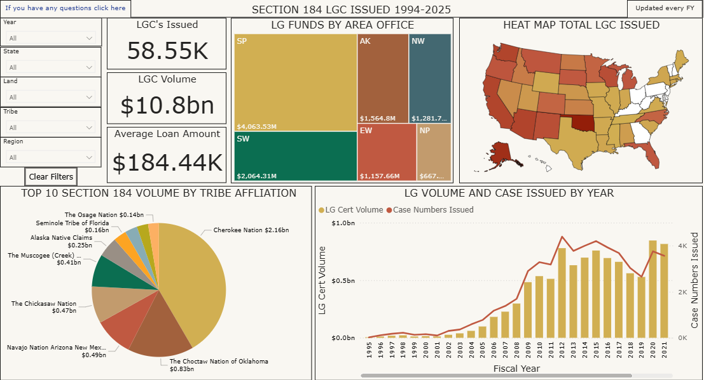
Section 184 All-Time, All-Place Homeownership Investment
Notes:
Since the inception of the program, Section 184 has guaranteed around $11Billion across Tribal borrowers and communities
We are tracking progress closely and able to break down progress on and off Tribal lands, by Tribe, by State and by lender.

Slide 6
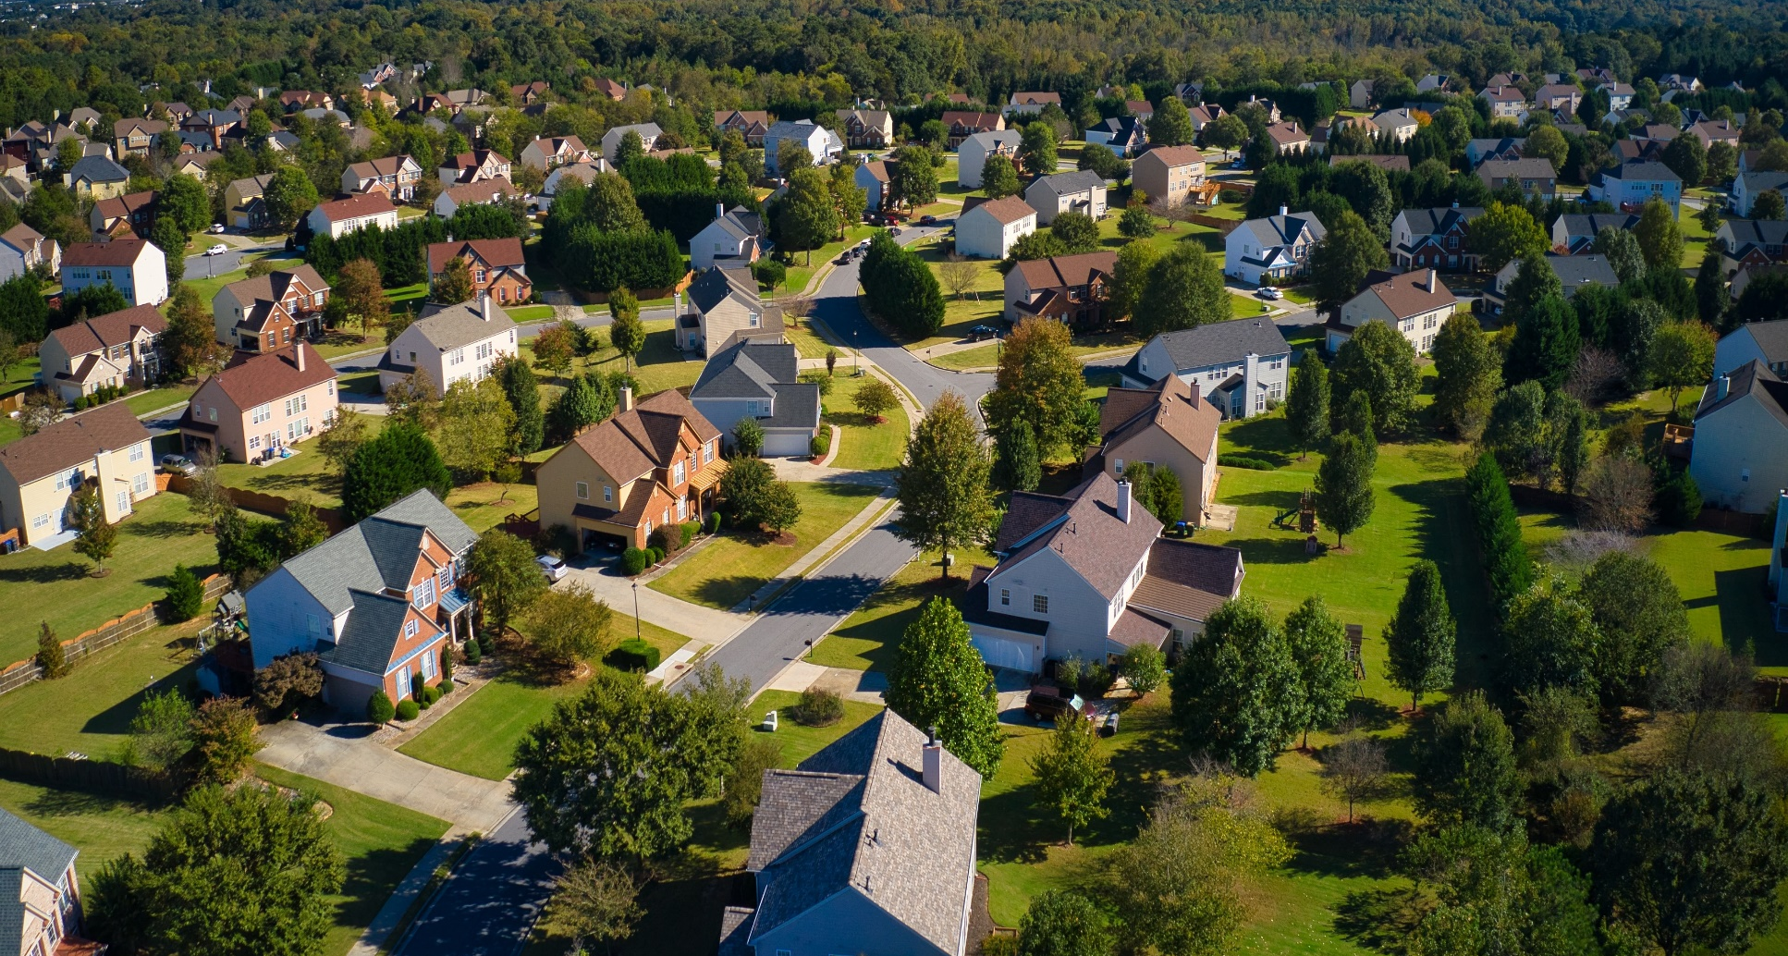
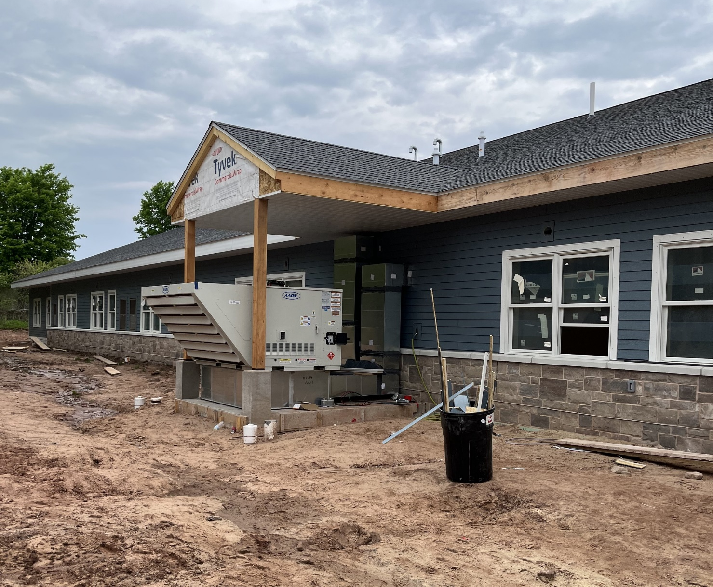
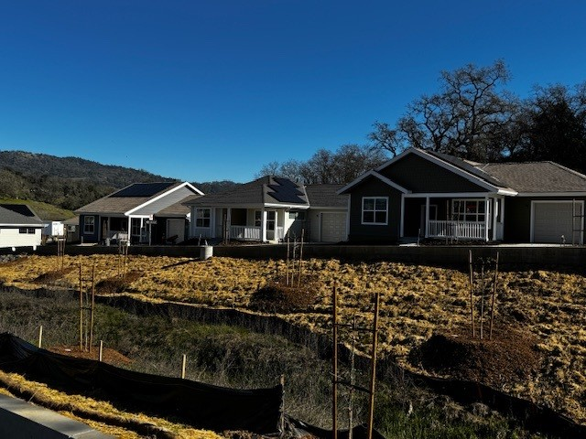
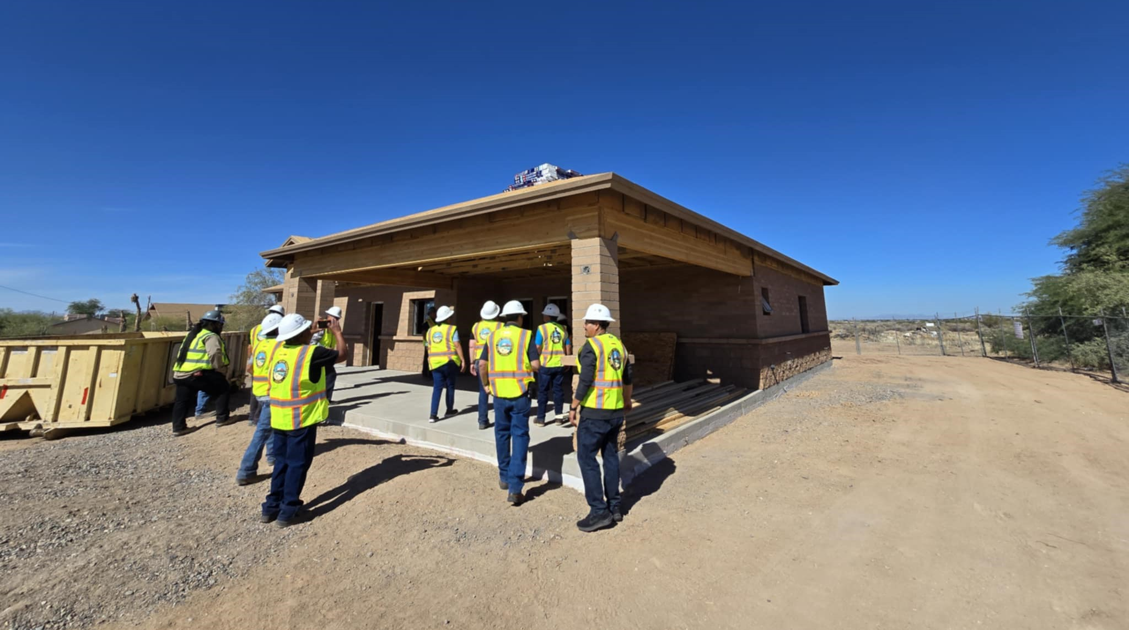
HUD offers a 100% loan guarantee through the
Section 184 program and is committed to:
Revitalizing Tribal Housing Markets
Reducing Barriers to Affordable Housing Supply
Increasing Homeownership Opportunities
Notes:
Since 1992 and going forward, HUD and the Office of Native American Programs is committed to working together with Tribal partners to toward the revitalization of Tribal housing markets, to reducing barriers to affordable housing supple, and to increasing homeownership opportunities

Slide 7
Section 184: New and Improved
  On March 20, 2024, The U.S. Department of Housing and Urban Development (HUD) released a final rule to strengthen the Section 184 Indian Housing Loan Guarantee (Section 184) program
  This final rule clarifies the rules governing Tribal participation in the program, establishes underwriting requirements, specifies rules on the closing and endorsement process, establishes stronger and clearer servicing requirements, establishes program rules governing claims submitted by Servicers and paid by HUD.
  Handbook of Program Guidance to be published late 2026 followed by Lender Trainings and an Underwriter Bootcamp
© 2021 Office of Native American Programs. All rights reserved.
March 12, 2025
Notes:
For many years the program functioned with limited underwriting guidelines that created some gray area
In recent years, after significant Tribal consultation, the program is working through necessary updates to improve clarity for lenders, accessibility to borrowers, all while minimizing risk and protecting program integrity
Leadership understands that lenders are partners in helping Tribal borrowers achieve sustainable Tribal homeownership, one of the most important priorities of today.

Slide 8
New and Improved
Underwriting Policy Changes
more aligned with industry standard
CURRENT POLICY | TO | NEW HANDBOOK POLICY
Lifetime Ban |  | Waiting Periods
Student Loans at 1% |  | Student Loans at 0.5%
DTI at 43% |  | DTI Increased to 45% (with compensating factors)
Collection Burdens |  | Collections Relief
Sourcing EMD Burden |  | Sourcing EMD Relief, under some conditions
Cash Out Refinance $25K Restriction |  | Restriction Lifted, up to 80% LTV allowable
Streamline Refinance Appraisal Required |  | Streamline Refinance Appraisal NOT Required
Single Close Construction Complete in 4-12 Months Depending On….. |  | Single Close Construction Complete 12 Months Across the Board
No Allowance For Remote Appraisals or Alternative Valuation Methods |  | Remote Observation and Alternative Valuation Methods Permitted
Manufactured Home Must Be De-Titled |  | Manufactured Homes De-Titling Exemption on Trust Land
Notes:
This is an example of some of the long-awaited updates aimed at making the program more accessible, aligning to industry standards and deregulating in key areas.
We are excited for these updates to open additional homeownership opportunities for even more Tribal borrowers and communities

Slide 9
Chapter II Proposed Handbook Key Highlights of New Guidelines
Credit Profile Updates
Debt-to-Income Ratio Increase
  Now up to 45% with compensating factors.
  Brings the program in line with conventional loan programs.
Co-Borrower Flexibility
  Tribal members with an existing Section 184 loan can now be a non-occupying co-borrower on another Section 184 loan.
  Helps those needing co-borrowers to qualify.
Collections, Charge Offs & Judgments Flexibility
  Collections over $2,000 may still be approved with payment arrangements or 5% added to DTI.
  Charge offs on credit reports are now acceptable if the borrower can provide an explanation for the hardship.
  Judgments now eligible with full payment or 3 months of on-time payments.
Bankruptcy, Short Sale & Foreclosure Wait Times Reduced
  Chapter 7 eligible after 1 year, Chapter 13 after 12 months.
  Foreclosures and Short Sale (not involved in Section 184 claims) eligible after 3 years (7 years if Section 184 claim was paid).
Student Loan Calculation Update
  0.5% used for DTI calculation, reducing borrower burden.
Loan Eligibility After Section 184 Foreclosure Claim
  Tribal members eligible for another loan 7 years after a claim has been paid.
  Supports borrowers overcoming financial setbacks
Notes:
The updates to the way the program assesses credit profiles include greater freedoms in the areas of debt-to-income ratios, assessment of previous negative credit, calculation of student loans and flexibility in using co-borrowers to assist in qualification.

Slide 10
Additional Key Highlights of New Guidelines
Collateral Updates
Overall Program Updates
Appraisal Validity
  Valid for 180 days, combine with an appraisal update allows a total of 1 year.
  Reduces delays and costs for Trust Land and Single Close loans.
Accessory Dwelling Units (ADU) Allowed
  Allows “in-law” units, promoting homeownership for Native families.
Manufactured Homes on Trust Land
  Title elimination not required for loans on Trust Land.
Cash-Out Refinance Flexibility
  No cash-in-hand limit on LTV up to 80%, enhancing access to home equity for tribal members.
Native Advantage
  Lenders can now order Case Numbers directly through Native Advantage.
  Increases efficiency, especially for Fee Simple properties.
Income Documentation Requirement for Weekly or Bi-Weekly Paystubs
  Verification period reduced to 28 days.
Notes:
Further updates in the use of collateral are designed specifically to improve homeownership rates on Tribal lands.
Overall program updates include greater ability to tap into the equity built over time for asset building purposes and updating key processing features.
Finally, the program is working to streamline and upgrade its systems for increased automation and maximum efficiency.

Slide 11
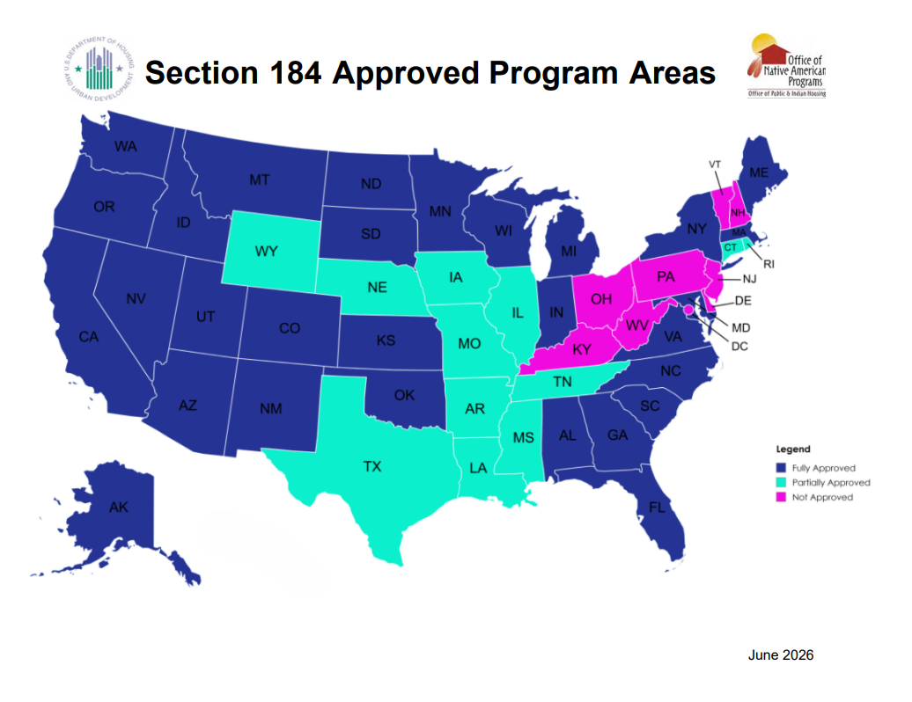
Notes:
The Section 184 program is authorized under the Housing and Community Development Act of 1992 (Act), as amended, under the program, HUD guarantees loans made to Indian families, Indian Tribes, and TDHEs within approved program areas.
April 13, 2023, OLG released Dear Lender Letter 2023-02 that states:
Tribes may request an expansion of their Section 184 Approved Program Area on a county-by-county basis. To request HUD’s approval of the expansion, Tribes must submit a statement providing the reason for the request, the name of the county or a list of the counties the Tribe would like to include in their Section 184 Approved Program Area and a certification as to the presence of enrolled Tribal members in the county or counties. The certification must include a statement that the Tribe has enrolled Tribal members residing in the county or counties listed. The certification must be signed and dated by an authorized Tribal official.
3. We are proud to announce that on June 15, 2026 HUD Expanded Section 184 Indian Home Loan Guarantee Program to 356 counties and cities across six states – Expansion Makes Entire States of Alabama, Georgia, Maryland, New York, and Virginia Eligible for Program During National Homeownership Month.
4. Up until a few years ago Texas only had 3 approved counties. As of today, they are up to 16 counties because of tribes requesting and demonstrating a need in other areas of Texas.
5. How can you help the Section 184 program expand? When you are speaking to tribes you can help them by letting them know there are options to expand their areas for their members. It does not need to be located in their operating area. Our Tribal Relations Department that can assist them with this.
ERIC
DANA IS NEXT – TRIVIA QUESTION

Slide 12
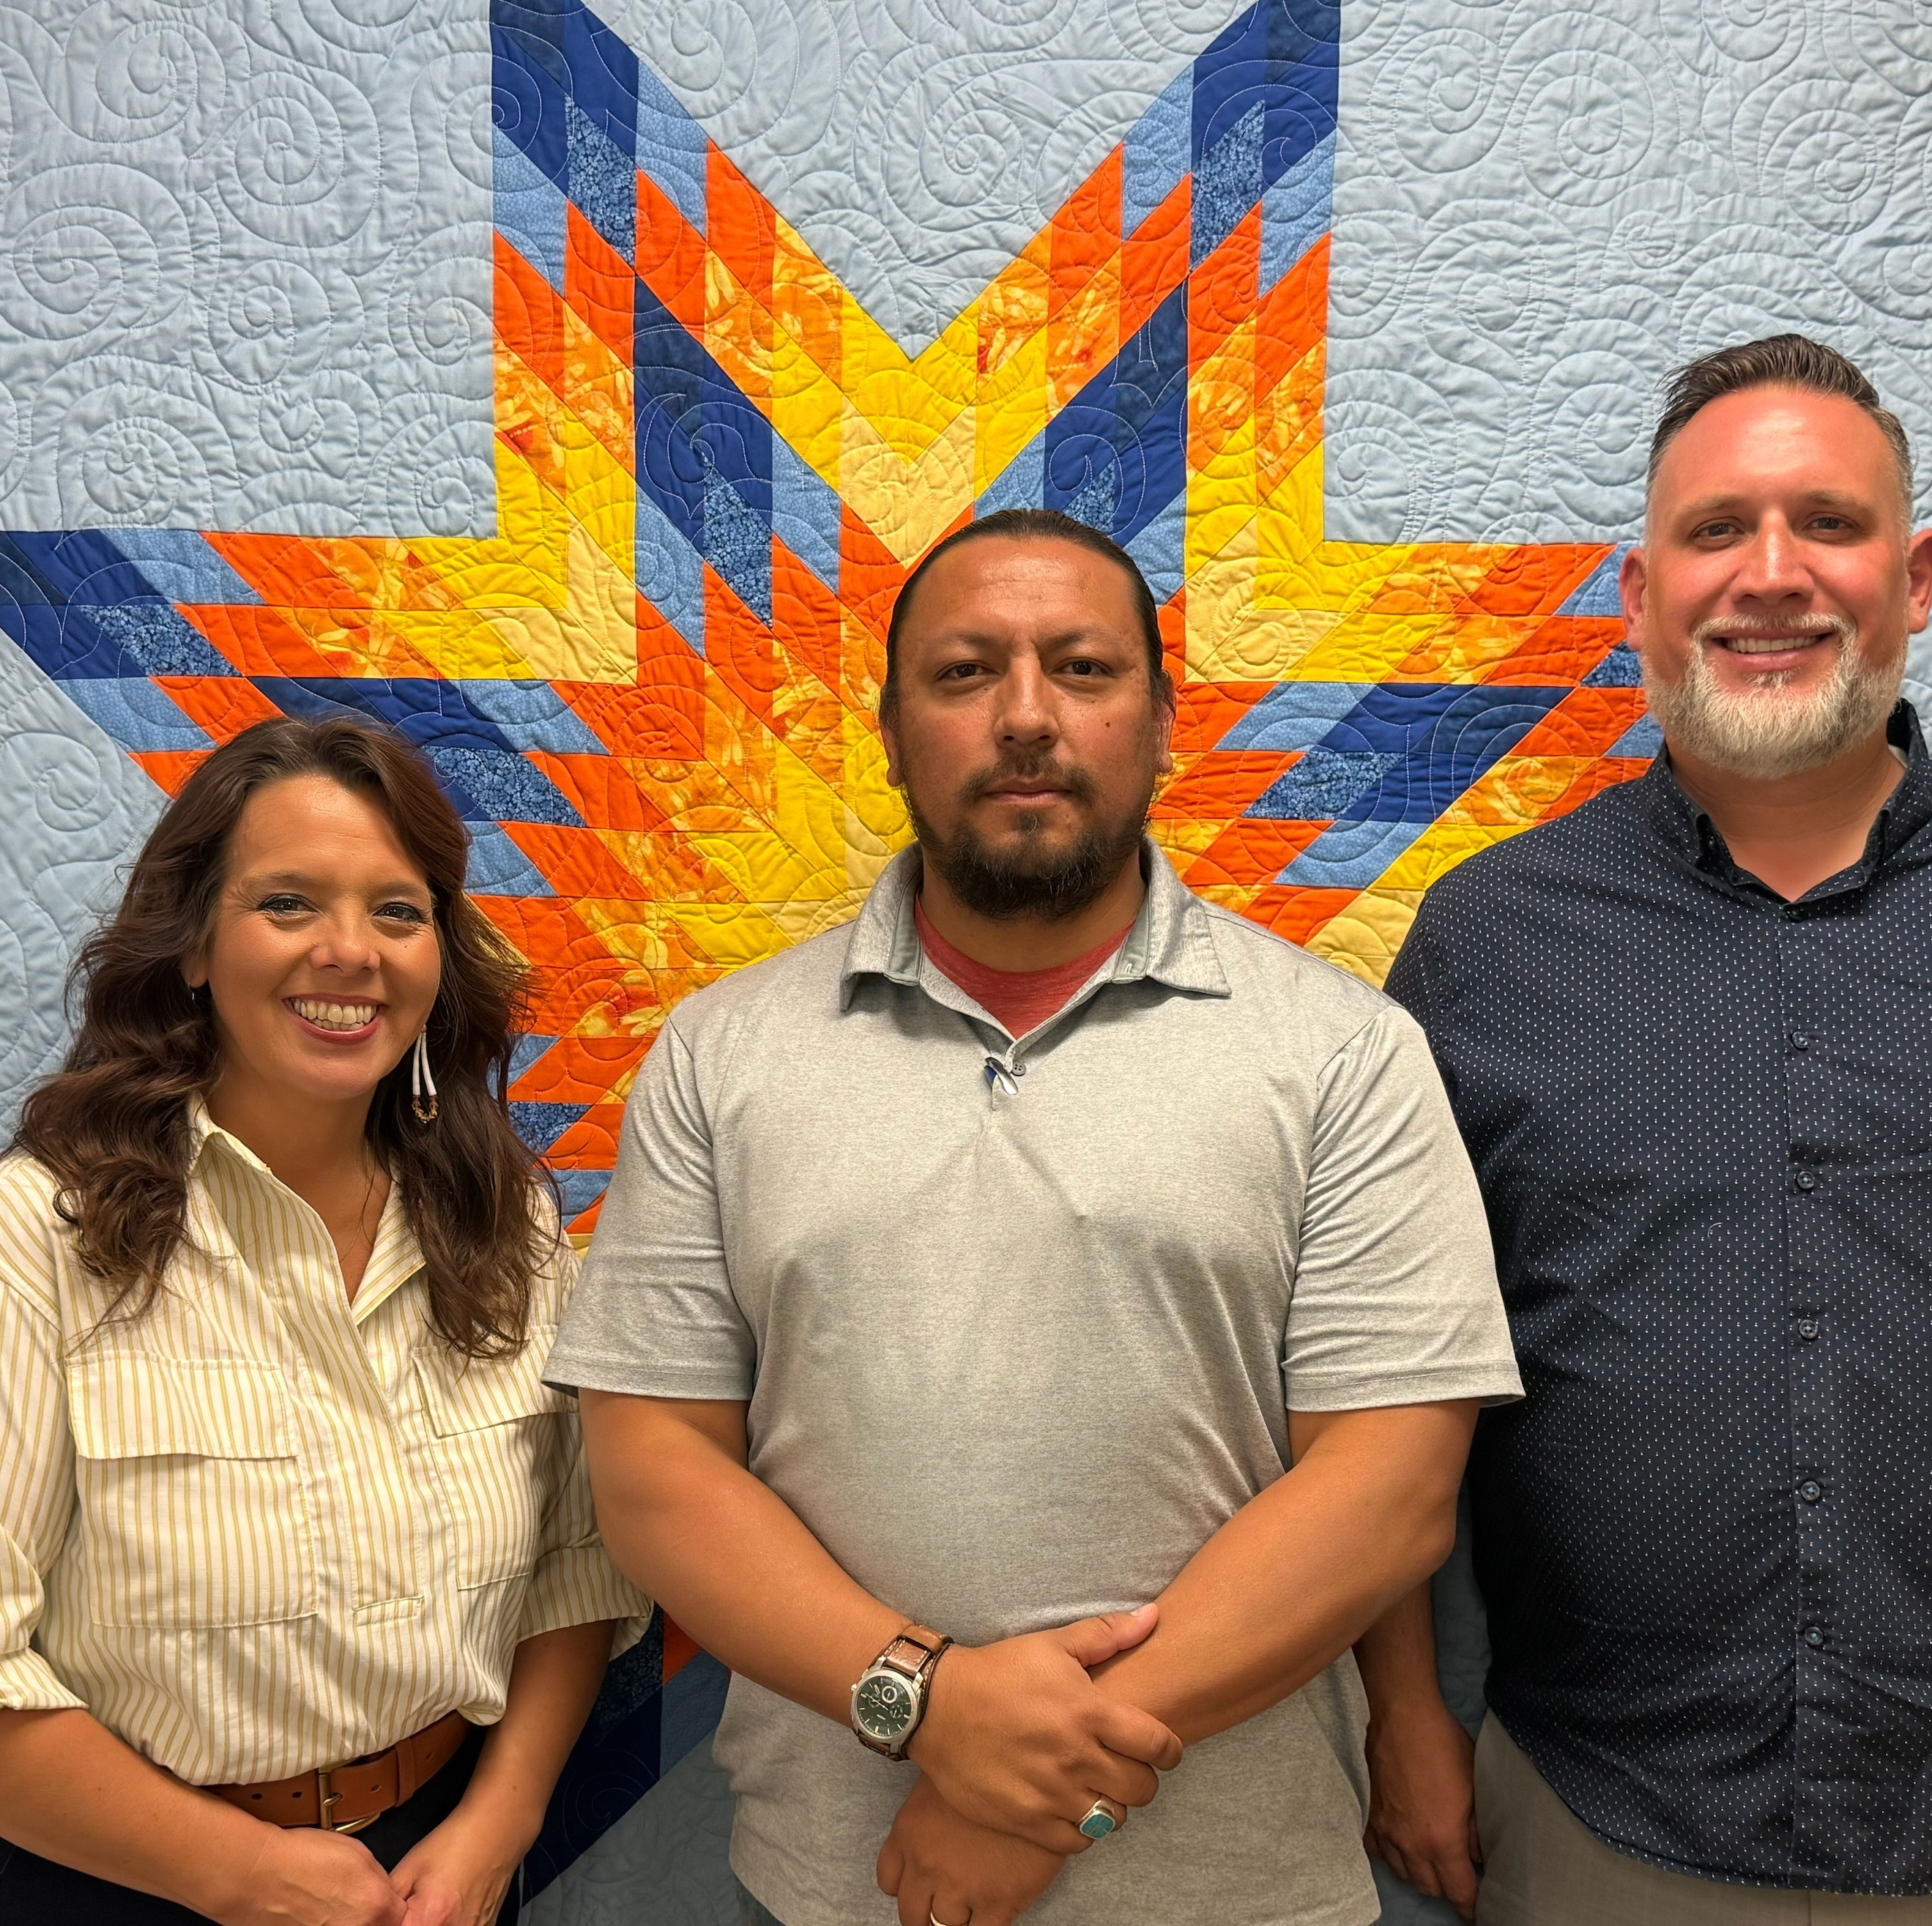
Tribal Relations with OLG
Consulting with Tribes on their unique homeownership and housing development goals
Reviewing Tribal mortgage, foreclosure, land use, planning and leasing code and policies
Approving Tribes to lend with Section 184
Assisting the Property Preservation Team with Note Sales to the Tribe
Notes:
OLG has developed a strong Tribal Relations team, whose primary objective is to establish and maintain an excellent working relationship with each Tribe. What that entails is respectful, open communication with all members and staff including the Chairperson, the Housing Directors, the land management staff, etc. We want to build that rapport and keep it in good standing so that that in the event issues arise, we have that solid relationship to resolve.
Within that relationship, we want to work with the Tribes to find their areas of need. Where are they deficient in terms of housing. What are their plans as they continue to develop. Do they have recent housing assessments?
We have over 235 tribes that are approved for program participation and are right at the goal line with another handful. Last year around this time, we reached out to every non-participating tribe to gauge interest.
As part of the Tribal approval process, we will review any tribal documents and ordinances that pertain to mortgages, leasing, foreclosure and evictions. The goal of these reviews is to always protect HUD in cases of default ensuring that we remain with the lease after those difficult processes.
Another duty that we take on is the negotiation of the Note Sales to the Tribe. In that process, when it comes to tribal trust properties, we will reach out to the Tribe to negotiate the sale of the note sale (debt) to the Tribe or TDHE. If not deal can be resolved, we’ll refer to DOJ for foreclosure
ERIC

Slide 13
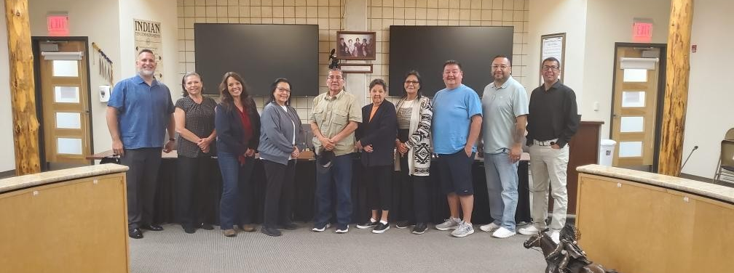
HUD & Tribal Partnerships
Tribes must assist HUD (when practical):
  Notification of Borrower’s default is received
  Notice of Tribal right of first refusal is received
  Properties are determined vacant or abandoned
  Tribal POC changes
  Any post approval, proposed changes relating to loan
  Upon conveyance to HUD, the tribe shall help in locating a buyer
Notes:
We always stress the importance of partnership when we work with the Tribes and lenders. Each, including OLG, plays a vital role in this process and for any of us to be successful, we all need to work together.
When a borrower’s loan goes into default, the lender will send the tribe a First Right of Refusal giving them the option to resolve.
Usually the Tribes will decline, which then the lender will assign the Note back to HUD and HUD will pay the lender in accordance with established policy
At that time, we’ll again reach out to the Tribe/TDHE again and see if we can negotiate a sale of the Note (as we mentioned earlier).
Our goal is to avoid a lengthy and expensive foreclosure and get the home back into the hands of another tribal member.
Again, responsiveness and partnership is critical. If no deal can be made we’ll refer the debt to the DOJ after the foreclosure has been completed, we’ll come back to the Tribe to see if they would like to purchase or to assist in finding a potential buyer (no one know their people better than the Tribes.)
We’re dependent on the Tribes to keep us up to date with current POC’s, although we have a plan in place to begin annual recertifications that we’d send to the tribe asking for current POC’s/staff, document changes, etc.

Slide 14



OLG Lender Relations
Growing Businesses. Reducing Risks. Expanding Homeownership
Flexible Lender Options
  Direct Guarantee Lender
  Non-Direct Guarantee Lender
  Servicer
Attractive Program Features
  Federal Loan Guarantee
  Opportunity to reach an Underserved Market
  Flexible Underwriting, low down payment options, and competitive rates
Dedicated Program Support
  Training and Technical Assistance
  Dedicated Staff for program guidance
  Support navigating secondary market options
Notes:
OLG has developed a new Lender Relations team focused specifically on servicing the lenders who serve tribes and tribal borrowers
We understand that not all lending intuitions are alike and has therefore created multiple options to participate in OLG programs based on their needs.
4. The participation types include:
5. Direct Guarantee Lender – This is the FULL PARTICIPATION option where lenders may originate, underwrite, service, purchase, hold or sell Section 184 Guaranteed Loans.
6. Non-Direct Guarantee Lender – This participation option is for lenders that only want to originate loans and must be sponsored by a DG Lender to participate
7. Servicers – Can include DG, Non-DG, or lenders with an approval from FHA or another agency of the Federal Government to service the agency’s insured loans
OLG programs help lenders reach qualified borrowers in Tribal communities and other eligible areas
that are often underserved by traditional mortgage financing….
AND Develop lasting relationships with Tribes, Tribal housing authorities, Native Community Development Financial Institutions (Native CDFIs),
real estate professionals, and local housing organizations.
We believe in supporting wholistic housing ecosystems that support strong housing development and homeownership and ultimately
build resilient Tribal economies grounded in housing stabilities. Our lenders are critical partners in this work!
14. OLG has dedicated staff to assist with all kinds of program areas.
15. Our dedicated staff is broken up into teams are all available for training and technical assistance, underwriting assistance, and navigating complex secondary markets.
16. Office of Loan Guarantee has a new team, The OLG Development Team. Jeff will tell you all about this
MEGAN
NEXT UP IS JEFF

Slide 15

We’re celebrating 30 years of NAHASDA!
Thriving National Economy
Strong Private Housing Market
Development of Strong Private Housing Finance Mechanisms
Economic Self Sufficiency
Economic Self Determination
Notes:
AT OLG, many of us are underwriters by trade, which means we look at the underlying principles and guidelines of things
We often reflect on the underlying principles of NAHASDA and the goals that originally shaped the legislation that governs the majority of Tribal housing today.
These are listed here and they include thriving economies, strong private housing markets,
the development of strong private housing finance mechanisms, and economic self-sufficiency and self-determination
Basically – NAHASDA never intended for Tribes to be fully grant dependent and for the annual Indian Housing Plan to utilize grants alone. It was always intended that Tribes would leverage grants and loans to maximize impact to achieve the goals and outcomes we see here
Today, we hope to share ways our offices can work together to serve Tribes and TDHEs to build more homes, increase homeownership and better honor the guiding principles of NAHASDA
Let’s look at some of the impact we’ve had so far!
Latoya, will you please tell the audience more about combining forces
CHRIS
LATOYA IS NEXT

Slide 16
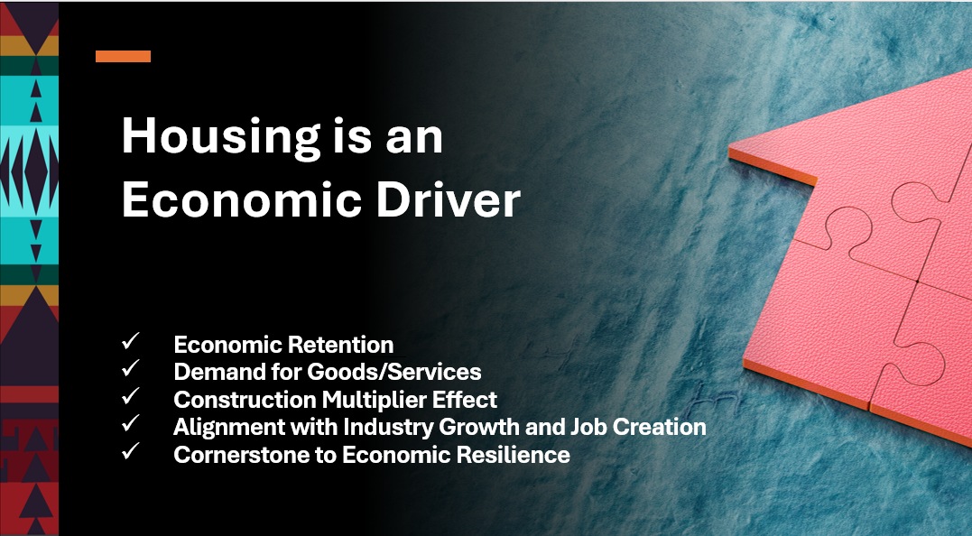
Notes:
Housing is so much more than a social construct. It is an economic driver.
A home is where our children dream of who they will become.
It is the very basis of health and security and education and upward mobility and prosperity.
Housing is the very cornerstone to economic resilience.
Economic drive and durability is empowered when housing goals are aligned and move in lock-step with a Tribe’s economic development goals.
Conversely, when a wholistic economic vision fails to include robust housing and homeownership plans, the execution of that economic vision is stunted.
Housing is just the beginning of the conversation. We are working to build whole ecosystems that support strong construction, development, lending, homeownership and wealth creation.
OLG stands at the ready to partner with our Lenders, with our Grants division, and with other agencies and federal programs as together we support Tribes to achieve the whole and thriving economies they are working for and to deliver real outcomes with generational impact.
CHRIS

Slide 17
Office of Loan Guarantee
Construction Programs for Tribal Entities
Section 184
No income Cap for 1-4 Unit Residential
Tribes Can Develop Up to 20 At a Time
Can be used for rental or homeownership
Skilled Workers Program
For Construction of 1-4 Unit Workforce Housing Rental Units
Can be used for Tribal and Non-Tribal workers
Built on Tribal and Fee Simple Land
Can be converted to homeownership
Title VI
Leveraging of IHBG funds provides a flexible options to finance affordable housing development
Excellent “first in” finance product in a diverse capital stack
Notes:
OK! Hold on to your seats! — this section is really about strengthening the work we're already doing together.
2. The OLG Development Team was established in FY2026 with one clear mission: to expand construction and rehabilitation on trust land and other Tribal owned land, and opening more doors to affordable, sustainable housing for Tribes and TDHEs nationwide.
3. But we can't do this alone — our success depends not only on strategy, but on strong partnerships. Every ONAP team member plays an instrumental role in turning this vision into reality, driving meaningful outcomes, and creating lasting opportunities for the communities we serve.
4. Today, we want you to see OLG as your partner — a resource ready to stand alongside you. Over the next few slides, we'll walk through Title VI, Section 184, and the Skilled Workers Program, and show you how, together, we can turn opportunity into real homes on the ground.
JEFF

Slide 18

Skilled Workers Program
WHAT IS IT?
Congress created the program to help Tribes and TDHEs construct rental housing for law enforcement, healthcare, education, technical, and other skilled workers (“Skilled Workers”)
PURPOSE
Helps Tribes recruit and retain employees
Fosters economic retention through housing stability
Aligns Tribal housing, business, and economic development strategies
BENEFITS
Low cost to the Tribe/TDHE (only $1 upfront fee and no annual fee)
Opportunity to convert to Assumable Home Mortgages
No income caps, allowing Tribes to serve the “missing middle” and higher income brackets
WHO IS ELIGIBLE FOR THE LOAN?
Federally Recognized Tribes
Tribally Designated Housing Entities
Individual Tribal citizens are not eligible
Notes:
ERIC
One of the biggest concerns/issues in Indian Country is the lack of housing for Skilled Workers. Housing that would keep skilled employees in the area- professionals like doctors, nurses, teachers, police officers, tribal administration staff, casino staff. The need was there, so Congress created the Skilled Worker Program to help Tribes construct rental housing for skilled workers serving the Tribe.
The idea is simple- the program allows the Tribes to better recruit and retain a strong local workforce, as well is invites tribal members who have left the community to earn an advanced degree, to come home and serve the community without fear of being over-income and without housing availability.
Unlike NAHASDA resources, this program holds no income caps, making it a viable solution for increasing housing stock, serving the “missing middle” and becoming a bridge to homeownership.
This is powerful because it can effectively turn economic leakage into economic retention and resilience.
Employees need a place to live and renters and homeowners need a place to work – the Skilled Workers Program encourages a perfect alignment of Tribal housing, business and economic development strategies for increased self-sufficiency, stability and growth.
The cost is low, with the upfront fee currently decreased to just $1
Over time, after the 10-year deed restriction (which says the housing will be used specifically for skilled workers), the loans may be assumed by a Tribal member for homeownership, or they may be kept as rental stock in perpetuity.

Slide 19

WHAT CAN A SECTION 184 SKILLED WORKERS
LOAN BE USED FOR?
1
New Construction of 1-4 Unit Family Rental Housing
Single-family units - scattered site or subdivision
Duplexes, triplexes or quadplexes
Current Section 184 loan limits and approved areas apply
No acquisition or rehabilitation
For the sole purpose of housing Skilled Workers
For example: Law Enforcement/Public Safety, Healthcare/First Responders, Educational/Social Services, Technical Workers
The Tribe determines their own definition of “Skilled Workers”
The property can be on or off reservation
2
3
Notes:
ERIC
New housing units built may be single family units in scattered sites or subdivisions, they may also be duplexes, tri-plexes and quad plexes
When the plan is to keep the housing stock as rentals, the proforma for the multi-plexes works out nicely because so many cost and time efficiencies are gained in using one foundation, one roof and one connection of water and electrical for multiple units
The Tribe, in its sovereignty, creates its own definition of what a skilled worker means – this is because each tribal community is economically distinct and the Tribe knows its needs best.
New units may be built on fee simple or Tribal lands – whatever is best for the Tribe
****SLIDE AND SCRIPTING TAKEN FROM NCAI MIDYEAR 2026 PPT (Eric you can delete this. I just put the resource-dana)
NEXT UP IS DANA WITH THE FINAL TRIVIA QUESTION

Slide 20
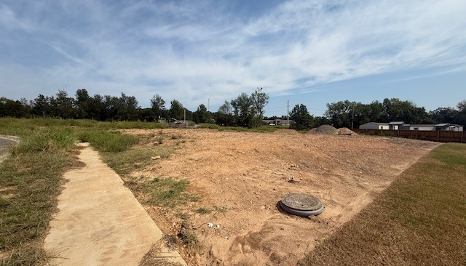
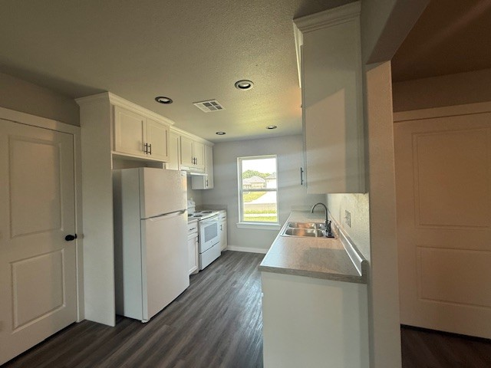
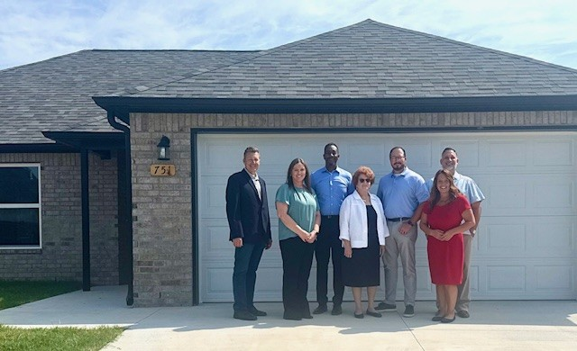
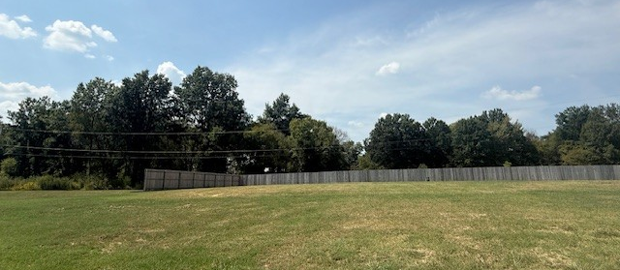
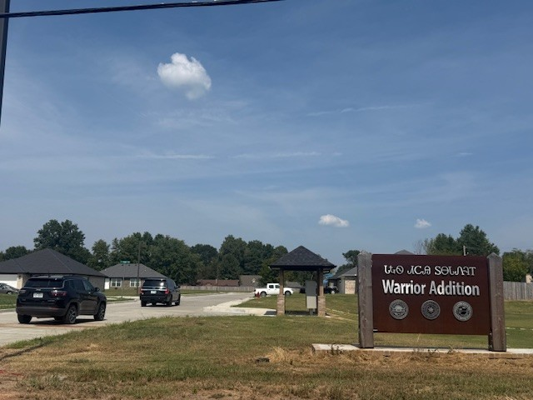
Five single family homes
Eventual homeownership
Homes for Police Officers as
Skilled Workers
Safety, Security and Peace for Cherokee Citizens
Four community subdivisions
Notes:
How to use it with the audience:
Read it aloud and ask:
“Would you accept this LOE/X as-is? Why or why not?”
“What’s missing? What questions does this raise for you?”
Follow-up prompts:
“Does this explain what caused the late payments?”
“Is there a timeline?”
“Is there documentation to support any claims?”
“Does it show that the issue is resolved and unlikely to recur?”
Debrief point:
This LOE/X is vague, lacks detail, and doesn’t give the underwriter a reason to move forward confidently.

Slide 21


HOW CAN I PARTICIPATE IN THE SECTION 184 SKILLED
WORKERS PROGRAM?
The Tribe or TDHE should email a letter of interest to: TribalRequests@HUD.gov
What to include in the email:
  In the subject line, put “Section 184 Skilled Workers/Letter of Interest
  Include information about your project and goals – skilled worker housing needs
  Contact Information
Once HUD receives your email, a Section 184 Tribal Relations Specialist will reach out to you to schedule the next steps and discuss which documents are required

Slide 22
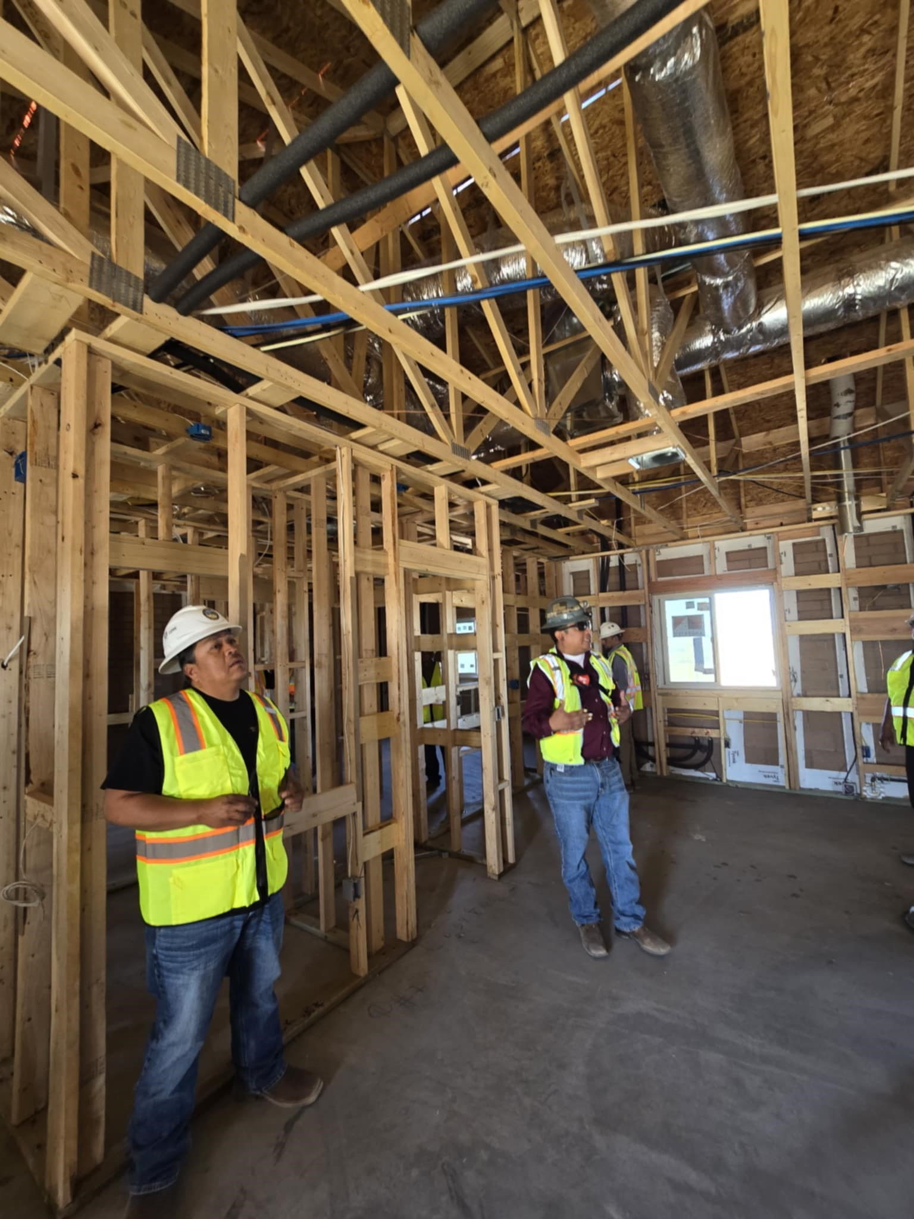
Title VI allows IHBG recipients to leverage their annual IHBG funds to finance affordable housing activities by pledging a portion of their current and future grant funds to HUD as security for the Title VI guarantee.
A private lender provides the financing, and HUD provides a 95% guarantee as collateral to the lender.
Accelerates Housing Development. Eligible for 5x’s the needs-based portion of IHBG formula funds
Notes:
Large projects must be approached with care. Unless the TDHE can show they have the resources for a larger number of simultaneous loans, keep phases manageable and demonstrate project completion before requesting more funding.

Slide 23
HUD Title VI Loan Guarantee Program — Tribal Financial Calculator
Enter your tribe's numbers in the BLUE cells to calculate borrowing power, repayment schedules, and leveraging impact.
The Title VI program allows eligible Tribes to borrow from a private lender using their IHBG as collateral — with HUD providing a 95% guarantee — up to 5× the Needs Portion of their annual allocation.
SECTION 1 — YOUR TITLE VI BORROWING POWER
Enter Annual IHBG Needs Portion ($): |  |  | $1,000,000 | ← Enter your IHBG Needs Portion here (find on your IHBG Formula Allocation notice)
Your IHBG Needs Portion |  | Leverage Multiplier (Max) |  | Maximum Title VI Loan Amount |  |  | HUD Loan Guarantee
$1,000,000 |  | 5× |  | $5,000,000 |  |  | 95%
SECTION 2 — LOAN REPAYMENT SCHEDULE (based on Maximum Loan Amount)
Enter Annual Interest Rate 1 (%): |  | 5.00% | Enter Annual Interest Rate 2 (%): |  | 6.50% | Enter Annual Interest Rate 3 (%): |  | 8.00%
Loan Term | Rate 1 |  |  | Rate 2 |  |  | Rate 3
 | Monthly Payment | Annual Payment | % of Needs Portion | Monthly Payment | Annual Payment | % of Needs Portion | Monthly Payment | Annual Payment | % of Needs Portion
5-Year Term | $94,356 | $1,132,274 | 113.2% | $97,831 | $1,173,969 | 117.4% | $101,382 | $1,216,584 | 121.7%
10-Year Term | $53,033 | $636,393 | 63.6% | $56,774 | $681,288 | 68.1% | $60,664 | $727,966 | 72.8%
15-Year Term | $39,540 | $474,476 | 47.4% | $43,555 | $522,664 | 52.3% | $47,783 | $573,391 | 57.3%
20-Year Term | $32,998 | $395,973 | 39.6% | $37,279 | $447,344 | 44.7% | $41,822 | $501,864 | 50.2%
SECTION 3 — THE POWER OF LEVERAGING: Tribe A vs. Tribe B
Enter Average Cost Per Unit ($): |  |  | $300,000 | ← Enter estimated construction cost per housing unit
Comparison |  |  |  |  | Tribe A — No Leveraging |  | Tribe B — Title VI (5× Leverage)
Annual IHBG Needs Portion |  |  |  |  | $1,000,000 |  | $1,000,000
Funds Available for Development |  |  |  |  | $1,000,000 |  | $5,000,000
Average Cost Per Unit |  |  |  |  | $300,000 |  | $300,000
Number of Units That Can Be Developed |  |  |  |  | 3 units |  | 16 units
Additional Homes Made Possible by Title VI |  |  |  |  | +13 additional homes made possible with Title VI leveraging
* Repayment figures assume the full maximum Title VI loan amount at the stated annual interest rate, compounded monthly. Actual loan terms will vary. This calculator is for illustrative purposes only. Contact HUD for official program guidance.
To Learn More: Contact the Office of Loan Guarantee at (202) 402-2355 | Email: TitleVI@hud.gov | hud.gov/codetalk
Notes:
To help bring these numbers to life, our Development Team built this financial calculator — a tool you can use side-by-side with Tribes and housing authorities during your own presentations and planning conversations.
2. Instead of talking in the abstract, you can enter a Tribe's actual IHBG Needs Portion and watch it transform in real time — how much borrowing power that unlocks, what repayment could
look like across different terms and rates, and just how many additional homes Title VI leveraging could make possible.
3. This is meant to be a conversation starter you can bring into the room. When a Tribe sees their own numbers turn into new homes right in front of them, that's when the partnership really
starts to click — and that's a moment we want to help you create.
JEFF

Slide 24
What Can Title VI
Funds Be Used For?
Create new housing
Rehabilitate housing
Build infrastructure
Construct community facilities
Acquire land to be used for housing
Prepare architectural & engineering plans
Fund financing costs
Notes:
Title VI Funds can only be used for NAHASDA Eligible Activities.
Eligible housing activities as defined in Sec 202 of NAHASDA – To develop, operate, maintain, or support affordable housing for rental or homeownership, or to provide housing services with respect to affordable housing through various housing activities such as Indian Housing Assistance, Housing Services, Crime Prevention and Safety Activities, etc….
Basically to be NAHASDA eligible, the activity must be for affordable housing or affordable housing related. But don’t worry, Your ONAP Team will confirm that your project is eligible very early in the process.

Slide 25
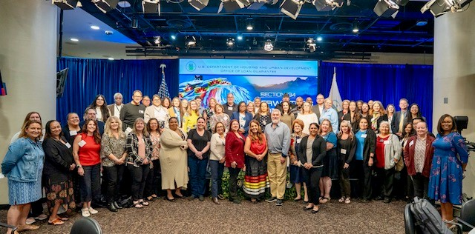
Notes:
In 2026 we plan to publish updated program guidance in the form of a 9-chapter Section 184 Handbook as well also offer a 2nd annual lenders bootcamp, inviting lenders of all types to better understand, engage with and deploy the program within their respective market areas.
This is a picture of our 1st annual Section 184 Lender Bootcamp last year with over 80 lenders that serve you as Tribes and your citizens to better deploy the program.

Slide 26
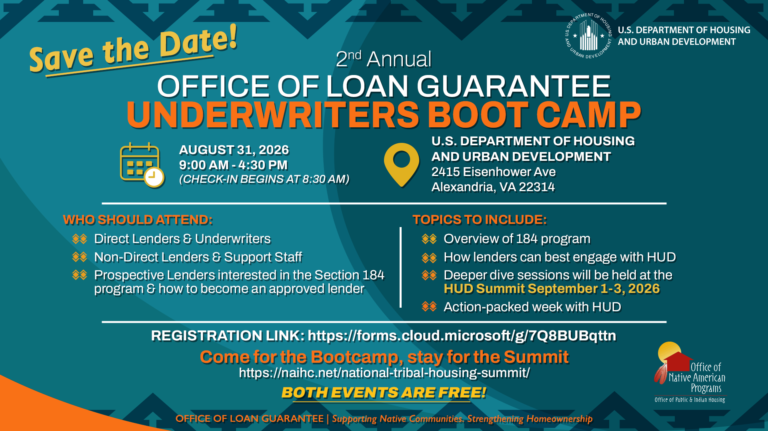
Notes:
Something great is on the horizon! Our upcoming training is about to raise the bar!
Last year we had more than 80 lenders in attendance and this year the word is out and we are ready to accommodate a larger crowd at our 2nd Annual OLG Underwriters Bootcamp
Here's the great news — if you or someone you know is planning to attend the HUD Summit, plan to arrive a day early and spend August 31st with us, absolutely free of charge!
Lenders can come on Monday, and then stay the rest of the week for the Summit networking with partners and learning even more about Indian housing
BRENNEN
NEXT UP IS DANA

Slide 27


Slide 28
Office of Loan Guarantee Contacts
General Inquiries, Borrowers and Lender questions:
Section184@hud.gov
OLG Development Team (Skilled Worker, 184, Title VI) TitleVI@hud.gov
Jeffery Glass (202) 402-2355
Patricia Foster (202) 402-3406
Tribal Relations TribalRequests@hud.gov
Eric Blumhardt (714) 955-0854
Bradley Erwin (202) 402-8240
Lender Relations 184lenderapproval@hud.gov
Leadership
Tonya Plummer, Director, Office of Loan Guarantee tonya.r.plummer@hud.gov
Matthew Dixon-Moran, OLG Deputy Director Matthew.J.Dixon-Moran@hud.gov
Andrew Lee, OLG Sr. Policy Advisor Chung-Yiu.Lee@hud.gov
Notes:
We want to be easily accessible to you. You can send all OLG related needs to section184@hud.gov and our staff will route it to the correct department within.
The Development team can be reached at TitleVI@hud.gov
The Tribal Relations team can be reached at TribalREquests@hud.gov
The Lender Relations team can be reached at 184lenderapproval @hud.gov
And myself and my leadership team contact information is here as well.
BRENNEN
NEXT UP is MEGAN

Slide 29

Thank You
OLG Info Messages: OLG INFO Messages: Office of Loan Guarantee News | HUD.gov / U.S. Department of Housing and Urban Development (HUD)

