Slide 1
Great Lakes Indian Housing Association – July 2026
Presented by: Dana Rauschnot, Minnesota Single Family Housing Program Director

Slide 2
USDA Rural Development’s Mission

Slide 3
Rural Development
Rural Business-Cooperative Service
Rural Housing Service
Rural Utilities Service

Slide 4
Rural Development Housing Programs
Site Loan Program
Native CDFI Relending Demonstration Program
Guaranteed Single Family Housing Program
Direct Single Family Housing Program
Section 504 Home Improvement Loan and Grant Program
Housing Preservation Grant Program

Slide 5
Site Loan Program
Provide financing for the purchase and development of housing sites for low- and moderate-income families.
Below market interest rate; fixed at closing.
Federally recognized tribes or public- or private-nonprofits are eligible to apply.
Environmental review and appraisals are required.

Slide 6
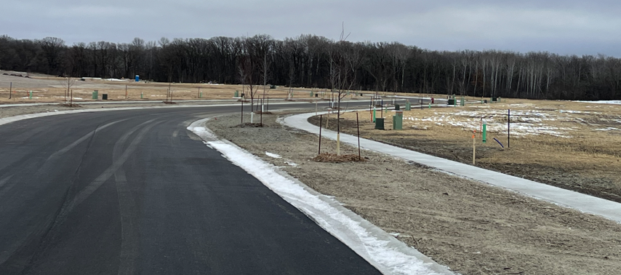
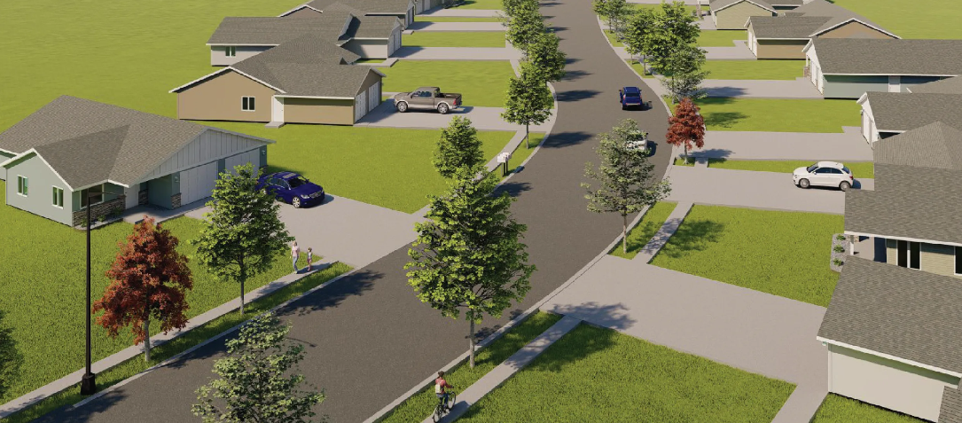
Site Loan Program – Real Life Case
15 acres in central Minnesota.
The site was already owned by the applicant.
Developed into 42 lots with road, sidewalk, utilities (sewer, water, storm).
Appraisal was completed on the as is status prior to closing and as completed per lot.
An Environmental Review was required; applicant hired a consultant.

Slide 7
Native CDFI Relending Demonstration Program
Purpose
  To improve homeownership opportunities for Native American Tribes, Alaska Native Communities, and Native Hawaiian communities in rural areas.
  Provide mortgage capital to Native CDFIs.
  Funds must be used to provide direct loans to ultimate recipients to buy, build, rehabilitate, improve, or relocate a primary residence on eligible land. The borrower must use the dwelling as their permanent residence.
Terms
  The minimum loan request for the participating Native CDFI is $500,000.
  Individual loans have terms of 33 years at 1 percent, fixed interest.
  Deferred principal and interest payments for the first three years of the loan.
  Relending Demonstration loan funds must be provided to individual loan recipients within three years of the loan closing date.

Slide 8
Native CDFI Relending Demonstration Program(Cont’d)
Who is eligible to apply?:
Entities certified as Native CDFIs by the U.S Treasury Secretary
How do I apply?
A Notice of Funding Opportunity (NOFO) was published in the Federal Register on June 18, 2026 to announce the funding availability and the application requirements. Applications are due August 14, 2026.

Slide 9
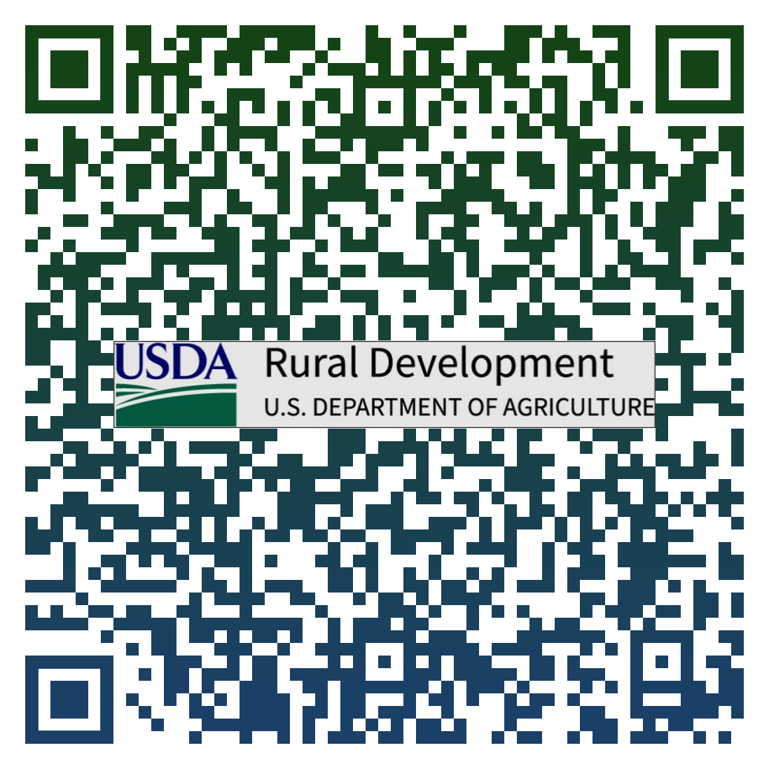
Single Family Housing Guaranteed Program
Guaranteed Program
Purpose: Assists low- and moderate-income applicants obtain decent, safe and sanitary housing in eligible rural areas.
Provides a 90% loan note guarantee to approved lenders.
Moderate Income: 115% of County AMI.
Interested applicants apply through USDA Rural Development’s approved lenders.
No maximum purchase price. Loans based on applicant repayment ability and appraised value.
No downpayment requirement.

Slide 10
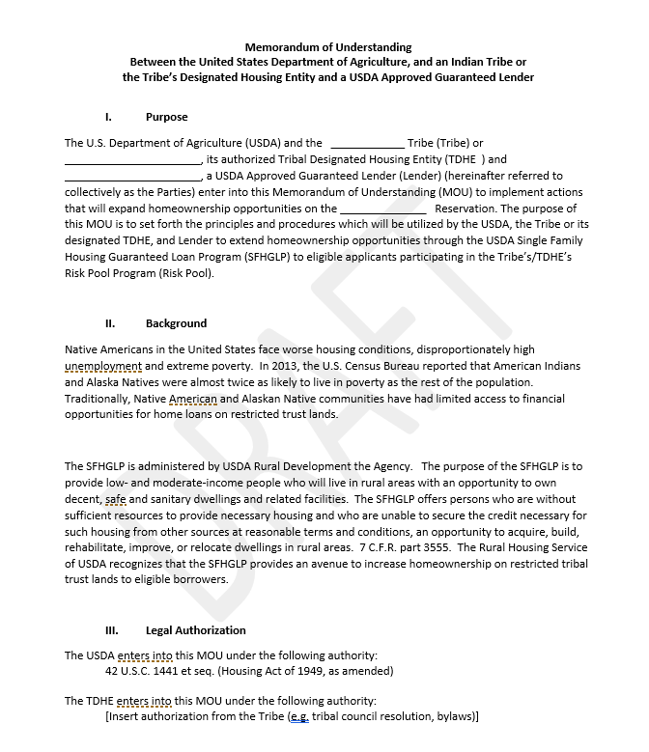

Single Family Housing Guaranteed Loan Program
Memorandum of Understanding (MOU)
First one signed with 1st Tribal Lending. Opens origination and secondary market purchasing through broker relationships.
Offers specified accommodations to the lender regarding default and foreclosure processing.
Not a standardized form – this is open to alterations.

Slide 11
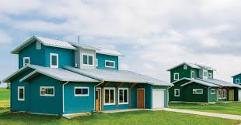
Single Family Housing Guaranteed Loan Program
Pilot Programs for Native Americans
Appraisals – making accommodations for the lack of availability of appraisers with knowledge and experience of trust land property
Repair/Rehab – allows for properties on federally recognized reservations currently owned without liens to utilize the rehabilitation and repair program

Slide 12
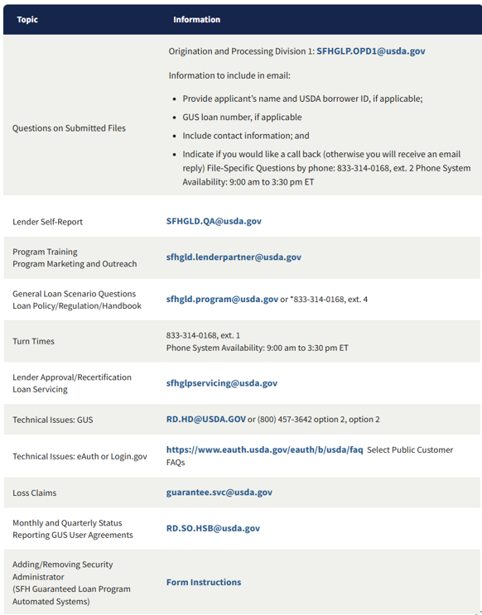
Single Family Housing Guaranteed Loan Program SFH Guaranteed Contacts
For training, marketing, or further information
surrounding our Native American efforts,
please contact the LPA team at:
sfhgld.lenderpartner@usda.gov

Slide 13
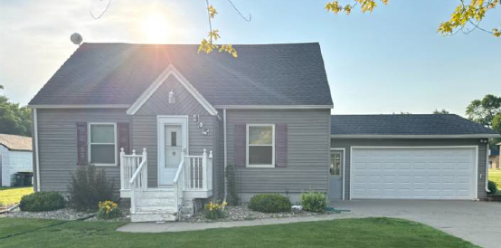
Single Family Housing Direct Home Loan Program
Purpose: Assists low- and very-low-income applicants obtain decent, safe and sanitary housing in eligible rural areas by providing and affordable loan product with payment assistance to increase an applicant’s repayment ability.
Loan Term: 33-year term and the interest rate as of July 2026 is 5.25%.
Low Income: 80% of County AMI.
Max Loan Amount: $324,700 in rural MN

Slide 14
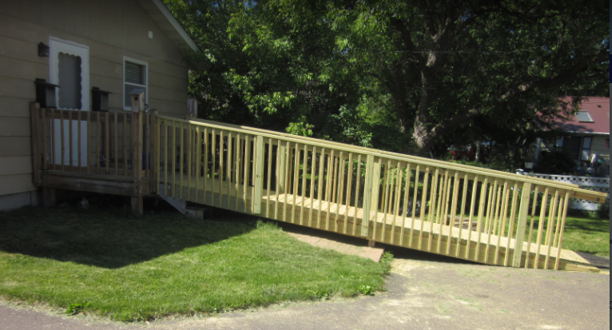
Single Family Housing Repair Loans and Grants
Purpose: Assists very-low-income applicants obtain funding to repair improve or modernize their homes.
Loan Term: 20-years
Interest rate: 1.0%.
Very Low Income: 50% of County AMI.
Max Loan Amount: $40,000
Max Grant Amount: $10,000
  Must be over 62
  Improvement need to be for health/safety or accessibility purposes.
  Once in a lifetime grant award.
Security: Promissory Note, Mortgage and/or Grant Agreement

Slide 15
Housing Preservation Grant Program
Provides grants to sponsoring organizations for the repair or rehab of housing owned and occupied by low- and very-low-income rural citizens.
Federally recognized tribes, nonprofits, and state and local governmental entities are eligible to apply.
Funds may be used to repair owner occupied housing or rental property owners may receive assistance for repairs if units stay available to low- and very-low-income families.

Slide 16
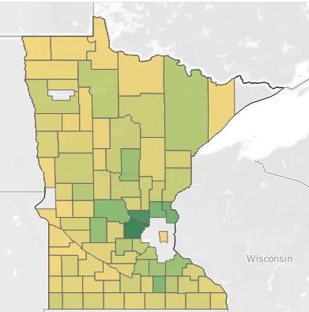
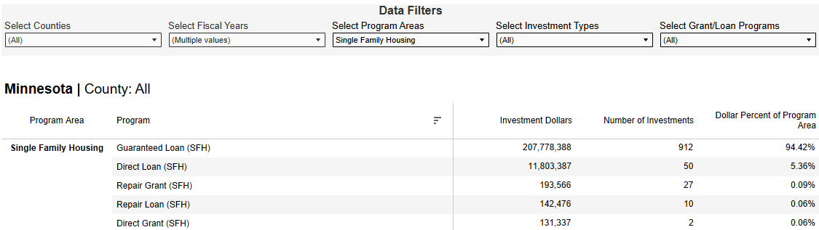
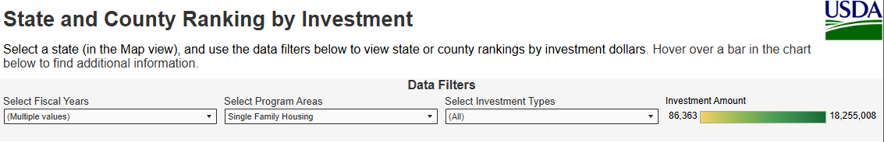
By the Numbers – Rural Investments
https://www.rd.usda.gov/rural-data-gateway/rural-investments/by-county
Notes:
The data shows FY 2025 and 2026.

Slide 17
Contact Information
Assistance under USDA Rural Development programs is available to applicants in areas designated as “rural.” Under law, the definition of “rural area” is different for each program.
Contact your local USDAHousingMN@usda.gov for more information.
Or go to: www.rd.usda.gov/mn or
https://www.rd.usda.gov/programs-services/single-family-housing-programs
Dana Rauschnot – SFH Program Director
dana.rauschnot@usda.gov
763-290-5863
USDA is an equal opportunity provider, employer, and lender.

Slide 18

End
USDA is an equal opportunity provider, employer, and lender.

